Slide 1

Module 4:
Engagement & Intervention of
Co-Occurring Substance Use,
Mental Disorders & Trauma
Child Welfare Training Toolkit
Notes:
Facilitator Script:
Hello and welcome! Thank you for creating time in your schedule for today’s training discussion. The next three hours were carefully designed to be a robust learning experience. Your active participation in the various adult learning exercises is encouraged, leading to a more in-depth understanding about engagement and intervention of co-occurring substance use, mental disorders, and trauma.

Slide 2




Acknowledgement
This content is supported by contract number 75S20422C00001 from the Children’s Bureau (CB), Administration for Children and Families (ACF), co-funded by the Substance Abuse and Mental Health Services Administration (SAMHSA). The views, opinions, and content of this presentation are those of the presenters and do not necessarily reflect the views, opinions, or policies of ACF, SAMHSA or the U.S. Department of Health and Human Services (HHS).
Notes:
Facilitator Script:
Before we begin, I’d like to acknowledge that this training module was developed by the National Center on Substance Abuse and Child Welfare an initiative of the U.S. Department of Health and Human Services and is co-funded by the Children’s Bureau, Administration for Children and Families, and the Substance Abuse and Mental Health Services Administration.​​

Slide 3
Learning Objectives
After completing this training,
child welfare workers will:
Identify the core values and key characteristics of family engagement
Differentiate between peers and recovery specialists with knowledge of the benefits to integrating peer recovery support services into child welfare service delivery models
Understand and apply solution-focused and motivational interviewing techniques to support treatment and service engagement
Define the stages of change model with actionable steps to enhance motivation and readiness for change
Expand referral and linkage practices for enhanced treatment and service engagement and retention for children, parents, and families affected by co-occurring disorders
Notes:
Facilitator Script:
The goal of module 4 is to provide in-depth knowledge and understanding about engagement and intervention strategies for use with co-occurring substance use, mental disorders, and trauma. Child welfare workers will acquire knowledge and skills specific to core values and key characteristics of family engagement; will be able to differentiate between peers and recovery specialists and speak to the benefits of integrating peer recovery support services in child welfare service delivery models; understand and apply solution-focused and motivational interviewing techniques to support treatment and service engagement; define the stages of change model with knowledge of actionable steps to enhance parents’ motivation and readiness for change; and finally, expand referral and linkage practices for enhanced treatment and service engagement and retention for children, parents, and families affected by co-occurring disorders.

Slide 4

Family Engagement
Notes:
Facilitator Script:
Let’s start today’s training with a discussion about family engagement…

Slide 5

“People don’t care how much you know until they know how much you care.”
~ Theodore Roosevelt
Notes:
Facilitator Script:
Engaging families begins with first developing rapport or connections in a way that helps promote child safety, parental recovery, and family stability. And as we all know, successful partnerships in child welfare do not just happen; they must be nurtured and developed. How we prepare for, show up, and relate to our families sets the foundation for the child and family teaming experience. As child welfare workers, we are charged with promoting an empowerment-based approach to case planning where families are supported to become effective change agents in their daily lives long after formal child welfare involvement.
Before we jump into our discussion about effective family engagement, let’s pause and reflect on what not to do based on some of our own personal experiences.
Additional Resources:
N/A
Slide Citations:
N/A
Script Citations:
N/A
Full Citations:
N/A

Slide 6
Consumer Service
Dissatisfaction
Activity Pair Share
Notes:
Facilitator Notes:
Ask participants to turn to a neighbor and…
Pair Share Prompt:
Share about a time when they were a recipient of poor (or less than desirable) consumer service. What was it about this experience that didn’t sit well with you?
Have participants focus on descriptors such as language, tone, non-verbal behavior or mannerisms, thoughts and feelings during and after the experience, and how this may or may not have impacted the outcome of their provider/consumer relationship. Ask for volunteers to share about their experiences (and have your own personal experience to share on standby if needed) before segueing the discussion to values and beliefs.

Slide 7

Values
& Beliefs
Notes:
Facilitator Script:
Thank you all for sharing! This was the perfect segue to our next discussion about the importance of values and beliefs…

Slide 8

Core Values of
Family Engagement
Encourage Voice & Choice
Listen, Value & Respect
Affirm Experiences &
Co-Create Achievable Goals
Notes:
Facilitator Script:
Engagement serves as the foundation to building trust and developing supportive partnerships with children, parents, and families. It involves the skillful art of partnering in ways that inspire greater readiness for change—creating pathways for child safety, parental recovery, and family stability.
It begins with the belief that the best way to support families is to honor their experiences and ensure they have a voice and choice in the decisions and services that affect their family.
In doing so, we create a teaming environment that listens, values, and respects the role of families—including their perspective and capacity to contribute to the shared-decision making process.
It is through this supportive teaming practice that we affirm the experiences of families with respect to their values and beliefs while establishing the foundation of mutual trust and support for the co-creation of achievable goals.
Additional Resources:
N/A
Slide Citations:
N/A
Script Citations:
N/A
Full Citations:
N/A

Slide 9

How Our Beliefs Guide Our Work with Families
SUDs are a brain disease
and are progressive in nature
All members of the
child and family team deserve
to have a voice and choice
Parental substance use
increases risk of harm;
recovery decreases risk of harm
Every parent and family
is worthy of our best efforts
Children should remain
with their parents and siblings
whenever safely possible
People deserve second chances;
we do not give up on families
SUDs involve the whole family,
so we must serve the whole family
Recovery works; treatment works
Notes:
Facilitator Script:
Values shape the beliefs that guide our work with children and families—here are some examples of what shared beliefs may look like in your work supporting families affected by parental substance use.
Now ideally, shared beliefs are co-developed amongst teams, units, and/or community partner agencies such as SUD treatment providers, law enforcement agencies, the courts, and other family serving entities…but let’s take a moment to react to these listed here.
Prompts for Participants:
Are these beliefs agreeable to your current agency practices? Now what about your collaborative partnerships with outside agencies?
Which of these are evident in your daily practice with families and which are missing or need improvement?
Additional Resources:
N/A
Slide Citations:
(Adapted with permission from the © National START Model; Willauer et al., 2018)
Script Citations:
N/A
Full Citations:
Willauer, T., Posze, L., & Huebner, R. A. (Eds.). (2018). The Sobriety Treatment and Recovery Teams (START) model: Implementation manual. Children and Family Futures.

Slide 10

Engagement of Families Affected by
Co-Occurring Substance Use Disorders
Everyone plays a role
in family engagement
Engagement starts at the initial assessment/contact with families
We want families to succeed!
Notes:
Facilitator Script:
We all play a role in family engagement! In child welfare, this process begins at the initial assessment or contact with families. How we approach explaining who we are and the reason for our involvement sets the tone for the level of partnership with the family. So, while technically the process begins at point of first contact—our work as child welfare workers truly begins a step prior in our preparation for meeting with the family. Once you have been assigned to a family, you’ll begin assessing where there are places you can begin building trust with the parents. Are there immediate needs you can fulfill to get them to identify you as a partner—things like help with accessing benefits, such as TANF or SNAP? Also, what are some strategies to help create a safe space for them? Perhaps that is using reflective listening to talk through their hesitation and fears to reduce the likelihood of disengagement. Remember, our goal is for families to succeed—we want to partner with parents in all stages of case planning to help them navigate how to reach long-term recovery while safely maintaining their children in the home whenever possible.
Additional Resources:
N/A
Slide Citations:
N/A
Script Citations:
N/A
Full Citations:
N/A

Slide 11

Key Characteristics of Family Engagement
Strength-based
Responsive
Collaborative in nature
Non-punitive and non-authoritarian
Viewed as partners in change
Notes:
Facilitator Script:
We mean it when we say we want families to succeed, but how do our actions support this statement in our work with families? How we engage and interact with families should be strength-based, responsive, collaborative in nature, non-punitive, and non-authoritarian. We value families as partners in change not just recipients of child welfare services. Above all, we recognize the level of impact our approach with families may have—the difference between successful engagement and retention or disengagement from treatment and services altogether.
Additional Resources:
National Center on Substance Abuse and Child Welfare: Building Collaborative Capacity Series—Module 6: Frontline Collaborative Efforts: Establishing Comprehensive Assessment Procedures and Promoting Family Engagement into Services (updated 2022)
Slide Citations:
N/A
Script Citations:
N/A
Full Citations:
N/A

Slide 12

Family Engagement Barriers
Stigma associated with substance use and parenting
A parent’s motivation and readiness for change
Fear of being separated or losing custody of children
Challenges navigating complex systems of care
Notes:
Facilitator Script:
As we are all familiar with, our work engaging families will often come with its set of challenges or barriers…
To begin with, there is a great deal of stigma associated with substance use and it is only compounded when a person is parenting;
In addition, parents may not view their substance use as a problem or recognize how it may be affecting their lives including their level of parenting and subsequent impact on their children’s safety;
Of course, there is also the legitimate fear of being separated from or losing custody of their children; and
The reality that families being served by child welfare are often being served by other complex systems, too—substance use disorder and mental health treatment, dependency courts, probation or parole—which can be a challenging and overwhelming process for most families. Let’s pause here and reflect on what we know about stigma…
Additional Resources:
National Center on Substance Abuse and Child Welfare: Engagement and Safety Decision-Making in Substance Use Disorder Cases (2023)​
Slide Citations:
N/A
Script Citations:
N/A
Full Citations:
N/A

Slide 13
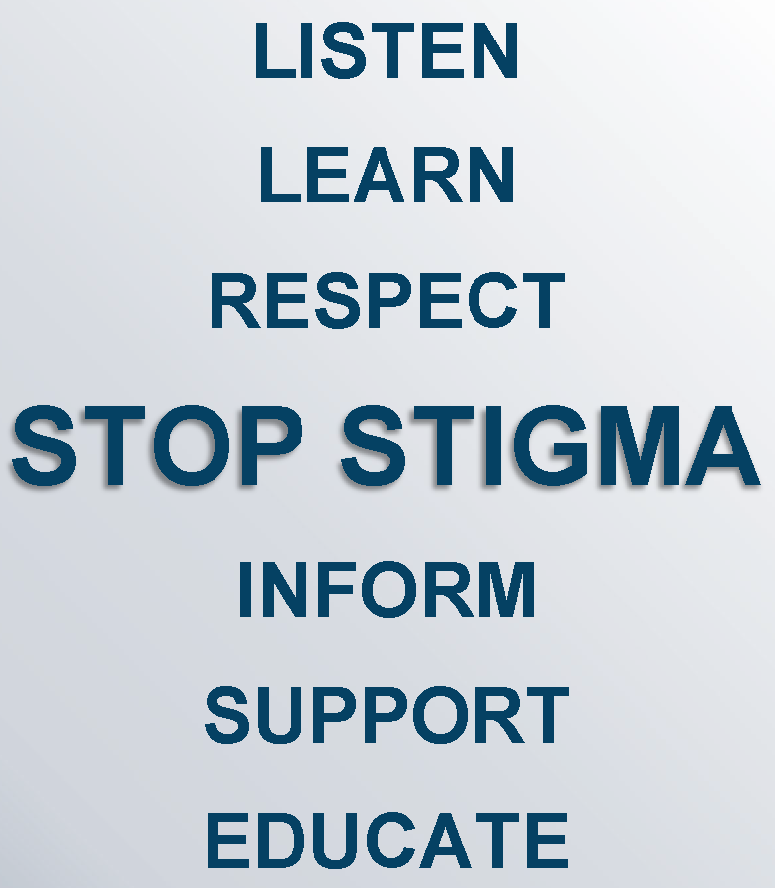
A Reminder About Stigma Reduction in Our Work with Families Affected by
Substance Use Disorders
Notes:
Facilitator Script:
We know the effects of stigma are alarming; preventing people from seeking help, influencing families' decisions not to receive treatment, limiting the quality of treatment services, reducing the likelihood of treatment retention or active recovery, and shaping policies that perpetuate bias and limit resource allocation. But what can we do about all this?
Research has shown that the language we use to describe SUDs can either perpetuate existing stereotypes and biases, impacting the treatment someone receives, or it can help engage someone in treatment similar to other chronic medical conditions. As partners in change, we have a responsibility to lead by example when it comes to substance use disorder stigma reduction—through ongoing awareness and learning. How do we get there as child welfare organizations—let’s take a closer review at the use of peer recovery support.
Additional Resources:
National Center on Substance Abuse and Child Welfare: Disrupting Stigma: How Understanding, Empathy, and Connection Can Improve Outcomes for Families Affected by Substance Use Disorders (2022)
National Center on Substance Abuse and Child Welfare: Disrupting Stigma: A Virtual Conversation (2022)
Slide Citations:
N/A
Script Citations:
N/A
Full Citations:
N/A

Slide 14

Peer Recovery Support Services
“Engaging people with lived experience represents one key way that federal agencies gather important information, shape programming and policy, and help improve outcomes for those served,” (Skelton-Wilson et al., 2021)
"Through shared understanding, respect, and mutual empowerment, peer support workers help people become and stay engaged in the recovery process and reduce the likelihood of [a return to use].”
(Substance Abuse and Mental Health Services Administration, 2023)
"Peer support services can effectively extend the reach of treatment beyond the clinical setting into the everyday environment of those seeking a successful, sustained recovery process.” (Substance Abuse and Mental Health Services Administration, 2023)
Peers and Recovery Specialists in child welfare and dependency court models help improve family outcomes.
(National Center for Substance Abuse and Child Welfare, 2019)
Notes:
Facilitator Script:
So, what exactly do we mean by Peer Recovery Support Services? Peer recovery support services is an umbrella term that encompasses a variety of peer positions held by persons with lived expertise in a multitude of settings and its importance has been recognized in the mental health and substance use treatment fields for many years.
Peers connect with parents and families on an interpersonal level built on mutual respect, trust, and empowerment; peers are a real-life embodiment that recovery is possible, instilling hope for parents and families’ own recovery and family stability goals.
The work of peers is robust. They not only facilitate parents’ successful engagement into treatment, but they also facilitate linkage to an array of community services designed to support their recovery across all life domains, including recovery support meetings, sponsorship, knowledge of recovery residences or sober living experiences, access to employment or vocational training programs, childcare and other forms of subsidies.
On a more macro-level, peers also help strengthen child welfare practice by providing subject matter expertise that may otherwise be lacking or limited among child welfare staff and thus, have an integral role in reducing stigma and bias as it relates to parental substance use and child safety.
As we’ve briefly touched on before, there are a variety of different names, models, and titles for peer support. Some are more experiential, some offer extra training, and some positions involve personal experience plus certification. Let’s break this down a little further on the next slide.
Additional Resources:
Peer Recovery Center of Excellence: Peer Recovery Now (2023)
Slide Citations:
(Skelton-Wilson et al., 2021; Substance Abuse and Mental Health Services Administration, 2023; National Center on Substance Abuse and Child Welfare, 2019)
Script Citations:
(Skelton-Wilson et al., 2021; Substance Abuse and Mental Health Services Administration, 2023; National Center on Substance Abuse and Child Welfare, 2019)
Full Citations:
Skelton-Wilson, S., Sandoval-Lunn, M., Zhang, X., Stern, F., & Kendall, J. (2021). Methods and emerging strategies to engage people with lived experience: Improving federal research, policy, and practice. Office of the Secretary for Planning and Evaluation, U.S. Department of Health and Human Services, ICF. https://aspe.hhs.gov/sites/default/files/documents/47f62cae96710d1fa13b0f590f2d1b03/lived-experience-brief.pdf
Substance Abuse and Mental Health Services Administration. (2023). Peer support workers for those in recovery. U.S. Department of Health and Human Services. https://www.samhsa.gov/brss-tacs/recovery-support-tools/peers
National Center on Substance Abuse and Child Welfare. (2019). The use of peers and recovery specialists in child welfare settings. Administration for Children and Families, Substance Abuse and Mental Health Services Administration. https://ncsacw.acf.hhs.gov/files/peer19_brief.pdf

Slide 15
Differentiating Between Peers & Recovery Specialists
PEERS
RECOVERY SPECIALISTS
Experiential Knowledge &
Lived Expertise
Specialized Training & Certification
Experiential Knowledge &
Lived Expertise
Peer Mentor
Peer Specialist
Peer Providers
Parent Partner
Recovery Support Specialist
Substance Abuse Specialist
Recovery Coach
Recovery Specialist
Parent Recovery Specialist
Notes:
Facilitator Script:
While there once was a clear distinction in terms of roles and responsibilities between peer and recovery specialist models, it has lessened in recent years. The models are described separately here, but it is important to note that many of the roles and responsibilities in child welfare settings may overlap between these two models.
Peers
Peers understand substance use disorders and the recovery process based on their own experiential knowledge and lived expertise. Parents are often more comfortable speaking candidly with peers as a result of these shared commonalities leading to higher levels of initial rapport and trust that then translates to increased service engagement and treatment retention.
Recovery Specialists
Recovery specialists, also sometimes referred to as substance abuse specialists and recovery coaches, are peers with training and advanced certification in substance use disorder treatment and recovery; and are often co-located in child welfare offices or dependency courts through agency partnerships. Their services often include on-site substance use disorder consultation, assessments, drug testing, and case management services to improve parents’ access to, and engagement in, substance use treatment. Their role may also consist of liaising or brokering relationships between child welfare, treatment providers, the courts, and other family-serving entities.
Additional Resources:
National Center on Substance Abuse and Child Welfare: Peer Support Specialist Programs for Families Affected by Substance Use and Involved with Child Welfare Services: A Four-Module Implementation Toolkit (2024)
Slide Citations:
N/A
Script Citations:
N/A
Full Citations:
N/A

Slide 16
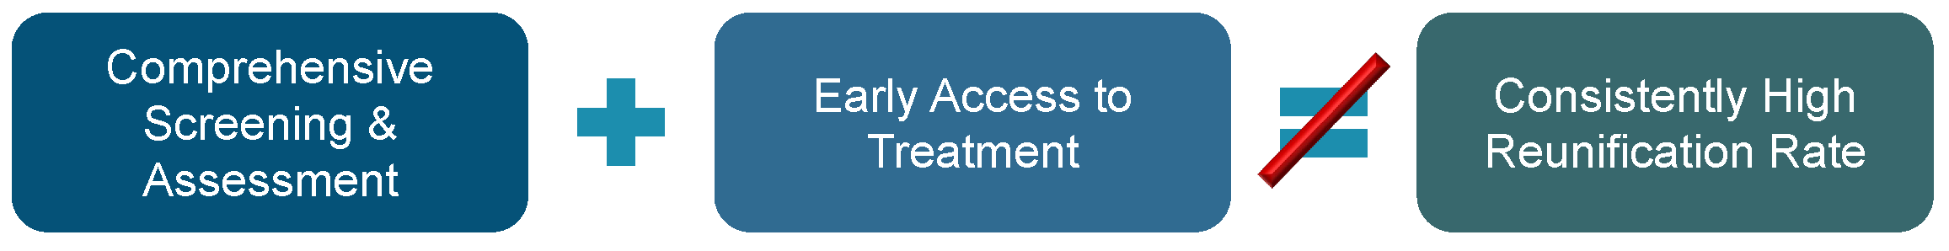
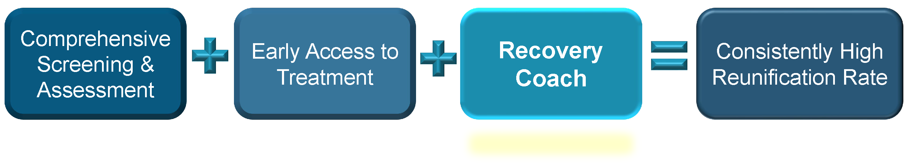
Timing of Recovery Support Matters
Notes:
Facilitator Script:
Let’s now zero in on the effectiveness and timeliness of peer recovery support models in child welfare. This information highlights key lessons from a randomized control trial from Cook County, Illinois’ Alcohol and Other Drug, or AOD, Waiver Demonstration project which included 3440 families. One of the program’s primary goals is to reduce the amount of time children spend in out-of-home care related to parental substance use. The program places a major emphasis on early identification for SUD assessment and treatment services paired with recovery support. In this model, recovery coaches serve as intensive and specialized case managers who aim to increase engagement in SUD treatment services and improve reunification and other safety and permanency outcomes. Their role uniquely positions them to reduce barriers, enhance motivation, re-engage parents in treatment and related services while working collaboratively with child welfare workers, treatment agencies, and the courts—resulting in early access to treatment, improved engagement and retention, reduced stays in out-of-home care—amounting to a total savings of over $10 million to the state.
Additional Resources:
N/A
Slide Citations:
N/A
Script Citations:
(Ryan et al., 2017)
Full Citations:
Ryan, J. P., Perron, B. E., Moore, A., Victor, B. G., & Park, K. (2017). Timing matters: A randomized control trial of recovery coaches in foster care. Journal of Substance Abuse Treatment, 77, 178–184. https://doi.org/10.1016/j.jsat.2017.02.006

Slide 17

Peer Recovery Support in Child Welfare
Family-centered
Includes support for
extended family/caregivers
Lens of child safety
and parental recovery
Notes:
Facilitator Script:
Use of peer recovery support in child welfare will be slightly different than in substance use disorder and mental health treatment settings. In child welfare, peer recovery support is designed to work with the identified parent as well as the entire family unit, which includes support to caregivers and extended family members.
Their work is also through the lens of both child safety and parental recovery. This includes introducing new skills for parenting while in active recovery and reinforcing family safety plans; supporting early recovery through engagement in treatment, self-help, or recovery support meetings, and helping parents identify and respond to concerning behaviors or signs of potential return to use.
Peer recovery support also facilitates linkage to aftercare services for sustained family stability and self-sufficiency well beyond the formal child welfare intervention period.
Additional Resources:
N/A
Slide Citations:
N/A
Script Citations:
N/A
Full Citations:
N/A

Slide 18

How Peer Recovery Support Engages Families in the Change Process Within
Child Welfare Settings
Notes:
Facilitator Script:
It’s important for us to understand the unique set of qualities peer recovery support brings to the table in child welfare settings.
Because of personal history, peer recovery support can often relate to parents in a way that the child welfare worker cannot. This speaks to the special rapport that is built with families based on their shared lived experiences. In time, parents recognize, respect, and trust the peer’s perspective allowing for greater accountability and the ability to say difficult things with credibility. Peers also have an awareness and ability to recognize signs that others may miss related to a parent’s recovery and can share and educate the family and team. Their presence in child welfare also plays a key role in re-engaging ambivalent or withdrawn parents (a common reality when addressing parental substance use) thereby supporting ongoing progress toward their case plan goals and objectives.
Additional Resources:
National Center on Substance Abuse and Child Welfare: The Use of Peers and Recovery Specialists in Child Welfare Settings (2019)​
Slide Citations:
N/A
Script Citations:
N/A
Full Citations:
N/A

Slide 19
Working with
Peer Recovery Support
Small Group Discussion
Notes:
Facilitator Script:
Let’s take the next 10 minutes in our small groups to discuss the following two questions:
Prompts for Participants:
In what ways can you envision peer recovery support helping with family engagement in your county? Or how has peer recovery support helped with family engagement in your county?
What worries or concerns would you have with this level of partnership in child welfare? Or are there any key lessons or takeaways from integrating peer recovery support services in your county that you can share with your peers?
Facilitator Note: After 10 minutes bring the learners back for a large group debrief—asking for volunteers to share about their small group discussions.
_______________________________________________________________
*Alternative Instructions for Virtual Training
Proceed with the discussion in a large group setting.

Slide 20
Peer Recovery Support
Small Group Discussion Questions
In what ways can you envision peer recovery support helping with family engagement in your county? Or how has peer recovery support helped with family engagement in your county?
What worries or concerns would you have with this level of partnership in child welfare? Or are there any key lessons or takeaways from integrating peer recovery support services in your county that you can share with your peers?
Notes:
Facilitator Notes:
In-person training: ask learners to identify a scriber for their small group discussion to support readiness for large group debrief. After [x] minutes, bring the learners back for a large group debrief asking for volunteers to share highlights or key takeaways from their table discussions.
Virtual training: proceed with facilitating a large group discussion.

Slide 21

Skills & Techniques for Building
Rapport & Engaging Families
Notes:
Facilitator Script:
Let’s now move our discussion to skills and techniques for building rapport and engaging families…

Slide 22

Helpful Techniques for Building Rapport
Empathy
Mirroring
Reframing
Partializing
Past Success Inquiries
Notes:
Facilitator Script:
Now that we are well versed in peer recovery support services and what doesn’t bode well in consumer-provider relations or interactions, let’s talk more about what does work. Here are some helpful techniques for building rapport with families involved with child welfare:
Expressing empathy helps families feel understood. While it is not a show of agreement, it does demonstrate that their point of view is heard and seen; helping to build trust and openness in the partnership.
Mirroring is an effective strategy for relating to and building rapport with families. It involves listening and taking note of specific words or phrases used by families to describe their current situation and incorporate them into the language we use when talking and reflecting with families.
Reframing is a cognitive restructuring technique that helps change a parent or family’s perception of a problem or event. In child welfare, we often use reframing to help families shift their perspective for system involvement—from a crisis to an opportunity for growth and change.
As we’ve discussed in previous modules, families that come to the attention of child welfare are often overwhelmed with a variety of stressors and system involvement can add to this greatly. Partializing is helping families to identify areas of change or improvement needed and then developing a case plan that is achievable and manageable. Assisting families in this process and celebrating their achievements (big or small) provides the family with a sense of accomplishment and reinforces that you care.
Families are resilient and sometimes need our help in recognizing their strengths and protective capacities. Use of skilled questioning to elicit what is already working for families and building off those strengths capture the art of past success inquiries. For a parent showing signs of return to use this might include asking, “You’ve shared about past return to use in your recovery process but were able to get back on track with your goals. What worked for you then?”
Additional Resources:
N/A
Slide Citations:
N/A
Script Citations:
N/A
Full Citations:
N/A

Slide 23

Solution-Focused Questions
Coping
Exception
Preferred Future
Position
Scaling
Notes:
Facilitator Script:
Now that we’ve added to or refreshed our rapport building skills, let’s also review some additional strategies for successful engagement.
Solution-Focused Questions are an interviewing strategy designed to focus on and elicit strengths through identifying what has previously worked well to help guide families toward solutions. Types of solution-focused questions include the following:
Coping: a parent is asked to reflect on how they have managed to cope or handle past difficult or challenging situations.
Exception: a parent is asked to identify a time when a specific problem was not happening in their life and what was different then as opposed to now.
Preferred Future: a parent is asked to consider what their preferred outcome would be including what their future would look like if the specific problem was no longer an issue.
Position: a parent is asked to consider an issue or challenge from the perspective of another family member (e.g., child, partner/spouse).
Scaling: a parent is asked to rate their current evaluation of a specific issue or challenge by picking a number on a scale of 1-5 or 1-10 and responses are used to explore what it would take for that evaluation of the specific issue or challenge to improve.
Additional Resources:
N/A
Slide Citations:
N/A
Script Citations:
(Northern California Training Academy, 2021)
Full Citations:
Northern California Training Academy, UC Davis Extension, 2018. (2021). Safety organized practice (SOP) resources. Commons Open Educational Resources (OER). https://www.oercommons.org/authoring/12342-safety-organized-practice-sop-resources

Slide 24
Let’s Role-Play!
Small Group Activity
Notes:
Facilitator Notes:
Ask participants to break into small groups of 3—taking turns with roles as 1) the social worker 2) the parent 3) an observer. Ask participants to try on/role-play using the different types of solution focused questions in their contacts with a parent affected by substance use or co-occurring disorders. Group members should take 5 minutes per each rotation with time to reflect on the experience from each other’s perspective before rotating and repeating the experience.
Examples of Solution-Based Questions to Kick-off Role-Plays:
Opening Question: Can you tell me about your relationship with alcohol and drugs?
Exception Question: Has there been times you’ve been able to manage your stress without alcohol or drugs? What was different about that time?
Positioning Question: If we were to ask your children how your use of alcohol or drugs affects them, what do you think they might say?
Miracle Question: If we were able to see into the future say a year from now, how would life look for you and your children?
Scaling Question: On a scale of 1-10 (one being the least ready and ten being the most ready), how ready are you to seek help for your substance use?
Bring small groups back into a large group setting to discuss reflections from the activity. Facilitate the activity debrief with the following prompts:
Prompts for Participants:
What worked well? How did this approach land as the parent? Child welfare worker? Observer?
Was there anything that didn’t work out so well? What was your comfort level with this approach?
Who in the room already uses solution-focused techniques in their practice with families? If so, how has it been received? Any helpful tips or lessons to share with your peers today?
_______________________________________________________________
*Alternative Instructions for Virtual Training​
​
Proceed with activity in a large group setting; Facilitator should enlist support of either a co-facilitator or support staff (or a volunteer from the learners) to ​play the role of the parent with the learners assuming the role of observer. The facilitator will then lead the exercise as child welfare worker modeling use of solution-focused techniques with a parent affected by a substance use or co-occurring disorder. Proceed with facilitating a large group debrief with the following adjusted prompts:
Prompts for Participants:
What were your observations? What appeared to work well with the solution-focused approach used in this role-play of a worker-parent contact?
Was there anything that didn’t work out so well? What could have been some alternatives to those moments?
Who in the room already uses solution-focused techniques in their practice with families? If so, how has it been received? Any helpful tips or lessons to share with your peers today?

Slide 25
Examples of Solution-Based Questions to Kick-Off Role-Plays
Opening Question: Can you tell me about your relationship with alcohol and drugs?
Exception Question: Has there been times you’ve been able to manage your stress without alcohol or drugs? What was different about that time?
Positioning Question: If we were to ask your children how your use of alcohol or drugs affects them, what do you think they might say?
Miracle Question: If we were able to see into the future say a year from now, how would life look for you and your children?
Scaling Question: On a scale of 1-10 (one being the least ready and ten being the most ready), how ready are you to seek help for your substance use?
Notes:
Facilitator Notes:
Ask participants to break into small groups of 3—taking turns with roles as 1) the social worker 2) the parent 3) an observer. Ask participants to try on/role-play using the different types of solution focused questions in their contacts with a parent affected by substance use or co-occurring disorders. Group members should take 5 minutes per each rotation with time to reflect on the experience from each other’s perspective before rotating and repeating the experience.
Examples of Solution-Based Questions to Kick-off Role Plays:
Opening Question: Can you tell me about your relationship with alcohol and drugs?
Exception Question: Has there been times you’ve been able to manage your stress without alcohol or drugs? What was different about that time?
Positioning Question: If we were to ask your children how your use of alcohol or drugs affects them, what do you think they might say?
Miracle Question: If we were able to see into the future say a year from now, how would life look for you and your children?
Scaling Question: On a scale of 1-10 (one being the least ready and ten being the most ready), how ready are you to seek help for your substance use?
Bring small groups back into a large group setting to discuss reflections from the activity. Facilitate the activity debrief with the following prompts:
Prompts for Participants:
What worked well? How did this approach land as the parent? Child welfare worker? Observer?
Was there anything that didn’t work out so well? What was your comfort level with this approach?
Who in the room already uses solution-focused techniques in their practice with families? If so, how has it been received? Any helpful tips or lessons to share with your peers today?
_______________________________________________________________
*Alternative Instructions for Virtual Training​
​
Proceed with activity in a large group setting; Facilitator should enlist support of either a co-facilitator or support staff (or a volunteer from the learners) to ​play the role of the parent with the learners assuming the role of observer. The facilitator will then lead the exercise as child welfare worker modeling use of solution-focused techniques with a parent affected by a substance use or co-occurring disorder. Proceed with facilitating a large group debrief with the following adjusted prompts:
Prompts for Participants:
What were your observations? What appeared to work well with the solution-focused approach used in this role-play of a worker-parent contact?
Was there anything that didn’t work out so well? What could have been some alternatives to those moments?
Who in the room already uses solution-focused techniques in their practice with families? If so, how has it been received? Any helpful tips or lessons to share with your peers today?

Slide 26
Role-Play Activity Reflections
What worked well? How did this approach land as the parent? Child welfare worker? Observer?
Was there anything that didn’t work out so well? What was your comfort level with this approach?
Who in the room already uses solution-focused techniques in their practice with families? If so, how has it been received? Any helpful tips or lessons to share with your peers today?
Notes:
Facilitator Notes:
Bring small groups back into a large group setting to discuss reflections from the activity. Facilitate the activity debrief with the following prompts:
Prompts for Participants:
What worked well? How did this approach land as the parent? Child welfare worker? Observer?
Was there anything that didn’t work out so well? What was your comfort level with this approach?
Who in the room already uses solution-focused techniques in their practice with families? If so, how has it been received? Any helpful tips or lessons to share with your peers today?
_______________________________________________________________
*Alternative Instructions for Virtual Training​
​
Proceed with activity in a large group setting; Facilitator should enlist support of either a co-facilitator or support staff (or a volunteer from the learners) to ​play the role of the parent with the learners assuming the role of observer. The facilitator will then lead the exercise as child welfare worker modeling use of solution-focused techniques with a parent affected by a substance use or co-occurring disorder. Proceed with facilitating a large group debrief with the following adjusted prompts:
Prompts for Participants:
What were your observations? What appeared to work well with the solution-focused approach used in this role-play of a worker-parent contact?
Was there anything that didn’t work out so well? What could have been some alternatives to those moments?
Who in the room already uses solution-focused techniques in their practice with families? If so, how has it been received? Any helpful tips or lessons to share with your peers today?

Slide 27

Motivational Interviewing
Notes:
Facilitator Script:
Child welfare involvement is often involuntary in nature—families are required to participate in services that they did not actively seek out which understandably may impact their level of engagement. For families affected by substance use disorders and co-occurring mental health and trauma this can be especially true.
Motivational Interviewing (commonly referred to as MI) is an approach to family engagement based on the principles of motivational psychology that has a large body of supporting evidence. Applied within child welfare settings, MI offers an affirming and transformative approach to recovery and family stability— one that actively explores ambivalence while fostering motivation toward individual recovery and family stability goals.
Additional Resources:
N/A
Slide Citations:
N/A
Script Citations:
N/A
Full Citations:
N/A

Slide 28
Motivational Interviewing for
Substance Use Disorders
Permission to Use & Video Credit Provided by ​Michael Brekelmans of Psychwire​
Video by Psychwire
Notes:
Facilitator Script:
Before we jump into techniques and strategies, let’s watch a brief 2-minute video about the use of motivational interviewing for substance use disorders with co-founder, Dr. William Miller.
Facilitator Note: Be sure to expand the view to full screen when playing video for learners.
Prompts for Participants:
Any initial reactions to what Dr. Miller said about the use of motivational interviewing for substance use disorders?
What about the part specifically about how acceptance doesn’t mean approval?
Any thoughts on how this strategy of engagement can shape the course of our work with children and families affected by parental substance use?
Video Source:
Psychwire and Michael Brekelmans of Psychwire​

Slide 29
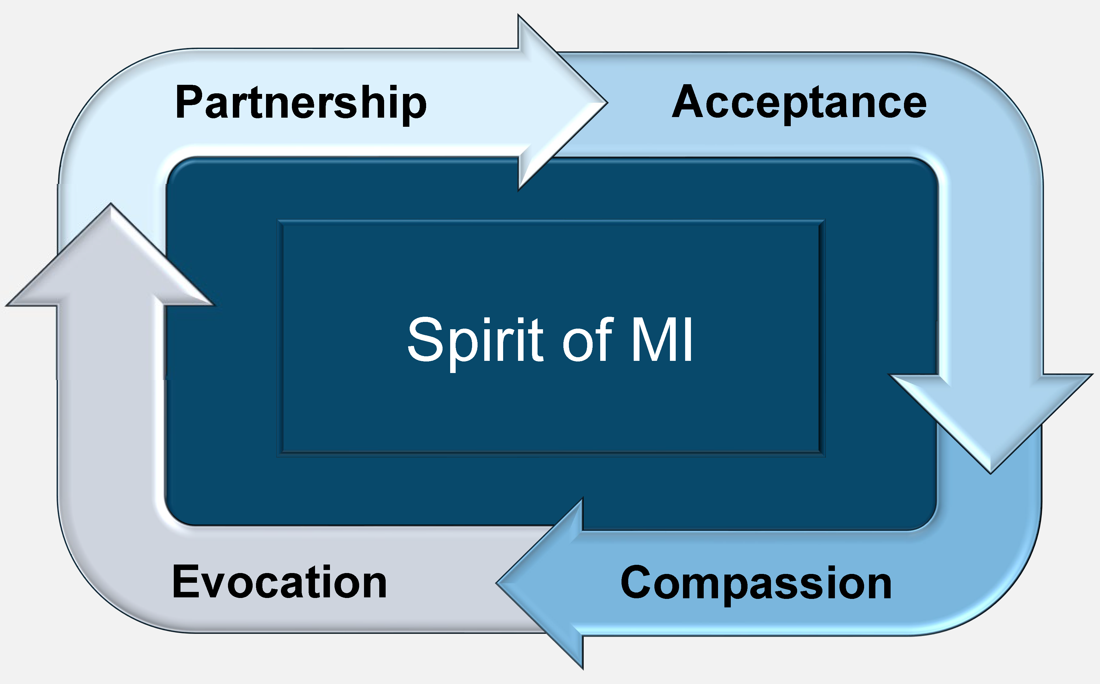
Spirit of MI
Notes:
Facilitator Script:
The spirit of MI represents the four cornerstones of this person-centered approach to change. Commonly referred to as the acronym PACE—it begins with the notion that the helping relationship between a practitioner and an individual seeking change is one of equal partnership—where the client is viewed as the expert of their own lives who partners with the practitioner to explore their own behaviors, motivations, and barriers to change. Next is acceptance—the notion that individuals seeking change are met wherever they are within the readiness to change process, a therapeutic stance of the practitioner that is rooted in autonomy, empathy, and respect. Some refer to this as neither pressure or persuasion. Then there’s compassion which represents the practitioner’s commitment to promoting their client’s best interests and well-being; and finally, evocation—the therapeutic skill of drawing out and encouraging a client’s intrinsic motivation and desire for change (in place of instilling or mandating such change).
Additional Resources:
N/A
Slide Citations:
N/A
Script Citations:
(Casey Family Programs, 2021)
Full Citations:
Casey Family Programs. (2021). Motivational interviewing. https://www.casey.org/motivational-interviewing/

Slide 30






Four Key Stages of MI
Engaging
Focusing
Evoking
Planning
Notes:
Facilitator Script:
Built on the key principles of engagement, MI includes four key stages:
Engaging in a collaborative partnership anchored in reflective listening and empathy
Focusing on the development of a shared purpose and understanding about what behaviors or actions may need to change
Evoking an intrinsic desire or motivation for change through actively exploring ambivalence and supporting an understanding of the ‘why’ behind behavior change
And planning for the change process driven by strengths and protective capacities with the belief and value that families are the experts of their own lives
Additional Resources:
N/A
Slide Citations:
N/A
Script Citations:
(Casey Family Programs, 2021)
Full Citations:
Casey Family Programs. (2021). Motivational interviewing. https://www.casey.org/motivational-interviewing/

Slide 31




Core Skills of MI
Open-Ended Questions
Affirmations
Reflective Listening
Summarizing
Notes:
Facilitator Script:
Motivational interviewing is built on four core, person-centered skills. These include:
Asking open-ended questions to explore and strengthen the family partnership, which serves as the foundation for the change process.
Using affirming statements to highlight strengths and protective capacities which drive intrinsic motivation for change through developing a parent or family’s inherent belief that they are capable of making these changes.
Engaging in reflective listening to explore what is being said at a deeper level, confirm understanding of what is being said, and engage families in the change talk process through supporting exploration of ambivalence.
And summarizing—a technique used to wrap up a contact or family meeting—similar to reflective listening, summarizing is an opportunity to review what was discussed, highlight and reinforce change talk, ensure that everyone is on the same page, and identify any immediate next steps or action items.
Additional Resources:
N/A
Slide Citations:
N/A
Script Citations:
(Motivational Interviewing Network of Trainers, 2021)
Full Citations:
Motivational Interviewing Network of Trainers. (2021). Understanding motivational interviewing. https://motivationalinterviewingunderstanding-motivational-interviewing.org/

Slide 32
MI Change Talk
DARN
Desire
CAT
Commitment
Ability
Activation
Reason
Taking Steps
Need
Notes:
Facilitator Script:
Commonly referred as its acronym—DARN CAT—motivational interviewing change talk is a helpful tool to understand how people talk about the idea of change. The DARN segment of the acronym represents preparatory change talk, these include:
Desire statements illuminate an intrinsic motivation for change. The parents we serve in child welfare often make changes even if they don’t want to (largely out of compliance with court mandates, etc.). Desire questions are crafted to evoke the ‘why’ behind the desire for change. Examples include:
What has happened that makes you want to get sober now?
How would you benefit from not using substances?
Ability statements illuminate one’s belief in their ability to make changes—the idea that we believe what we say to ourselves. What does the parent believe about their ability to make change? Ability questions are crafted to evoke ‘how’ parents would go about making change. Examples include:
What would it take to enter treatment for your substance use disorder?
What services or resources would you need to support your path to recovery?
Reason statements illuminate the reasons why change is being considered. With these the ‘why’ will speak to both reasons for and reasons not to change. Example include:
What would continuing to use substances prevent you from having?
What relationships will be affected by your decision to not seek treatment?
Need statements illuminate the need to make changes—and are often rooted in emotion (unlike reason statements which tend to be more rationally-driven logic). With these the focus is on evoking the significance and urgency of the change. Examples include:
What have you lost in life because of your substance use disorder?
How will recovery heal or repair those relationships?
The CAT segment of the acronym represents implementing change talk, these include:
Commitment statements illuminate what a parent is willing to do AND what he or she did. With these the emphasis is on how the change will be maintained. Examples include:
On a scale of 1-10 (one being the lowest and ten being the highest), how ready are you to seek treatment for your substance use disorder?
What would you need to move your score up by 1-2 points?
Activation statements illuminate a parent’s readiness, preparedness, and willingness to change.
Examples include:
What types of substance use treatment programs are you considering?
Who could you call on as a supportive caregiver during your active recovery?
Taking Steps statements illuminate what a parent has already done to implement change.
Examples include:
What steps have you taken to identify a sponsor in your recovery community?
How will you decide among the recommended outpatient providers?
Additional Resources:
N/A
Slide Citations:
N/A
Script Citations:
(Motivational Interviewing Network of Trainers, 2021; Substance Abuse and Mental Health Services Administration, 2019)
Full Citations:
Motivational Interviewing Network of Trainers. (2021). Understanding motivational interviewing. https://motivationalinterviewing.org/understanding-motivational-interviewing
Substance Abuse and Mental Health Services Administration. (2019). Enhancing motivation for change in substance use disorder treatment. Treatment improvement protocol (TIP) series No. 35. SAMHSA Publication No. PEP19-02-01-003. U.S. Department of Health and Human Services. https://store.samhsa.gov/sites/default/files/d7/priv/tip35_final_508_compliant_-_02252020_0.pdf

Slide 33

Rolling with Resistance
Normalize ambivalence as
part of the change process
Help the parent develop their own view
of the problem and their own solutions
Avoid an argument or persuasion
Think dance, not wrestle
Use reframes to reflect on the resistance
Notes:
Facilitator Script:
Resistance is a natural part of the change process. You might notice it in your interactions with parents as arguing, challenging, interrupting or talking over you; it might also present as blaming, denying, minimizing, or an unwillingness to change; and perhaps most notably, resistance can look like increasing levels of disengagement, disregard, or complete unresponsiveness to your attempts at re-engaging them in services. Again, this is all par for the course when it comes to change, so why not start with normalizing this for our parents?
The following are some additional techniques to help ‘roll’ with the resistance:
There’s a well-known quote about the art of persuasion that reads, ‘People are generally better persuaded by the reasons which they themselves discovered than by those which have come into the mind of others.’ Our role in MI is to help parents develop their own view of the problem and their own solutions (recall all those DARN CAT strategies). We do this by first recognizing resistance and all the ways it manifests and use caution to not fall trap to things like arguing, lecturing, or prescribing the problem and solutions for them. This is where the metaphor of ‘think dance not wrestle’ comes into play—our role is to lead parents through navigating their own state of ambivalence, not get entangled in the crosshairs of it. So, how is it that we lead in the face of resistance—we reframe! This might look like reflecting on the resistant statement, “You don’t seem to like that option for recovery.” Or reflecting on the tone that you are hearing, “You seem frustrated.” Another technique is to reflect on the ambivalence, “I hear how much your family means to you, but I am also hearing you might not be ready to enter treatment.” And finally, supporting the parent’s choice and control, “It’s up to you on how you move forward with your recovery.”
Additional Resources:
N/A
Slide Citations:
N/A
Script Citations:
(Substance Abuse and Mental Health Services Administration, 2019)
Full Citations:
Substance Abuse and Mental Health Services Administration. (2019). Enhancing motivation for change in substance use disorder treatment. Treatment improvement protocol (TIP) series No. 35. SAMHSA Publication No. PEP19-02-01-003. U.S. Department of Health and Human Services. https://store.samhsa.gov/sites/default/files/d7/priv/tip35_final_508_compliant_-_02252020_0.pdf

Slide 34

Readiness for…
Notes:
Facilitator Script:
Motivation and readiness for change will vary from parent to parent. While the choice may appear simple from an outside perspective, the reality is that parents are being asked to let go of their primary coping mechanism—their use of substances. Their ambivalence toward change might be rooted in fear about how to cope while in recovery, dealing with the shame of their past actions or inactions, or managing past unresolved trauma. Whatever the source, motivational interviewing equips us with strategies to engage and build trust with parents and families, a critical step toward their long-term recovery and family stability also known as the stages of change process.
Additional Resources:
N/A
Slide Citations:
N/A
Script Citations:
N/A
Full Citations:
N/A

Slide 35
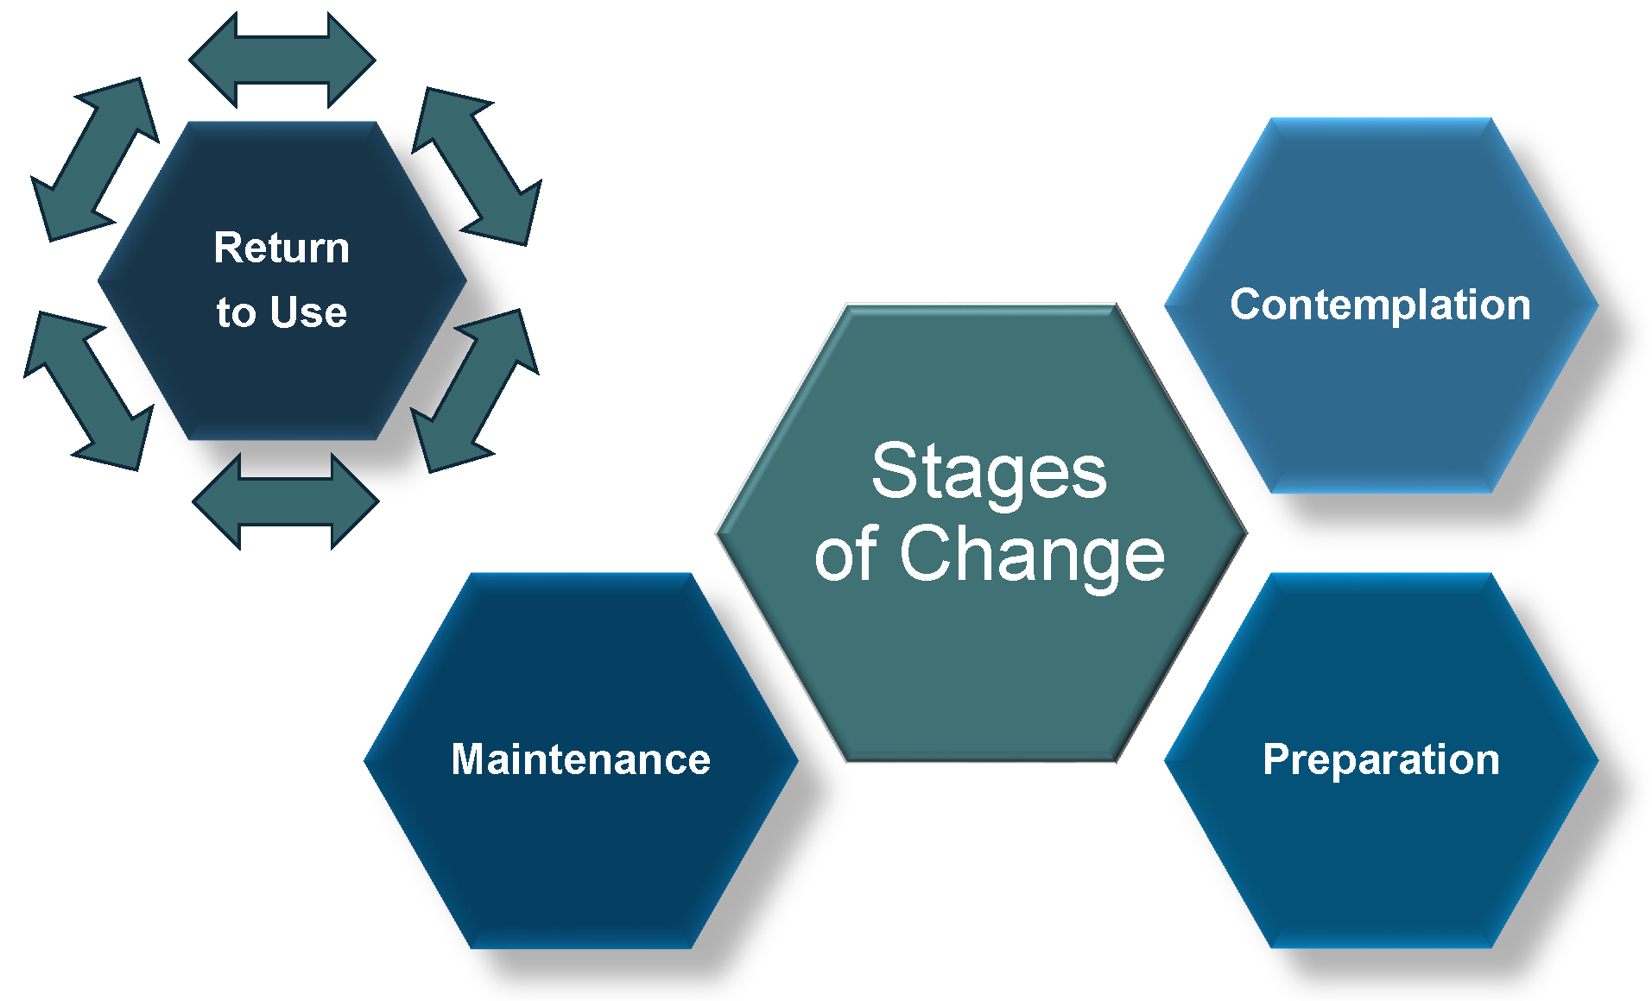


Stages of Change
Notes:
Facilitator Script:
Motivation to change and motivational techniques or strategies go hand in hand through the change process. It can be helpful to view change as a circular, multi-level process. As illustrated here, the stages of change can be understood as fluid in nature. Change often begins at the pre-contemplation stage and continues through the contemplation, preparation, action, and maintenance stages. Ideally, there is a final exit at the maintenance stage to long-term recovery. However, it may take some people longer than others to reach that final maintenance stage.
The change process is not static—individuals typically move back and forth between stages. People will move through the stages at different rates, but it is relatively uncommon for people to linger in the early stages once issues have received visible attention. Return to use (also sometimes still referred to as relapse) can happen at any stage as individuals move back and forth between the stages.
As change takes place, it is also common for people to fluctuate between stages. Motivation may change over time within each individual, both in its source and strength. In fact, it is very common for people in recovery from a substance use or mental health disorder to have a return to use, where the behaviors or symptoms recur for a period of time, threatening the person’s recovery but not necessarily stopping it.
As child welfare workers, our role would be to assist parents in becoming open to positive change by recognizing where the parent is in the stages of change and intervening appropriately.
Additional Resources:
N/A
Slide Citations:
(Substance Abuse and Mental Health Services Administration, 2019)
Script Citations:
(Substance Abuse and Mental Health Services Administration, 2019)
Full Citations:
Substance Abuse and Mental Health Services Administration. (2019). Enhancing motivation for change in substance use disorder treatment. Treatment improvement protocol (TIP) series No. 35. SAMHSA Publication No. PEP19-02-01-003. U.S. Department of Health and Human Services. https://store.samhsa.gov/sites/default/files/d7/priv/tip35_final_508_compliant_-_02252020_0.pdf

Slide 36





Stages of Change Strategies
Notes:
Facilitator Script:
Let’s pause here and spend some more time learning about each of the stages of change strategies…
In the pre-contemplation stage, the parent has no perception of having a problem or a need to change. So, what can the child welfare worker do? At this stage, you can:
Establish rapport and build trust;
Increase the parent’s perception of the risks and problems with their current behavior; and
Raise awareness about their behaviors such as generalized discussions about risks to children caused by a parent’s substance use.
In the contemplation stage, the parent first recognizes that their behavior may be a problem but feels ambivalent about change. At this stage, you can:
Help parents understand that ambivalence to change is normal;
Emphasize their free choice, responsibility, and self-efficacy for change;
Help the parent identify reasons or benefits for changing as well as risks for not changing; and
Reiterate that change is possible and achievable.
The interventions for the remaining stages of change are relatively straightforward…
In the preparation stage, the parent makes a conscious decision to change and has identified a motivation for change. Your role as the child welfare worker can be to help the parent identify the best actions to take and support their motivations for change. In addition, you can also:
Help parents enlist social support; and
Develop a plan with specific steps to take to support their decision for change.
In the action stage, the parent takes steps to change. As a child welfare worker, you can help the parent implement their identified strategies and support the steps they take, particularly by linking them to qualified treatment providers and other recovery-oriented support and services within the community. During this stage, it is helpful for child welfare workers to:
Support a realistic view of change through small actionable steps; and
Help parents find new reinforcements for positive change.
In the maintenance stage, the parent is actively working on sustaining change strategies and maintaining long-term recovery. The maintenance stage is designed to be a gateway to long-term recovery. As a child welfare worker you can:
Help parents identify triggers or activators and use planned strategies to prevent a return to use;
Maintain supportive contact and availability; and
Advocate for community support and reinforcements.
As we touched on, return to use is an anticipated part of the change process. So, if and when this occurs, the goal would be to help parents re-engage in the contemplation, preparation, and action stages.
Additional Resources:
N/A
Slide Citations:
(Substance Abuse and Mental Health Services Administration, 2019)
Script Citations:
(Substance Abuse and Mental Health Services Administration, 2019)
Full Citations:
Substance Abuse and Mental Health Services Administration. (2019). Enhancing motivation for change in substance use disorder treatment. Treatment improvement protocol (TIP) series No. 35. SAMHSA Publication No. PEP19-02-01-003. U.S. Department of Health and Human Services. https://store.samhsa.gov/sites/default/files/d7/priv/tip35_final_508_compliant_-_02252020_0.pdf

Slide 37
Identifying Behavioral Indicators for Readiness for Change
Small Group Activity
Notes:
Facilitator Script:
Let’s now reconvene in our small groups for an activity on identifying behavioral indicators for readiness for change for each stage of the change process; behavioral indicators are things you might observe or hear from parents that help inform where they are in their own recovery process.
For example, a parent or caregiver in the precontemplation stage might deny or minimize their use and say to you, “just because I have a few beers or smoke some pot doesn’t mean I have a serious problem.”
Each group should identify a scribe who is responsible for capturing your list on the large easel paper and a volunteer to facilitate your large group report out. Let’s plan to reconvene as a large group in (x minutes).
Materials Needed:
- Large Easel Paper
- Markers
_______________________________________________________________
*Alternative Instructions for Virtual Training
Proceed with activity in a large group setting.
Facilitator Note: Additional Examples
Pre-Contemplation: A parent’s denial of minimization of use or statements such as “just because I have a few beers or smoke some pot doesn’t mean I have a serious problem.”
Contemplation: A parent’s acknowledgement that their substance use is affecting them and their family but is not ready to implement change or statements such as “I know I am taking a risk getting high once I put the kids to sleep, but if I don’t get high then I don’t get sleep and I need to be able to sleep.”

Slide 38

Important Considerations for a Collaborative Change Process
Notes:
Facilitator Script:
Again, change is a process that has multiple stages. Remember, people often begin at the pre-contemplation stage and may go back and forth through the stages (contemplation, preparation, action, and maintenance), with the maintenance stage representing long-term recovery.
It is really important that parents in the child welfare system are motivated to engage in and remain in treatment, because the requirements of federal and state statutes do not allow much time to be lost in return to use before decisions are made about the permanent care of children and adolescents.
Child welfare workers can help motivate parents to move from one stage of recovery to the next. Although the primary responsibility for motivating parents to engage in treatment rests with treatment providers, child welfare workers can help parents maintain the motivation to meet the court’s timelines so that they have the best possible chance to retain or regain custody of their children. Often, during the pre-contemplation and contemplation stages, child welfare workers are the primary motivator, especially if the parent has yet to be assessed or referred for substance use disorder treatment.
Additional Resources:
N/A
Slide Citations:
N/A
Script Citations:
N/A
Full Citations:
N/A

Slide 39

ASFA as the Lever for
Cross-System Collaboration
No time to lose
Conflicting timelines
Working on behalf of children
and families with urgency
Notes:
Facilitator Script:
There truly is no time to lose when it comes to serving families at risk of losing custody of their children. Child welfare practice is guided by federal law—the Adoption and Safe Families Act (commonly referred to as ASFA). ASFA stipulates that if a child has been in out-of-home care for 15 of the last 22 months then child welfare must move toward an alternate plan of permanency for the child. This may include filing a petition for termination of parental rights, pursuing adoption or legal guardianship proceedings, or granting permanent custody to a relative or non-relative extended family member.
The challenge here is that substance use disorder treatment doesn’t always fit nicely into this ASFA timeline. Sometimes this is due to a parent’s return to use—which we now understand is a natural part of the recovery and behavioral change process. Other times, this can be a result of systems-level issues such as insufficient screening and referral policies which prevent timely access to substance use disorder treatment. No matter the cause of the delay, the ASFA timeline remains the same—which reinforces the sense of urgency when working on behalf of children and families affected by substance use disorders.
Additional Resources:
N/A
Slide Citations:
N/A
Script Citations:
N/A
Full Citations:
N/A

Slide 40



What Can You Do to Help?
Screen, refer, and link to high quality treatment providers
Emphasize family voice and choice in service planning
Help parents engage and remain in treatment
Respond appropriately to return to use
and support sustained recovery
Help parents understand dependency court requirements
Work with attorneys
and the courts
Notes:
Facilitator Script:
So, what exactly can we do to help parent engage in appropriate forms of treatment? First, we can facilitate access to screening for early identification and where indicated, refer for a clinical assessment and diagnosis. We then play an integral role in motivating parents to engage in treatment and take the necessary steps to ensure that treatment referrals align with the level of care recommendations and parent preference as discussed in module two of this toolkit.
We also have an array of motivational enhancement strategies to encourage parents' willingness and commitment to engage in treatment. As we just covered, motivational enhancement strategies emphasize parents’ ability to voice personal goals and values in ways that elicit their own motivation to change, and to make choices about their treatment options that are personalized and responsive.
And while treatment engagement is such a significant milestone, it is only the first of many in a parent’s recovery journey. So, our role as child welfare workers in collaboration with peer recovery specialists, treatment providers, and the courts also involves supporting substance use and co-occurring disorder treatment retention, which includes having appropriate policies and practices in place to support a potential return to use while still upholding the goals and objectives of the recovery management and family safety plans.
Additional Resources:
National Center on Substance Use and Child Welfare: Understanding Engagement of Families Affected by Substance Use Disorders: Child Welfare Practice Tips (2019)
Slide Citations:
(Geiger et al., 2017)
Script Citations:
(Geiger et al., 2017)
Full Citations:
Geiger, J. M., Piel, M. H., & Julien-Chinn, F. J. (2017). Improving relationships in child welfare practice: Perspectives of foster care providers. Child & Adolescent Social Work Journal, 34(1), 23–33. https://doi.org/10.1007/s10560-016-0471-3

Slide 41

Reshaping the Dialogue
About Treatment Readiness
Rethinking “Rock Bottom”
Embracing “Raising the Bottom”
Notes:
Facilitator Script:
It’s common for people to think about treatment readiness with the adage, someone must hit “rock bottom” in order to change, but every person’s bottom is different.
A substance use disorder is like an elevator that keeps going down. The elevator stops at different floors from time to time when something happens, and the person with a substance use disorder can get off. Sometimes the right information at the right time is all that is required for them to recognize that they must make a change, get off the elevator, and take advantage of available supports and services.
The recovery community is beginning to shift the language from “rock bottom” to opportunities that “raise the bottom”—this could be a crisis, court-ordered treatment, or a planned intervention. For the families we serve, it might be child welfare services knocking on their door that gets a parent to step off the elevator. However, if the person chooses to stay on the elevator, it keeps going down and becomes much harder to get off. Our work then becomes about raising the bottom—and as some might say, “striking while the iron is hot.”
Additional Resources:
N/A
Slide Citations:
(Rivera & Sullivan, 2015)
Script Citations:
(Rivera & Sullivan, 2015)
Full Citations:
Rivera, M., & Sullivan, R. (2015). Rethinking child welfare to keep families safe and together: Effective housing-based supports to reduce child trauma, maltreatment recidivism, and re-entry to foster care. Child Welfare, 94(4), 185–204. https://pubmed.ncbi.nlm.nih.gov/26827482/

Slide 42



Referral & Linkage to Comprehensive
Treatment & Recovery Support Services
High-Quality SUD treatment
Integrated Care Providers
Recovery-Oriented Resources
Fatherhood Initiatives
Food, Housing, and Other Concrete Supports
Family Residential Programs
Adult Mental Health Programs
Vocational Services
Parenting Support Services
Healthcare Services
Specialized Treatment Services
Peer Support Models
Educational Services
Subsidized Childcare Services
Notes:
Facilitator Script:
One way we can achieve this is by familiarizing ourselves with our community’s comprehensive service array so that when a parent chooses to actively ‘step off the elevator’ and seek support, we are fully prepared to provide referral and linkage to their individually tailored service needs without further delay.
Additional Resources:
N/A
Slide Citations:
N/A
Script Citations:
N/A
Full Citations:
N/A

Slide 43
Community Resource Mapping
Small Group Activity
Notes:
Facilitator Script:
Let’s go ahead now and reconvene in our small groups for a final activity on community resource mapping. Using the previous slide as a guide, work with your group members to identify respective treatment and service providers for each category or any gaps that exist within your community. This list wasn’t meant to be exhaustive, so also feel free to list out any additions that come to mind. Each group should identify a scribe (to capture your list on your easel paper) and a volunteer to facilitate your large group report out. Let’s plan to reconvene as a large group in (x minutes).
Materials Needed:
- Large Easel Paper
- Markers
_________________________________________________
*Alternative Instructions for Virtual Training
Proceed with activity in a large group setting; Facilitator should enlist support of either a co-facilitator or support staff (or learner) to scribe large group responses to the community resource mapping activity so that the comprehensive list of providers can be shared with learners for their use post training.

Slide 44





Avoid Missed Opportunities
“Here’s a referral– Let me know when you make contact.”
“They’ll get into treatment if they really want it.”
“Don’t work harder than the client.”
“We will see you back here in 90 days.”
Notes:
Facilitator Script:
Nice work mapping out your existing community resources and current gaps in service array. That’s an important step in our referral and linkage practice but our work on behalf of children and families shouldn’t stop there. We must do our very best in facilitating access and utilization of these services, too. Let’s do our part to avoid the following common missed opportunities:
“Here’s a referral—let me know when you make contact with the provider.”
“They’ll get into treatment if they really want it.”
“Don’t work harder than the client.”
“We’ll see you back here in 90 days.”
And instead, focus on strategies that enhance our referral and linkage efforts…
Additional Resources:
N/A
Slide Citations:
N/A
Script Citations:
N/A
Full Citations:
N/A

Slide 45
Referral & Linkage Strategies
Skill-based coaching
Service engagement
walk-throughs
Warm handoffs
Notes:
Facilitator Script:
Striking while the iron is hot is less successful when parents are handed a list of services and expected to follow through on their own accord—hence missed opportunity!
Remember, most pre-contemplative parents don’t perceive they have a problem or see a need for change, so the likelihood of taking the list and following through is quite low. Here are some strategies to avoid missed opportunities for effective engagement specific to our referral and linkage practices:
Skill-based coaching can be thought of as pro-active case management practice. The goal here is to support the parent in taking active steps toward service engagement. Do they need support in calling, drafting up informational questions for more detailed program information, or technical support like access to a computer or laptop that is Wi-Fi enabled to complete any online program or service enrollment requirements?
Service engagement walk-throughs can be another helpful tool to promote a parent’s follow through. These can go several different ways—first, you can talk the parent through what to expect with the referral and intake process for the respective treatment or service. Another option is to conduct a mock engagement where you play the provider, and you walk the parent through what to expect. Or you can coordinate a visit to the office location of the treatment or service provider and orient the parent while on-site.
That last option also opens the door to another effective strategy called warm handoffs. The idea here being that you as the referring service provider facilitate virtual or in-person introductions with the goal of increasing the parent’s initial engagement and service retention—leading to improved outcomes for children and families.
Additional Resources:
National Center on Substance Abuse and Child Welfare: Understanding Substance Use Disorder Treatment: A Resource for Professionals Referring to Treatment (updated 2022)
Slide Citations:
N/A
Script Citations:
N/A
Full Citations:
N/A

Slide 46
Recovery Is Possible
Permission to Use & Video Credit provided by
The University of Tennessee & Dr. Jennifer Crowley
Stories of Hope: Mallie’s Story
Notes:
Facilitator Script:
Let’s now close today’s training discussion with a reminder that recovery from a substance use disorder is possible—we’ll now view Mallie’s story, made possible by the University of Tennessee and Dr. Jennifer Crowley in partnership with the Rural Communities’ Opioid Response Program—East Tennessee Consortium (RCORP-ETC) and Project Hope.
Prompts for Participants (after Mallie’s Story):
What parts of Mallie’s story resonated with you the most?
What events, resources, and treatment opportunities led to Mallie’s long-term recovery?
Did your opinion about recovery from a substance use disorder change after hearing Mallie’s story?
This wraps up our time together today…thank you again for our rich discussion and keep doing great work on behalf of children and families affected by substance use disorders!
Video Sources:
The University of Tennessee & Dr. Jennifer Crowley

Slide 47

Contact the NCSACW TTA Program
Connect with programs that are developing tools and implementing practices and protocols to support their collaborative
Training and technical assistance to support collaboration and systems change
https://ncsacw.acf.hhs.gov/
ncsacw@cffutures.org
Toll-Free @ 1-866-493-2758
Notes:
Facilitator Script:​
​
Alright, this wraps up the instructional content for module four. If you have any follow up questions from today’s training, feel free to reach out to the National Center on Substance Abuse and Child Welfare at ncsacw@cffutures.org or toll free at 1-866-493-2758. Thank you all for our rich discussion today and for your continued work on behalf of children, parents, and families affected by substance use and co-occurring disorders. ​Take care, everyone!

Slide 48
References

Slide 49
References, 1 of 2
Casey Family Programs. (2021). Motivational interviewing. https://www.casey.org/motivational-interviewing/
Geiger, J. M., Piel, M. H., & Julien-Chinn, F. J. (2017). Improving relationships in child welfare practice: Perspectives of foster care providers. Child & Adolescent Social Work Journal, 34(1), 23–33. https://doi.org/10.1007/s10560-016-0471-3
Motivational Interviewing Network of Trainers (MINT). (2021). Understanding motivational interviewing. https://motivationalinterviewing.org/understanding-motivational-interviewing
National Center on Substance Abuse and Child Welfare. (2019). The use of peers and recovery specialists in child welfare settings. Administration for Children and Families, Substance Abuse and Mental Health Services Administration. https://ncsacw.acf.hhs.gov/files/peer19_brief.pdf
Northern California Training Academy, UC Davis Extension, 2018. (2021). Safety organized practice (SOP) resources. Commons Open Educational Resources (OER). https://www.oercommons.org/authoring/12342-safety-organized-practice-sop-resources
Rivera, M., & Sullivan, R. (2015). Rethinking child welfare to keep families safe and together: Effective housing-based supports to reduce child trauma, maltreatment recidivism, and re-entry to foster care. Child Welfare, 94(4), 185–204. https://pubmed.ncbi.nlm.nih.gov/26827482/
Ryan, J. P., Perron, B. E., Moore, A., Victor, B. G., & Park, K. (2017). Timing matters: A randomized control trial of recovery coaches in foster care. Journal of Substance Abuse Treatment, 77, 178–184. https://doi.org/10.1016/j.jsat.2017.02.006

Slide 50
References, 2 of 2
Substance Abuse and Mental Health Services Administration. (2019). Enhancing motivation for change in substance use disorder treatment. Treatment improvement protocol (TIP) series No. 35. SAMHSA Publication No. PEP19-02-01-003. U.S. Department of Health and Human Services. https://store.samhsa.gov/sites/default/files/d7/priv/tip35_final_508_compliant_-_02252020_0.pdf
Substance Abuse and Mental Health Services Administration. (2023). Peer support workers for those in recovery. https://www.samhsa.gov/brss-tacs/recovery-support-tools/peers
Skelton-Wilson, S., Sandoval-Lunn, M., Zhang, X., Stern, F., & Kendall, J. (2021). Methods and emerging strategies to engage people with lived experience: Improving federal research, policy, and practice. Office of the Secretary for Planning and Evaluation, U.S. Department of Health and Human Services, ICF. https://aspe.hhs.gov/sites/default/files/documents/47f62cae96710d1fa13b0f590f2d1b03/lived-experience-brief.pdf
Willauer, T., Posze, L., & Huebner, R. A. (Eds.). (2018). The Sobriety Treatment and Recovery Teams (START) model: Implementation manual. Children and Family Futures.

Slide 51
Resources

Slide 52
Resources
Casey Family Programs: Strong Families Issue Brief: What Are Some of the Strategies Being Used to Reunite Families with Substance Use Disorders? (2017)
National Center on Substance Abuse and Child Welfare: Building Collaborative Capacity Series—Module 6: Frontline Collaborative Efforts: Establishing Comprehensive Assessment Procedures and Promoting Family Engagement into Services (updated 2022)
National Center on Substance Abuse and Child Welfare: Disrupting Stigma: A Virtual Conversation (2022)
National Center on Substance Abuse and Child Welfare: Disrupting Stigma: How Understanding, Empathy, and Connection Can Improve Outcomes for Families Affected by Substance Use Disorders (2022)
National Center on Substance Abuse and Child Welfare: Engagement and Safety Decision-Making in Substance Use Disorder Cases (2023)
National Center on Substance Abuse and Child Welfare: Peer Support Specialist Programs for Families Affected by Substance Use and Involved with Child Welfare Services: A Four-Module Implementation Toolkit (2024)
National Center on Substance Abuse and Child Welfare: Planning for Safety in Cases When Parental Substance Use Disorder is Present (2023)
National Center on Substance Abuse and Child Welfare: The Use of Peers and Recovery Specialists in Child Welfare Settings (2019)
National Center on Substance Use and Child Welfare: Understanding Engagement of Families Affected by Substance Use Disorders: Child Welfare Practice Tips (updated 2023)
National Center on Substance Abuse and Child Welfare: Understanding Substance Use Disorder Treatment: A Resource Guide for Professionals Referring to Treatment (updated 2022)
Peer Recovery Center of Excellence: Peer Recovery Now (2023)
Substance Abuse and Mental Health Services Administration: Treatment Improvement Protocol (TIP) Series 42 Substance Abuse Treatment for Persons with Co-Occurring Disorders (2020)

