Slide 1

Module 3:
Understanding Co-Occurring Disorders, Domestic Violence & Trauma
Child Welfare Training Toolkit
Notes:
Facilitator Script:
Hello and welcome! Thank you for creating time in your schedule for today’s training discussion. The next three hours were carefully designed to be a robust learning experience. Your active participation in the various adult learning exercises is encouraged, leading to a more in-depth understanding about co-occurring disorders, domestic violence, and trauma.

Slide 2




Acknowledgement
This content is supported by contract number 75S20422C00001 from the Children’s Bureau (CB), Administration for Children and Families (ACF), co-funded by the Substance Abuse and Mental Health Services Administration (SAMHSA). The views, opinions, and content of this presentation are those of the presenters and do not necessarily reflect the views, opinions, or policies of ACF, SAMHSA or the U.S. Department of Health and Human Services (HHS).
Notes:
Facilitator Script:​
​
Before we begin, I’d like to acknowledge that this training module was developed by the National Center on Substance Abuse and Child Welfare an initiative of the U.S. Department of Health and Human Services and is co-funded by the Children’s Bureau, Administration for Children and Families, and the Substance Abuse and Mental Health Services Administration.​

Slide 3
Learning Objectives
After completing this training,
child welfare workers will:
Discuss mental health as a spectrum with key language improvements to promote optimal health and well-being
Identify the prevalence and common types of co-occurring disorders along with associated symptoms
Recognize the three models of care management for co‑occurring substance use and mental disorders
Acquire knowledge about domestic violence and how it overlaps with co-occurring disorders including prevalence, power and control dynamics, interagency response efforts, and best practice screening tools
Differentiate between domestic violence and the co‑occurrence of domestic violence and child maltreatment, including key considerations when assessing safety and risk
Acquire knowledge and strategies for increasing safety and protective capacities for families experiencing violence
Understand the cumulative effects of trauma and the importance of providing trauma-informed care
Notes:
Facilitator Script:
The goal of module 3 is to provide in-depth knowledge and understanding of co-occurring disorders, domestic violence, and trauma. Child welfare workers will acquire knowledge specific to the mental health spectrum, including strategies to promote optimal health and well-being; identify the prevalence and common types of co-occurring disorders including associated symptoms; recognize the three models of care management for co-occurring substance use and mental disorders; acquire knowledge about domestic violence and how it overlaps with co-occurring disorders including prevalence, power and control dynamics, interagency response efforts, and best practice screening tools; differentiate between domestic violence and the co-occurrence of child maltreatment including key considerations when assessing safety and risk; acquire knowledge and strategies for increasing safety and protective capacities for families experiencing violence; and finally, awareness of the cumulative effects of trauma and the importance of providing trauma-informed care.

Slide 4

Mental Disorders
Notes:
Facilitator Script:
Mental Health is HEALTH—and includes our emotional, psychological, and social well-being. It affects how we feel, how we think, how we show up in life, including how we handle stress and make decisions. Before we jump into today’s training, let’s take a moment to check in with ourselves and our neighbors—how are we feeling today? Take a moment to honor what you need to be more fully present in today’s discussion.
Additional Resources:
N/A
Slide Citations:
N/A
Script Citations:
N/A
Full Citations:
N/A

Slide 5
Mental Health Spectrum
Healthy
Coping
Struggling
Unwell
Notes:
Facilitator Script:
Reimagining mental health as a continuum or spectrum allows us to shift the narrative around our mental and emotional well-being. This now becomes a conversation that is open to everyone as we all would fall somewhere along the spectrum (with our positioning often fluctuating in response to a host of situational factors). Imagine what our conversations both personally and professionally could be like if we began to frame our mental and emotional well-being questions as, "How are you doing? How has your mental health been lately? Where would you fall on the continuum today? Has there been times when it was better? If so, what was different then?”
Notice how we've moved away from the often-stigmatizing questions like, "Do you have a mental health illness?" or “What’s your diagnosis?” This can also look like when people place an over emphasis or generalization on the mental health diagnosis or label itself, “She seems off, she must be depressed!” or “He’s acting bipolar today!”
Prompt for Participants:
What are some other examples of stigmatizing or generalizing language around mental health?
Facilitator Note: there are many variations of mental health spectrum or continuums using different types of scaling language. This one from the Centre for Mental Health was solely selected for its simplicity and applicability across audiences.
Additional Resources:
N/A
Slide Citations:
(Bell, 2021)
Script Citations:
(Bell, 2021)
Full Citations:
Bell, A. (2021). Mental health for all: Working across the spectrum. Centre for Mental Health. https://www.centreformentalhealth.org.uk/mental-health-all-working-across-spectrum/

Slide 6

Which Term Should I Use?
Mental Health
Behavioral Health
Mental Health Condition
Behavioral Health Condition
Mental Health Disorder
Behavioral Health Disorder
Mental Disorder
Behavioral Disorder
Notes:
Facilitator Script:
We know that many families involved with child welfare are affected by substance use and co-occurring disorders—and you may notice these mental health terms being used interchangeably and/or work within systems that have preferred terminology. In this training module, we will be using the term 'mental disorder' and in the same way that mental health is a continuum, so is the term 'disorder.' It's important to remember that the language we use to describe and talk about mental health is often shaped by our own personal and social experiences. The term 'disorder' shouldn't be conflated with qualifiers such as 'serious' or 'debilitating;' rather, it is helpful to think of disorders with respect to their diagnostic specifiers of mild, moderate, or severe which was covered in module two of the toolkit.
Additional Resources:
N/A
Slide Citations:
N/A
Script Citations:
N/A
Full Citations:
N/A

Slide 7
Creating a Shared Language & Understanding of Substance Use
& Mental Disorders
Large Group Discussion
Notes:
Facilitator Script:
Facilitator Note: Engage learners for a large group discussion on creating a shared language and understanding of substance use and mental disorders.
Prompts for Participants:
Did anybody notice what common mental health term wasn’t listed on the previous slide? (Give learners an opportunity to answer by going back to the slide briefly); Answer: Mental Illness.
This helps us segue nicely to my next question for you all…
Why is language we use in our work with families so important?
How does the language we use to discuss substance use and mental disorders affect the children and families we serve?

Slide 8

The Negative Effects of Stigma on Treatment & Recovery Outcomes
Notes:
Facilitator Script:
Stigma is defined as the relationship between an attribute and a stereotype that assigns undesirable labels, qualities, and behaviors to a person exhibiting the attribute. Let’s take parents affected by substance use and co-occurring mental disorders involved with the child welfare system as an example.
At the institutional level, stigma around parental substance use has and continues to shape policies and practices that can greatly influence family unification and reunification, respectively. This is in part due to the level of public stigma (driven by attitudes, beliefs, emotions, and behaviors) assigned to parents with substance use and co-occurring mental disorders—this includes stereotypes or misconceptions about parents choosing drugs or alcohol over their children, not being able to safely parent while in recovery, or beliefs that parents on medication for opioid use disorder are merely just replacing one drug for another.
The combined effects of institutional and public stigma then perpetuate a level of self-stigma or shame that is carried and internalized, often becoming the very thing standing between a parent seeking treatment and other supportive services.
Prompts for Participants:
What are some other ways stigma affects families involved with child welfare?
Facilitator Note: Encourage open large group discussion and then follow-up with next question…
Have there been any active strategies to reduce stigma in your agencies?
Possible answers include training on the importance of person-first language (e.g., parent affected by substance use disorder versus addict or drug user); integrating peer recovery specialists into service delivery models; using public awareness campaigns to dispel common myths or misconceptions at the agency and community level.
Additional Resources:
N/A
Slide Citations:
N/A
Script Citations:
(National Center on Substance Abuse and Child Welfare, 2022)
Full Citations:
National Center on Substance Abuse and Child Welfare. (2022). Disrupting stigma: How understanding, empathy, and connection can improve outcomes for families affected by substance use and mental disorders. Administration for Children and Families, Substance Abuse and Mental Health Services Administration. https://ncsacw.acf.hhs.gov/files/disrupting-stigma-brief.pdf

Slide 9
Language Paradigm Shift
Medical vs. Recovery Model
Person-First vs. Identity-First
Notes:
Facilitator Script:
The medical versus recovery model is the difference between focusing on the illness versus the person affected by the illness. It is the difference in how we ask, “what is wrong with you?” versus “what has happened to you.” While once dominated by the medical model, our field has been undergoing a language paradigm shift with active efforts toward prioritizing healing and well-being, valuing the lived experience of our parents, viewing them as an expert on themselves, and engaging them in shared decision-making.
Another example of this paradigm shift is the emphasis being placed on language improvements in our field—more specifically, efforts at raising awareness around the importance of person-first language in place of the long-standing identity-first language used. Person-first language places emphasis on the person before the disability (diagnosis, condition, ailment, etc.). This shift is not specific to child welfare and SUD treatment—as we are witnessing public awareness and workforce development efforts across all disciplines.
Prompts for Participants:
Has your agency implemented any efforts toward language improvements and awareness? If so, what has this looked like?
While many would agree that person-first language is a current best practice standard, can anyone think of any exceptions where identity-first language might be preferred and why?
[One possibility is members in the recovery community—often within the secular/self-help groups terms and language like ‘addict, alcoholic, etc.’ are still used and within the norm for those settings].
Wrap up the discussion and close with:
This has been a good discussion. One final thought is that it's important to remember that person-first and identity-first language is never as simple as always right or always wrong—rather, affirming the preferences by asking what others prefer should always be the rule of thumb.
Additional Resources:
N/A
Slide Citations:
N/A
Script Citations:
N/A
Full Citations:
N/A

Slide 10
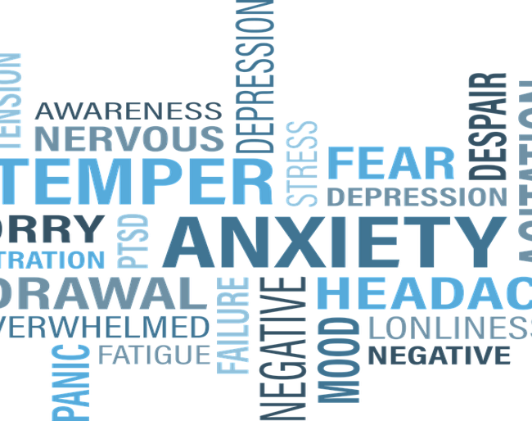
Co-Occurring Substance Use & Mental Disorders
Notes:
Facilitator Script:
Now let’s shift our attention to the topic of co-occurring substance use and mental disorders…

Slide 11
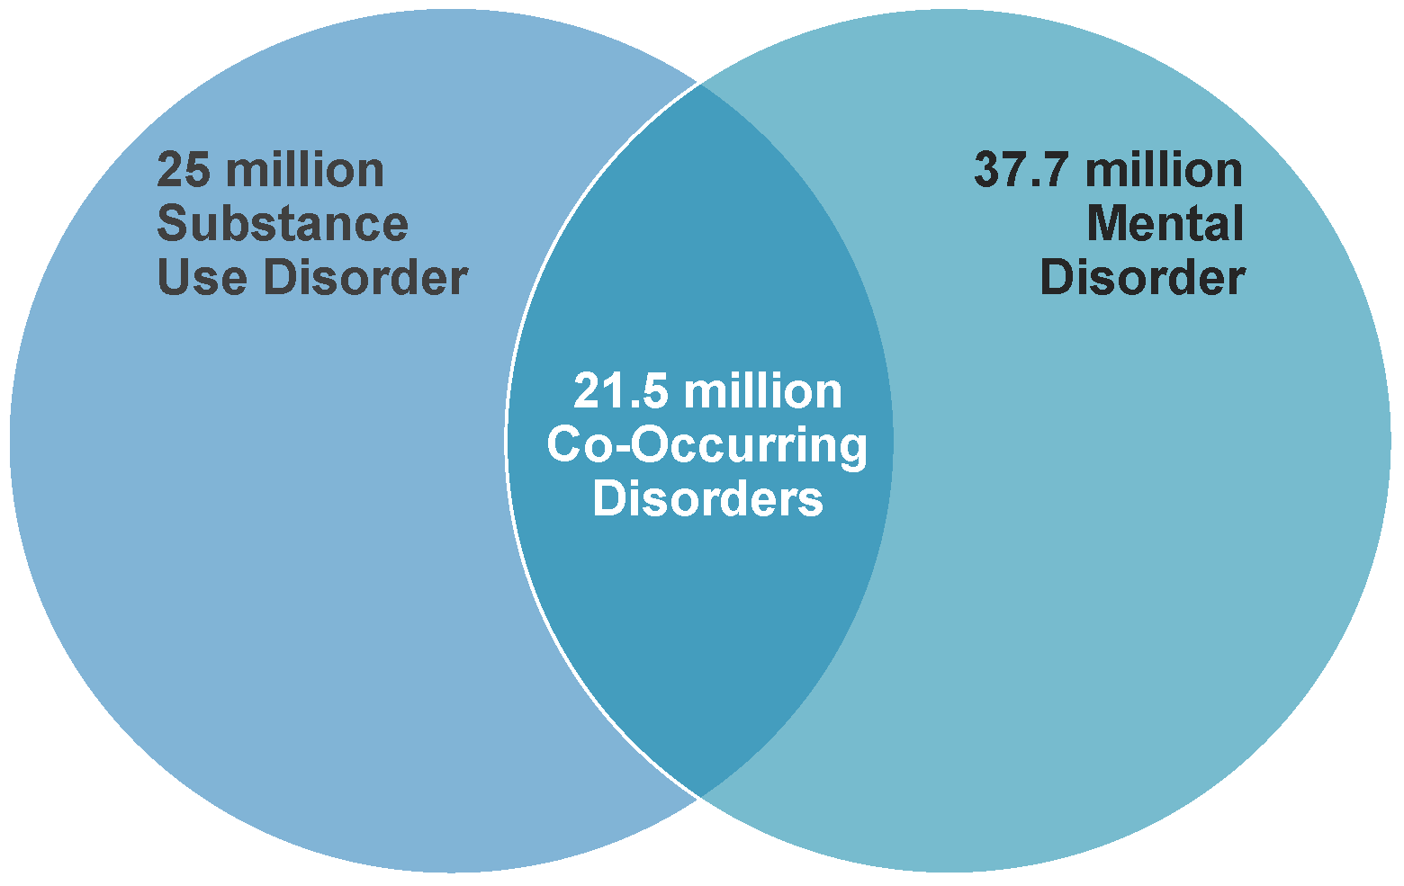
Prevalence of Co-Occurring Disorders
Notes:
Facilitator Script:
As an important recap to module one, co-occurring disorders are increasingly common. According to SAMHSA’s 2022 National Survey on Drug Use and Health, over 21.5 million adults met this diagnostic criterion which, if you recall, just means being affected by both a substance use and mental disorder at the same time. This may present as a substance use disorder in combination with a mood disorder such as depression or bipolar disorder; or an anxiety disorder such as post-traumatic stress disorder (PTSD); or for some individuals a psychotic disorder like schizophrenia (among many other different types). Regardless of the specific type, it’s important to remember that the severity of the co-occurring disorder can vary from mild, moderate, or severe. Sometimes one disorder can mask or complicate the symptoms of the other, making it difficult to differentiate for diagnostic and treatment planning purposes.
Now, that we have covered the latest data on prevalence, let’s spend some time going over the most common types of co-occurring mental disorders…
Additional Resources:
N/A
Slide Citations:
(Substance Abuse and Mental Health Services Administration, 2023b)
Script Citations:
(Substance Abuse and Mental Health Services Administration, 2023b)
Full Citations:
Substance Abuse and Mental Health Services Administration. (2023b). Key substance use and mental health indicators in the United States: Results from the 2022 national survey on drug use and health (NSDUH). HHS Publication No. PEP23-07-01-006, NSDUH Series H-58. U.S. Department of Health and Human Services. https://www.samhsa.gov/data/report/2022-nsduh-annual-national-report

Slide 12
Common Types of Co-Occurring Mental Disorders
Mood
Anxiety
Psychotic
Personality
Notes:
Facilitator Script:
So, the most common types of co-occurring mental disorders generally fall into these four categories: mood, anxiety, psychotic, and personality.
Mood disorders are a classification of mental health diagnoses that are marked by impairments to a person’s emotional state of well-being—particularly how we think and feel, and these changes begin to interfere with our ability to function in our everyday lives. Common symptoms of mood disorders include excessive sadness, withdrawal, isolation, fatigue, irritability, poor concentration, sleep disturbances, changes in appetite, and at times suicidal thoughts and behaviors. Like all mental health diagnoses, mood disorders range in severity from mild, moderate, to severe with some causing short-term temporary challenges while others are considered lifelong conditions.
Anxiety disorders (on the other hand) are a group of related mental health diagnoses that share one commonality which is a level of persistent, excessive fear or worry that manifests both physically and emotionally. Common symptoms include apprehension, dread, restlessness, hypervigilance, racing heart, shortness of breath, sweating, upset stomach, headaches, fatigue, or insomnia. Like mood disorders, anxiety disorders are marked by their level of interference with our normal daily functioning and are the most common of all mental health conditions.
There are also psychotic disorders, which are a group of severe mental disorders characterized by their disconnection from reality. The two telltale symptoms of these disorders include delusions (or false beliefs) and hallucinations (false perceptions), but other common symptoms include disorganized thinking, incoherent speech, unusual behavior, and poor hygiene. Onset of psychotic disorders typically appear in late adolescence into early adulthood, affecting both males and females equally.
Lastly, we have personality disorders which are a group of mental disorders marked by rigid and unhealthy patterns of thinking and relating thereby causing significant challenges related to school, work, friendships, and relationships. Personality disorders are organized into three clusters based on common characteristics and symptoms:
Cluster A is marked by odd or eccentric thinking and behavior; personality disorders in this cluster include paranoid, schizoid, and schizotypal;
Cluster B is marked by overly dramatic, emotional or unpredictable thinking and behavior; and include personality disorders such as antisocial, borderline, histrionic, and narcissistic; and
Finally, Cluster C is marked by anxious or fearful thinking and behavior which includes avoidant, dependent, and obsessive-compulsive personality disorders.
Onset of personality disorders also typically occur in late adolescence into early adulthood and often cause significant disruption to not only the lives of those affected but also to those closest to them.
Additional Resources:
N/A
Slide Citations:
N/A
Script Citations:
(Substance Abuse and Mental Health Services Administration, 2023a)
Full Citations:
Substance Abuse and Mental Health Services Administration. (2023a). Co-occurring disorders and other health conditions. U.S. Department of Health and Human Services. https://www.samhsa.gov/medications-substance-use-disorders/medications-counseling-related-conditions/co-occurring-disorders

Slide 13
Three Models of
Care Management for
Co-Occurring Disorders
Coordinated
Co-located
Integrated
Notes:
Facilitator Script:
And finally, SAMHSA recognizes three specific models of care management for co-occurring disorders: coordinated, co-located, and integrated.
Coordinated care models refer to when an individual receives care from two separate practitioners—one who is qualified to treat the substance use disorder and one who is qualified to treat the mental disorder. The two practitioners then ideally coordinate treatment to support their client’s recovery and well-being. For decades this was the standard of care in the field largely due to not having the scientific advancements, resources, and trained professionals to offer anything beyond this.
Co-located care models improved upon the well documented challenges of coordinated care models by housing both substance use and mental health treatment providers together in one office setting. While this model does not solve the issue of having two separate practitioners it does help considerably in reducing communication and other logistical challenges thereby improving the level of collaborative partnership which directly benefits the consumer (or in our case, court-involved families).
Ideally though, all individuals affected by co-occurring disorders would have access to integrated care models. Like the name implies integrated care models screen for both substance use and mental disorders at the same time and follow this up with developing an integrated treatment plan. In this model, treatment is also provided by one practitioner (or a team of practitioners) who are trained and qualified to treat both conditions offering consumers a more robust recovery experience and in turn improved outcomes such as reduced or discontinued use of substances, improvements to mental health symptoms including decreased hospitalizations and reduced medication interactions, and an overall improved quality of life.
Prompts for Participants:
Now a question for the large group…On average, which care management model are child welfare-involved families receiving in your state and local communities—coordinated, co-located, or integrated? And if not integrated, what have been the challenges to implementation?
Additional Resources:
Ward, A., Barry, K., Laliberte, T., & Meyer-Kalos, P.: Supporting Recovery in Parents with Co-Occurring Disorders in Child Welfare. No. 26 (2016)
Substance Abuse and Mental Health Services Administration: Treatment Improvement Protocol (TIP) 42: Substance Use Treatment for Persons With Co-Occurring Disorders (2020)
Slide Citations:
N/A
Script Citations:
(Substance Abuse and Mental Health Services Administration, 2009; Substance Abuse and Mental Health Services Administration, 2022)
Full Citations:
Substance Abuse and Mental Health Services Administration. (2009). Integrated treatment for co-occurring disorders: Building your program. (DHHS Pub. No. SMA-08-4366). U.S. Department of Health and Human Services. https://store.samhsa.gov/sites/default/files/d7/priv/ebp-kit-building-your-program-10112019.pdf
Substance Abuse and Mental Health Services Administration. (2022). Co-occurring disorders: Diagnoses and integrated treatments. U.S. Department of Health and Human Services. https://www.samhsa.gov/co-occurring-disorders

Slide 14
Mental Scategories
Small Group Activity
Notes:
Facilitator Script:
Now that we have some foundational knowledge under our belts—how about we put it to the test?! Let’s convene in small groups of (X) number at your tables. For this activity, each group will receive a large piece of easel paper with the four common types of co-occurring mental disorders listed. You’ll receive an envelope with 20 various mental diagnoses listed on little post-it notes. You and your group members will have (x) amount of time to properly ‘scategorize.’ First group to complete the task will walk us through their answers in a large group setting and the group with the most correct answers wins…bragging rights!!
Materials Needed:
Large Easel Paper (Pre-filled with sections for Mood, Anxiety, Psychotic & Personality)
Envelopes containing 20 pre-filled small post-it notes containing one mental diagnosis (one per small group—prep based on size of each training)
Specific diagnoses for the 20 pre-filled post-it notes:
Mood:
Major Depression
Bipolar I
Cyclothymia
Seasonal Affective
Postpartum Depression
Anxiety:
Obsessive-Compulsive
Agoraphobia
Post-Traumatic Stress
Social Phobia
Body Dysmorphia
Psychotic:
Shared Psychosis
Substance-Induced Psychosis
Schizophrenia
Schizoaffective
Schizophreniform
Personality:
Histrionic
Narcissistic
Schizoid
Paranoid
Antisocial
___________________________________________________________
*Alternative Instructions for Virtual Training
Use breakout rooms feature on your respective virtual platform to allow for small group activity. Once groups are assigned to breakout rooms provide them access to a de-categorized list of the 20 specific mental health diagnoses listed below by adding to the group chat. Use the same talking points to set up the virtual small group activity…
You and your group members will have (x) amount of time to properly ‘scategorize.’ First group to complete the task will walk us through their answers in a large group setting and the group with the most correct answers wins…bragging rights!!
Materials Needed:
*Be sure to de-categorize the list below before adding it to the chat box.
Mood:
Major Depression
Bipolar I
Cyclothymia
Seasonal Affective
Postpartum Depression
Anxiety:
Obsessive-Compulsive
Agoraphobia
Post-Traumatic Stress
Social Phobia
Body Dysmorphia
Psychotic:
Shared Psychosis
Substance-Induced Psychosis
Schizophrenia
Schizoaffective
Schizophreniform
Personality:
Histrionic
Narcissistic
Schizoid
Paranoid
Antisocial

Slide 15

Domestic Violence & Co-Occurring Disorders
Notes:
Facilitator Script:
Let’s now keep all that information about co-occurring disorders in mind as we move into a discussion about how it may overlap with domestic violence.

Slide 16
An Introduction to Domestic Violence (DV)
Definitions & Parameters
Other Qualifying Indicators
Types of DV
Rates of Prevalence
Notes:
Facilitator Script:
Another example of preferred terminology used within systems includes the reference to domestic violence in place of other synonymous terms.
Definitions and Parameters: As defined by the law, domestic violence is any act of violence that occurs within a household between any two individuals residing together. This could mean violence between a couple, a parent and child, two roommates, etc. Again, the emphasis on any two individuals residing in the same home together. For purposes of this module, domestic violence is centered around violence occurring in families involving two parents or caregivers.
Types of DV: Power and control between domestic partners may present vastly different from one to the next. In addition to the telltale forms of physical or sexual violence, we should also understand how other forms manifest in relationships which may include attempts to exert power and control through emotional, psychological, financial, spiritual, reproductive, and other tactical means.
Other Qualifying Indicators:
Other important qualifying indicators of domestic violence include types of partnerships. DV includes all forms of relationships including current or former spouses, domestic partners, boyfriends and girlfriends, dating partners including casual sex partners. In addition to type of partnership, information related to type of violence, level of connection, and the degree or amount of contact is critical for assessment and service planning.
Rates of Prevalence:
So just how common is DV? According to data from the Centers for Disease Control and Prevention’s, or CDC’s National Survey, roughly 41% of women and 26% of men have experienced DV during their lifetime. This survey was limited to sexual and physical acts of violence, including stalking, and therefore does not account for all the other various forms of power and control experienced within domestic partnerships. A separate figure from the CDC estimated that over 61 million women and 53 million men have experienced emotional or psychological aggression during their lifetime which might be a more accurate figure capturing the depth of this public health issue.
Additional Resources:
N/A
Slide Citations:
N/A
Script Citations:
(Hidalgo, 2023)
Full Citations:
Hidalgo, R. (2023). DVAM 2023: Ending domestic violence requires us all to work together. U.S. Department of Justice, Office on Violence Against Women. https://www.justice.gov/archives/ovw/blog/dvam-2023-ending-domestic-violence-requires-us-all-work-together#:~:text=Data%20from%20the%20last%20National,intimate%20partner%20violence%2Drelated%20impact

Slide 17
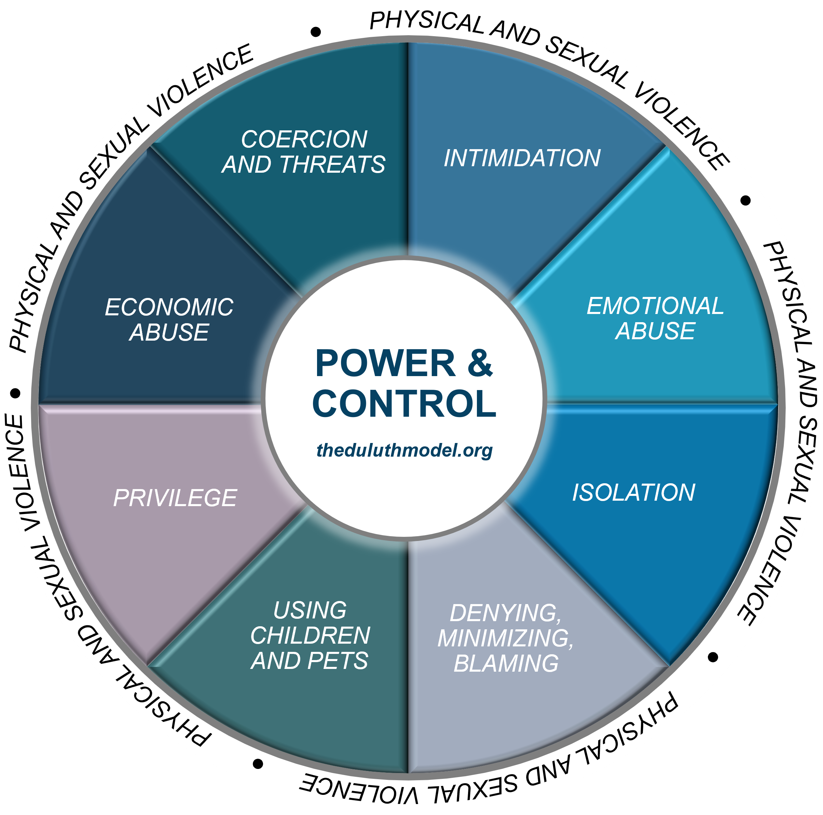
Understanding
DV Dynamics
Notes:
Facilitator Script:
So now that we have covered an introduction to domestic violence including definitions, types, qualifying indicators, and its prevalence—let’s now move into a discussion about understanding DV dynamics. This is a de-identified version of the Duluth Model’s Power and Control Wheel. This adapted version only lists out the broader level tactics used to exert power and control within domestic partnerships which is different from the original version informed by focus groups held with female survivors during the mid-to-late eighties.
As we move into an experiential exercise, it’s important to note that while these broader level tactics apply to all types of domestic partnerships, details in how they manifest may present differently due to factors beyond traditional stereotypes or assumptions about DV.
Additional Resources:
Domestic Abuse Intervention Programs: The Duluth Model Wheel Library (2017)
National Domestic Violence Hotline (n.d.)
Strong Hearts Native Helpline (2024)
Slide Citations:
(Domestic Abuse Intervention Programs, 2017)
Script Citations:
(Domestic Abuse Intervention Programs, 2017)
Full Citations:
Domestic Abuse Intervention Programs. (2017). Understanding the power and control wheel. The Duluth Model.​
https://www.theduluthmodel.org/wheels/

Slide 18
Identifying Behavioral
Indicators of DV
Small Group Activity
Notes:
Facilitator Script:​
​
Let’s now reconvene in our small groups for an activity on identifying behavioral indicators for each category of the power and control wheel with consideration to various types of domestic partnerships. Let’s plan to meet in our small groups for (x amount of time) before reconvening for a large group report out and discussion. ​
Here’s an example to get you started in your small groups:
Isolation:
An example of isolation as a power and control tactic would be when a person doesn’t allow their partner to have any meaningful social connections such as not allowing them to work, or maintain relationships with family, friends, or neighbors.
Now it’s your turn, let’s plan to reconvene as a large group in [x] minutes!
​
Materials Needed:
-Large Easel Paper ​
-Markers​
​
_______________________________________________________________​
*Alternative Instructions for Virtual Training​
​
Use breakout rooms feature on your respective virtual platform to allow for small group activity or proceed with an individual activity followed by large group discussion.​

Slide 19
Understanding DV & Substance Use Coercion
26%
used substances as a coping mechanism for DV dynamics
27%
24.4%
were forced or pressured to use substances or use more than they wanted to
noted being
afraid to
seek help due to fear of reported consequences
37.5%
received threats that their substance use would be reported to employers, LEA, or CPS
15.2%
15.2%
acknowledged trying to seek treatment but
60%
were prevented or discouraged
Notes:
Facilitator Script:​
Now let’s focus on the relationship between DV and substance use. Substance use may play a facilitative role in DV, meaning it might either precipitate or exacerbate the level of violence between partners. A form of DV that we haven’t already discussed in this toolkit involves substance use coercion, or tactics used by the partner using violence to control and/or manipulate their partner’s use of substances, access to treatment and other sources of protection.
The National Domestic Violence Hotline in collaboration with the National Center on Domestic Violence, Trauma and Mental Health administered a first of its kind survey to hotline callers who were not in immediate crisis over a six-week period. A total of 3,248 respondents agreed to participate in the survey and this is what the results found:
26% acknowledged using substances as a coping mechanism in response to violence or coercive behavior,
27% reported being forced or pressured to use substances and/or use more than they wanted by their partner,
37.5% stated that their partner threatened to report their substance use to employers, law enforcement, or child protective services to exert power and control,
24.4% noted being afraid to seek out help or sources of protection because their partner said they would face consequences for being under the influence of substances, for example, being arrested or having their children taken away, and
15.2% acknowledged trying to seek treatment for their substance use in the last few years but also that 60% of those same respondents had partners who prevented or discouraged them from participating.
Overall, 43% of survey respondents experienced at least one type of substance use coercion.
Additional Resources:
National Center on Domestic Violence, Trauma & Mental Health Website (2023)
Slide Citations:
(Warshaw & Zapata-Alma, 2025)
Script Citations:
(Warshaw & Zapata-Alma, 2025)
Full Citations:
Warshaw, C., & Zapata-Alma, G. (2025). In honor of domestic violence awareness month: Responding to substance use coercion in treatment and recovery services. National Center on Domestic Violence, Trauma, and Mental Health, Addiction Technology Transfer Center Network. https://attcnetwork.org/in-honor-of-domestic-violence-awareness-month-responding-to-substance-use-coercion-in-treatment-and-recovery-services/

Slide 20



Child Welfare Involvement as a Power & Control Tactic
Escalating violence and coercive behavior
Withholding finances or jeopardizing employment status
Making false reports to child abuse hotlines
Filing false police reports or restraining orders
Notes:
Facilitator Script:
As the hotline survey results indicated, a person using violence may use child welfare involvement to further assert power and control in their partnership. This will be different for all families experiencing violence but may include threats or retaliations such as:
Escalating violence and coercive behavior
Withholding finances or jeopardizing employment status
Making false reports to child abuse hotlines
Filing false police reports or restraining orders
Let’s keep all this information in mind as we transition into a discussion about differentiating between DV and child maltreatment and the complexities that mandated reporting laws present…
Additional Resources:
N/A
Slide Citations:
(HeadStart ECLKC, 2024)
Script Citations:
(HeadStart ECLKC, 2024)
Full Citations:
HeadStart ECLKC. (2024). Domestic violence and child abuse reporting. https://eclkc.ohs.acf.hhs.gov/publication/domestic-violence-child-abuse-reporting

Slide 21

DV & Child Maltreatment: Understanding the Complexities of Mandated Reporting Laws
Notes:
Facilitator Script:
As child welfare workers, a critical first step to promoting safety and healing for children, parents, and families experiencing violence is to be able to differentiate between domestic violence from co-occurring domestic violence and child maltreatment. This can be a challenging task for many reasons, but let’s begin by understanding how differences in state, local, and tribal laws influence mandated reporting practices across communities.
First, there are considerable differences in how mandated reporting laws define child abuse and neglect, including the overlap with DV exposure. In some localities, the law mandates that a report be made for any known or suspected DV exposure, while in others, the law allows for reporter discretion—such as consultation with child protective services and local law enforcement agencies. And then in some other instances, the law does not include any specific reference or guidance; this is why as mandated reporters, it is especially important for you to be familiar with your jurisdiction’s reporting requirements.
Additional Resources:
Child Welfare Information Gateway: State Statutes Search (n.d.)
Slide Citations:
N/A
Script Citations:
(Mandated Reporter Training, 2022; HeadStart ECLKC, 2024; UCLA Pritzker Center, 2021)
Full Citations:
Mandated Reporter Training. (2022). Which states have mandatory domestic violence reporting? https://mandatedreportertraining.com/resources/blog/which-states-have-mandatory-domestic-violence-reporting/
HeadStart ECLKC. (2024). Domestic violence and child abuse reporting. https://eclkc.ohs.acf.hhs.gov/publication/domestic-violence-child-abuse-reporting
UCLA Pritzker Center. (2021). Child welfare and domestic violence: The report on intersection and action. https://pritzkercenter.ucla.edu/wp-content/uploads/2021/05/Pritzker-Domestic-Violence-Report-Endnotes_final.pdf

Slide 22




DV Interagency Response Efforts
Coordinated Community Response
Enhanced Screening & Emergency Response Protocols
Evidence-Informed & Practice-Based Approaches
Notes:
Facilitator Script:
As we’ve learned, domestic violence is a serious public health matter—one that requires multiagency collaboration to ensure proper identification and intervention for families experiencing violence. A coordinated community response to domestic violence brings together stakeholders from child welfare, family violence service providers including survivor advocates, substance use and mental health treatment providers, law enforcement agencies, and the judicial system with the goal of advancing interagency response efforts—more specifically opportunities for enhanced collaboration, cross-training, and trauma-informed service provision.
For child welfare jurisdictions, this includes opportunities for enhanced screening and emergency response protocols that 1) promote identification and accountability of the person causing harm through use of violence, 2) amplify the voice of the person experiencing violence related to defining safety and healing for themselves and their children, and 3) prioritize the physical, emotional, and psychological safety for all involved parties—children, parents, and families experiencing violence as well as the professionals charged with immediate intervention and ongoing service provision.
So, what are some actionable policy and practice improvements specific to child welfare intervention for families experiencing violence? An environmental scan highlights several evidenced-informed and practice-based approaches. These include 1) ensuring that allegations are filed or screened in under the name of the parent using violence and not the parent experiencing violence, 2) engaging the parent experiencing violence to identify family strengths and protective capacities and working together to enhance safety and prevent family separation whenever possible, and 3) partnering with community agencies for co-location of family violence prevention specialists or survivor advocates in child welfare settings to provide essential functions, including:
Engaging and supporting children, parents, and families experiencing violence
Collaborating with child welfare workers for enhanced casework practice through consultation and service planning
Improving interagency collaboration and coordinated community response efforts through subject matter expertise and cross-training learning opportunities
Additional Resources:
Quality Improvement Center on Domestic Violence in Child Welfare: Adult & Child Survivor-Centered Approach for Addressing Domestic Violence (2019)
National Center on Substance Abuse and Child Welfare: Strengthening Systems Collaboration for Families: The Intersection of Domestic Violence and Co-Occurring Substance Use and Mental Health Disorders, (2025)
Battered Women's Justice Project: Reimagining Coordinated Community Response (CCR): A Focus on Survivor-Centered Design (2022)
Center for Justice Innovation: Coordinated Community Response Definition Fact Sheet (2022)
Minnesota Department of Human Services: Minnesota’s Best Practice Guide for the Co-Occurrence of Child Maltreatment and Domestic Violence (2021)
UCLA Pritzker Center: Child Welfare and Domestic Violence: The Report on Intersection and Action, (2021)
Starr, R. W., Summers, A., Malhotra, K., Gonzalez, C., Branch, E. J., & Sicafuse, L.: Moving Toward Evidence-Based Practices: A Guide for Domestic Violence Organizations (2016)
Slide Citations:
N/A
Script Citations:
(Warrier & Lizdas, 2022; Center for Justice Innovation, 2022; UCLA Pritzker Center, 2021; Minnesota Department of Human Services, 2021)
Full Citations:
Warrier, S., & Lizdas, K. (2022). Reimagining coordinated community response (CCR): A focus on survivor-centered design. Battered Women's Justice Project. https://bwjp.org/wp-content/uploads/2022/08/CCR_Report.pdf
Center for Justice Innovation. (2022). Coordinated community response definition [Fact sheet]. National Crime Victim Law Institute. https://www.innovatingjustice.org/sites/default/files/media/document/2024/Coordinated%20Community%20Response%20Definition%20Fact%20Sheet.pdf
UCLA Pritzker Center. (2021). Child welfare and domestic violence: The report on intersection and action. https://pritzkercenter.ucla.edu/wp-content/uploads/2021/05/Pritzker-Domestic-Violence-Report-Endnotes_final.pdf
Minnesota Department of Human Services. (2021). Minnesota’s best practice guide for the co-occurrence of child maltreatment and domestic violence. https://edocs.dhs.state.mn.us/lfserver/Public/DHS-3490-ENG

Slide 23
Local Protocols Guiding Practice with Children, Parents & Families Experiencing Violence
Large Group Discussion
Notes:
Facilitator Script:
So, while we’ve covered more general information on evidence-informed and practice-based approaches, let’s now hear what is happening locally within our own communities.
Prompt for Large Group Discussion:
How are local protocols guiding our practice with children, parents, and families experiencing violence? Would anyone like to share about current screening, emergency response, or field safety protocols?
This was very informative, thank you all for sharing about your local protocols. Let’s now transition to a discussion about DV screening tools and how these can support proper identification and intervention for parents experiencing violence.

Slide 24

DV Screening
Tools
ABUSE ASSESSMENT SCREEN (AAS)
HUMILIATION, AFRAID, RAPE, and KICK (HARK)
ONGOING VIOLENCE ASSESSMENT TOOL (OVAT)
PARTNER VIOLENCE SCREEN (PVS)
DANGER ASSESSMENT 5 (DA-5)
WOMAN ABUSE SCREENING TOOL (WAST)
Notes:
Facilitator Script:
Screening for DV will also vary depending on type of care setting or service provision. The United States Preventative Services Task Force (USPSTF) and the Department of Health and Human Services recommend DV screening and counseling as an integrated part of preventative health care services—specifically those of childbearing age or older, including vulnerable adults. This recommendation has led to more efforts at promoting universal screening during routine annual healthcare visits—and the extension of this recommendation into child welfare settings is yet another example of an evidence-informed and practice-based approach to promoting a future without violence.
While an environmental scan produced numerous options for validated DV screening tools, the tools highlighted here represent those that are accessible at no cost to service providers:
The Abuse Assessment Screen (AAS) is a tool administered via provider and contains a total of five standardized questions, including a body map that marks the area of injury with a corresponding incident rating using a 1-6 scale.
The Ongoing Violence Assessment Tool (OVAT) previously referred to as the Ongoing Abuse Screen (OAS) is an adaptation of the AAS allowing for screening of ongoing DV. The tool is administered via self report and contains four standardized questions—three of which are yes or no, with the final question answered using a 5-point Likert scale.
The Danger Assessment 5 (DA-5) is an adaptation of the full Danger Assessment and is administered via self report; it contains five standardized yes or no questions with a scoring key identifying next steps for the provider conducting the screening.
The Humiliation, Afraid, Rape, and Kick (HARK) is a tool administered via self report and contains four standardized yes or no questions with one point given for every yes response.
The Partner Violence Screen (PVS) is a provider-administered tool and contains three standardized questions designed to assess physical DV in the last year, as well as current levels of safety.
And finally, the Woman Abuse Screen Tool (WAST) is administered via self report and contains seven standardized questions designed to assess for physical and emotional violence.
Prompts for Participants:
Alright, now I’d like to hear from you all. Has your agency begun screening for DV? And if so, which tools are you currently using?
Additional Resources:
N/A
Slide Citations:
N/A
Script Citations:
(U.S. Preventive Services Task Force, n.d.; de Boinville, 2013)
Full Citations:
U.S. Preventive Services Task Force. (n.d.). USPSTF recommendations app for web and mobile devices. Prevention TaskForce. https://www.uspreventiveservicestaskforce.org/apps/
de Boinville, M. (2013). Screening for domestic violence in health care settings [Policy brief]. Office of the Assistant Secretary for Planning and Evaluation (ASPE), Office of Human Services Policy, U.S. Department of Health and Human Services. https://aspe.hhs.gov/reports/screening-domestic-violence-health-care-settings-0

Slide 25

DV Exposure & Child Welfare Intervention
Notes:
Facilitator Script:
Let’s now take what we have learned about family violence—both DV and DV exposure—and begin exploring key considerations for assessment of safety and risk.

Slide 26
Key Considerations When Assessing Safety & Risk
Nature & Severity of DV Dynamics
Family History of DV Dynamics
Level of Perceived Safety During &
Following the DV Dynamics
Level of Parental Protective Capacities
Notes:
Facilitator Script:
Proper identification and intervention with families experiencing violence can be challenging, but our focus as child welfare workers should always remain on understanding the level of risk to the child and increasing safety and protective capacities for the family—with services and supports directed at both the parent/caregiver using violence and the parent/caregiver experiencing the violence.
Let’s first start by reviewing key considerations for when assessing the level of risk to a child. This will include information that can inform the nature, severity, and frequency of family violence. This includes details about the level of exposure to violent and/or coercive behavior, how long it has been going on for, level of perceived safety both during and following the occurrence of violent or coercive behavior, and the level of parental protective capacities to help mitigate risk and increase child and family safety.
Additional Resources:
N/A
Slide Citations:
N/A
Script Citations:
(HeadStart ECLKC, 2024; Minnesota Department of Human Services, 2021)
Full Citations:
HeadStart ECLKC. (2024). Domestic violence and child abuse reporting. https://eclkc.ohs.acf.hhs.gov/publication/domestic-violence-child-abuse-reporting
Minnesota Department of Human Services. (2021). Minnesota’s best practice guide for the co-occurrence of child maltreatment and domestic violence. https://edocs.dhs.state.mn.us/lfserver/Public/DHS-3490-ENG

Slide 27
Assessing for Level of Risk
Specific to DV Exposure
Large Group Discussion
Notes:
Facilitator Script:
Let’s now spend some time together discussing as a large group the types of questions we should be asking when assessing for level of risk specific to DV exposure.
Here’s an example to get us started:
Has the violence and coercive behavior occurred before? Or escalated over time?
Prompt for Large Group Discussion:
What are some other examples from your experience working with families who have experienced violence?

Slide 28





Questions to Consider When Assessing for Level of Risk
Has the violence and coercive behavior occurred before? Or escalated over time?
Does the parent/caregiver using violence and coercive behavior prevent the other parent/caregiver from meeting their child’s needs?
For example, does the parent/caregiver using violence prevent the child from attending school or doctor’s appointments?
Does the parent/caregiver using violence and coercive behavior also struggle with substance use or co-occurring mental health conditions?
If yes, how may this be precipitating or exacerbating the level of violence? And how may this be affecting their child’s safety and well-being?
Does the parent/caregiver experiencing violence and coercive behavior also struggle with substance use or co-occurring mental health conditions?
If yes, how may this be affecting their child’s safety and well-being?
Has the child expressed fear of being harmed by the parent/caregiver using violence and coercive behavior? Or expressed fear that their other parent/caregiver may be seriously harmed?
Notes:
Facilitator Notes:
As a follow up to the large group discussion, walk participants through the list of questions to consider when assessing for level of risk specific to DV exposure.
Facilitator Script:
Alright, let’s check out how we did! Questions to consider when assessing for level of risk specific to DV exposure include:
Has the violence and coercive behavior occurred before? Or escalated over time?
Does the parent/caregiver using violence and coercive behavior prevent the other parent/caregiver from meeting their child’s needs?
For example, does the parent/caregiver using violence prevent the child from attending school or doctor’s appointments?
Does the parent/caregiver using violence and coercive behavior also struggle with substance use or co-occurring mental health conditions? If yes, how may this be precipitating or exacerbating the level of violence? And how may this be affecting their child’s safety and well-being?
Does the parent/caregiver experiencing violence and coercive behavior also struggle with substance use or co-occurring mental health conditions? If yes, how may this be affecting their child’s safety and well-being?
Has the child expressed fear of being harmed by the parent/caregiver using violence and coercive behavior? Or expressed fear that their other parent/caregiver may be seriously harmed?
Additional Resources:
N/A
Slide Citations:
(HeadStart ECLKC, 2024; Minnesota Department of Human Services, 2021)
Script Citations:
(HeadStart ECLKC, 2024; Minnesota Department of Human Services, 2021)
Full Citations:
HeadStart ECLKC. (2024). Domestic violence and child abuse reporting. https://eclkc.ohs.acf.hhs.gov/publication/domestic-violence-child-abuse-reporting
Minnesota Department of Human Services. (2021). Minnesota’s best practice guide for the co-occurrence of child maltreatment and domestic violence. https://edocs.dhs.state.mn.us/lfserver/Public/DHS-3490-ENG

Slide 29

Additional Questions to Consider…
Has the child ever been injured as a result of the parent/caregiver’s use of violence and coercive behavior? Or has the child ever intervened to deescalate or protect their parent?
Has the parent/caregiver using violence and coercive behavior ever threatened to harm the child?
Has the child shown any signs of concerning behavior in response to the parent/caregiver’s use of violence and coercive behavior?
For example, has the child used violence toward other children or siblings?
Does the parent/caregiver using violence and coercive behavior have access to firearms or other weapons?
If yes, have they used or threatened to use them to cause harm to the other parent/caregiver, child, or family pets?
Has the parent/caregiver using violence and coercive behavior ever threatened to kill the other parent/caregiver? Or threatened to kill the children?
Has the parent/caregiver using violence and coercive behavior ever threatened to commit suicide?
Notes:
Facilitator Script:
And some additional questions to consider:
Has the child ever been injured as a result of the parent/caregiver’s use of violence and coercive behavior? Or has the child ever intervened to deescalate their parent/caregiver’s use of violence and coercive behavior? Or has the child ever intervened to protect their parent/caregiver experiencing violence or coercive behavior?
Has the parent/caregiver using violence and coercive behavior ever threatened to harm the child?
Has the child shown any signs of concerning behavior in response to the parent/caregiver’s use of violence and coercive behavior?
For example, has the child used violence toward other children or siblings?
Does the parent/caregiver using violence and coercive behavior have access to firearms or other weapons? If yes, have they used or threatened to use them to cause harm to the other parent/caregiver, child, or family pets?
Has the parent/caregiver using violence and coercive behavior ever threatened to kill the other parent/caregiver? Or threatened to kill the children?
Has the parent/caregiver using violence and coercive behavior ever threatened to commit suicide?
Additional Resources:
N/A
Slide Citations:
(HeadStart ECLKC, 2024; Minnesota Department of Human Services, 2021)
Script Citations:
(HeadStart ECLKC, 2024; Minnesota Department of Human Services, 2021)
Full Citations:
HeadStart ECLKC. (2024). Domestic violence and child abuse reporting. https://eclkc.ohs.acf.hhs.gov/publication/domestic-violence-child-abuse-reporting
Minnesota Department of Human Services. (2021). Minnesota’s best practice guide for the co-occurrence of child maltreatment and domestic violence. https://edocs.dhs.state.mn.us/lfserver/Public/DHS-3490-ENG

Slide 30



Developmental Considerations
When Assessing for Level of Risk
Physical
Emotional
Behavioral
The Relationship Between Violence Exposure and Trauma
Notes:
Facilitator Script:
So, in addition to the types of questions we should be asking when assessing for level of risk, we also have some important developmental considerations to keep in mind as well. As we’ve learned from previous modules, adverse childhood experiences including exposure to domestic violence can cause traumatic stress for children and adolescents. Responses to traumatic stress will range depending on considerations such as age, developmental stage, along with other factors including nature and severity of violence exposure, and the presence of individual and familial strengths and protective capacities. Let’s review some important developmental considerations when assessing level of risk…
For infants and toddlers, while they can’t understand what is happening developmentally, they can indeed sense the violence through what they hear and what they feel from their caregivers and their environment. Traumatic stress at this stage of development will often present as increased dysregulation such as crying, fussiness, and challenges with soothing the infant or toddler.
Similarly, for preschool-aged children, they also rely heavily on their senses—what they see, hear, and feel. Traumatic stress at this stage of development will often present as regressive behavior such as thumb sucking, increased clinginess, nightmares, and bedwetting.
School-aged children begin to have a better understanding of the complexities of family violence. Traumatic stress at this stage of development will often present as somatic complaints such as headaches or stomachaches, difficulty concentrating in the classroom, withdrawn or reactive behavior including increased anger or irritability.
And finally, adolescents are more likely to demonstrate the long-term effects of violence exposure through their choices and behaviors. Traumatic stress at this stage of development will often present as engaging in high-risk behavior such as fighting, skipping school, experimenting with alcohol and other drugs, and repeating patterns of abuse—both the person using violence and coercive behavior and the person experiencing violence and coercive behavior.
As we touched on in module one, when the cumulative effects of emotional stress or adverse childhood experiences are not dealt with timely or appropriately, the level of toxic stress can very much escalate to the point of clinical intervention and diagnosis with a host of serious, long-term health and well-being implications.
Additional Resources:
Casey Family Programs: How Can Child Welfare Partner with Other Systems to Support Families Experiencing Domestic Violence? (2024)
Slide Citations:
N/A
Script Citations:
(Casey Family Programs, 2024; Cunningham & Baker, 2007)
Full Citations:
Casey Family Programs. (2024). How can child welfare partner with other systems to support families experiencing domestic violence? https://www.casey.org/child-welfare-domestic-violence-collaboration/
Cunningham, A. & Baker, L. (2007). Little eyes, little ears: How violence against a mother shapes children as they grow. National Clearinghouse on Family Violence, Family Violence Prevention Unit, Public Health Agency of Canada. https://www.socialworkerstoolbox.com/little-eyes-little-ears-how-violence-against-mother-shapes-children-as-they-grow-booklet

Slide 31



  Increasing Safety & Protective Capacities for Families Experiencing Violence
Increased Accountability for the Person Using Violence
Collaborative Engagement of the Person Experiencing Violence
Empowerment-Based Safety Planning for the Family
Notes:
Facilitator Script:
Now as we’ve learned, some families experiencing violence may present with safety considerations that will require child welfare intervention due to the co-occurrence of domestic violence and child maltreatment. For these families, optimal family outcomes will necessitate a coordinated community response to increase safety and protective capacities to prevent further harm while also facilitating the process of healing.
Beginning with the person using violence this will look like increasing accountability through creating pathways for personal responsibility and transformative change including reparations for the harm they have caused to their partner and children. For service planning, this will necessitate greater engagement and support to the person using violence including referral and linkage to abusive partner intervention programs, or APIPs, and individualized safety plans that reinforce accountability and insight into the effects of their use of violence and coercive behavior.
Increasing accountability for the person using violence will also require a change to policies and practices that have historically misdirected responsibility to the person experiencing the violence under the guise of statutory responses such as failure to protect and environmental circumstances statues. Instead, child welfare and family violence experts strongly advocate for collaborative engagement of the person experiencing violence to identify existing protective capacities while working to enhance family safety and stability, such as:
Providing referral and linkage to family violence service providers and resources
Facilitating access to concrete supports and services to ensure the family’s basic needs are being met
Engaging the parent experiencing violence to learn about steps they have already taken to protect their children from harm, including discussion of what has worked and what hasn’t worked in the past
Exploring the benefits and drawbacks of different sources of protection for the children and parent experiencing the violence and co-develop a family safety plan that is achievable and adaptable based on changes to the family’s circumstances
Identifying actionable steps detailing who to call, where to go, and what to do in response to increased violence and coercive behavior
Developing a list of personal and familial items needed during an emergency situation requiring the family to leave and seek immediate safety. Such personal items may include birth certificates, important documents, list of contact information for family, friends, service providers, banking information, insurance cards, etc.
Additional Resources:
Criminal Justice Investment Initiative Creating a Trauma-Informed Abusive Partner Intervention Program (2021)
National Center on Domestic Violence, Trauma, and Mental Health Family-Centered Toolkit for Domestic Violence Programs (2021)
National Center on Domestic Violence, Trauma & Mental Health Guide for Engaging & Supporting Parents Affected by Domestic Violence (2015)
Slide Citations:
N/A
Script Citations:
(Criminal Justice Investment Initiative, 2021; Blumenfeld & Baca, 2021; Blumenfeld, 2015; Minnesota Department of Human Services, 2021)
Full Citations:
Criminal Justice Investment Initiative. (2021). Creating a trauma-informed abusive partner intervention program. https://www.innovatingjustice.org/sites/default/files/media/document/2022/Creating%20a%20Trauma-Informed%20Abusive%20Partner%20Intervention%20Program.pdf
Blumenfeld, S. & Baca, J. (2021). Family-centered toolkit for domestic violence programs. National Center on Domestic Violence, Trauma, and Mental Health. https://ncdvtmh.org/wp-content/uploads/2022/10/NCDVTMH-Family-Centered-Toolkit.pdf
Blumenfeld, S. (2015). Guide for engaging & supporting parents affected by domestic violence. National Center on Domestic Violence, Trauma & Mental Health. https://ncdvtmh.org/wp-content/uploads/2022/10/NCDVTMH_GuideEngagingSupportingParents.pdf
Minnesota Department of Human Services. (2021). Minnesota’s best practice guide for the co-occurrence of child maltreatment and domestic violence. https://edocs.dhs.state.mn.us/lfserver/Public/DHS-3490-ENG

Slide 32










The Five Interrelated Protective Factors for Families Experiencing Violence
Safer & More Stable Conditions
Resilience & Growth Mindset
Social & Emotional Abilities
Social & Spiritual Connections
Nurturing Parent-Child Interactions
Notes:
Facilitator Script:
The Quality Improvement Center on Domestic Violence in Child Welfare or QIC-DVCW developed the Adult & Child Survivor-Centered Approach that includes a Risk and Protective Factors Framework. Protective factors in the context of family violence comprise of individual and relational attributes in addition to environmental and social conditions that help mitigate risk of harm while building individual and familial strengths, healthy development and nurturing relationships, and conditions that support the safety, healing, and well-being for families experiencing violence.
Safer & More Stable Conditions: For families experiencing violence, safer conditions refers to a reduced risk of physical, sexual, or emotional harm including power and control tactics such as threats, retaliations, intimidation, oppression, coercion, and isolation—for both physical and social environments and relationships. Just as each family experiences violence differently, safer conditions will also look different for each family. Similarly, more stable conditions refer to the presence of positive experiences such as the presence of consistent and predictable housing, employment, educational or vocational opportunities, childcare, and other sources of concrete supports and services.
Social & Spiritual Connections: For families experiencing violence, social and spiritual connections refer to healthy and constructive relationships that foster connectedness and positive self-identity. This will also look different for each family but generally represents sustained relationships within their natural network such as family members or peers, as well as community, institutional, and faith-based supports. These connections are valuable resources as they increase trust, belonging, hope, and belief in oneself while also providing concrete, affiliative, emotional, informational and spiritual supports to families experiencing violence.
Resilience & Growth Mindset: For families experiencing violence, resilience and growth mindset refers to an individual or family’s ability to adapt and grow in response to adverse experiences. This includes an individual or family’s ability to cope, problem solve, access and utilize resources that will support personal and familial growth. Resilient and growth mindset families view their adverse experiences as temporary conditions or challenges that can be positively influenced by their own choices or actions and commitment to change.
Nurturing Parent-Child Interactions: For families experiencing violence, nurturing parent-child interactions refers to the presence of at least one parent or caregiver who consistently responds to and meets the needs of the child demonstrating love, nurturance, patience, and attunement. This protective factor is considered the single most important resource for children’s healthy development and for children exposed to family violence, this also extends to their healing, increased sense of safety, and well-being. Similarly, for parents experiencing violence, nurturing parent-child interactions also facilitate a greater sense of self-efficacy—or a belief in their ability to meet their child’s needs in the context of the family violence while also maintaining or strengthening their emotional bond of trust, love, and affection.
Social & Emotional Abilities: For families experiencing violence, social and emotional abilities refers to knowledge, attitudes, and abilities that lend to understanding and responding appropriately to emotions, feeling and demonstrating empathy for others, setting and achieving individual and familial goals, establishing and maintaining healthy and positive relationships, and making responsible decisions and choices. This protective factor helps families who experience violence develop a healthier self-concept; one of increased self-esteem and self-efficacy, enhanced communication and problem-solving skills, and equipped with the tools to manage stress and persevere through adverse challenges or circumstances.
Additional Resources:
Quality Improvement Center on Domestic Violence in Child Welfare: Protective Factors for Survivors of Domestic Violence (2019)
Slide Citations:
(Quality Improvement Center on Domestic Violence in Child Welfare, 2019)
Script Citations:
(Quality Improvement Center on Domestic Violence in Child Welfare, 2019)
Full Citations:
Quality Improvement Center on Domestic Violence in Child Welfare. (2019). Protective factors for survivors of domestic violence [Issue brief]. Futures Without Violence. https://promising.futureswithoutviolence.org/wp-content/uploads/2022/07/FWV-QIC-Protective-Factors-Brief-Final-09-1.pdf

Slide 33
Strategies to Promote
Protective Factors for Families Experiencing Violence
Small Group Activity
Notes:
Facilitator Script:​
​
Let’s now go ahead and reconvene in our small groups. For this activity, each group will receive a large piece of easel paper for you and your group members to record all the strategies you identify for each of the five interrelated protective factors. Let’s plan to meet in our small groups for (x amount of time) before reconvening for a large group report out and discussion. ​
Here’s an example to get everyone started…
Safer & More Stable Conditions:
Identifying significant life stressors and helping the parent experiencing the violence obtain or secure needed resources.
Materials Needed:
-Large Easel Paper ​
-Markers​
​
_______________________________________________________________
​
*Alternative Instructions for Virtual Training​
​
Use breakout rooms feature on your respective virtual platform to allow for small group activity or proceed with an individual activity followed by large group discussion.​

Slide 34
Evidence-Based Interventions for Families
Experiencing Violence
Child Development-Community Policing Program
Child-Parent Psychotherapy
Structured Psychotherapy for Adolescents Responding to Chronic Stress
Trauma-Focused Cognitive Behavioral Therapy
Notes:
Facilitator Script:
Before we wrap up this section, we also wanted to highlight some evidence-based interventions that also offer a path forward for families experiencing violence—through creating a safe place for healing and improved well-being.
The Child Development-Community Policing Program is a secondary prevention model offering crisis intervention and follow-up interventions for DV-exposed children. The model is a collaborative partnership between child mental health professionals and law enforcement agencies and is designed to build parents’ capacity to support their child’s well-being following violence or coercive control dynamics. The model consists of two interventions—the Domestic Violence Home Visit Initiative and the Child and Family Traumatic Stress Initiative.
Child-Parent Psychotherapy, also referred to as CPP, is an intervention model targeting children 0-6 with exposure to at least one traumatic event and/or subsequent mental or behavioral challenges. CPP is rooted in attachment theory but also pulls in techniques from cognitive-behavioral, developmental, social, and trauma-informed modalities. Treatment sessions are held together with the goal of supporting and improving the parent-child relationship.
Structured Psychotherapy for Adolescents Responding to Chronic Stress is a group treatment modality guided by a curriculum manual. The model is designed for adolescents and young adults ages 12-21 with histories of chronic violence exposure and moderate to severe mental health symptoms such as affect dysregulation and impulsivity, low self-esteem, poor social functioning, dissociative and self-harm behaviors.
Trauma-Focused Cognitive Behavioral Therapy or TF-CBT is a components-based treatment model that combines trauma-focused intervention strategies with cognitive-behavioral techniques to help children, adolescents, and their parents or caregivers overcome trauma-related difficulties through a combination of individual and collateral sessions. Note, TF-CBT does not include the parent using violence and coercion; rather, focuses on involving the parent who experienced violence and coercion to help them recognize and respond appropriately to their child’s trauma responses. TF-CBT has a strong evidence base with the 3-18 population but can serve young adults up to the age of 21 who have a diagnosis of PTSD or other mental health challenges related to family violence exposure.
Additional Resources:
N/A
Slide Citations:
N/A
Script Citations:
(The National Child Traumatic Stress Network, n.d.-a)
Full Citations:
The National Child Traumatic Stress Network. (n.d.-a). Interventions. https://www.nctsn.org/what-is-child-trauma/trauma-types/intimate-partner-violence/interventions

Slide 35

Working Within the Interconnections of Trauma
Notes:
Facilitator Script:
Now as we move on from our discussion about DV, it is important to remember that a large majority of individuals exposed to this form of violence, have not been screened or referred for trauma responsive services or formerly diagnosed with a trauma-related disorder—meaning our work on behalf of children, parents, and families often occurs within the interconnections of underlying trauma...
Additional Resources:
National Center on Substance Abuse and Child Welfare: Collaborative Teams Toolkit for Trauma-Informed Care—Part 1: Trauma-Informed Care Tip Sheet for Collaborative Teams Serving Children, Parents, and Family Members Affected by Substance Use and Co-occurring Mental Health Challenges (2024)
Slide Citations:
N/A
Script Citations:
N/A
Full Citations:
N/A

Slide 36
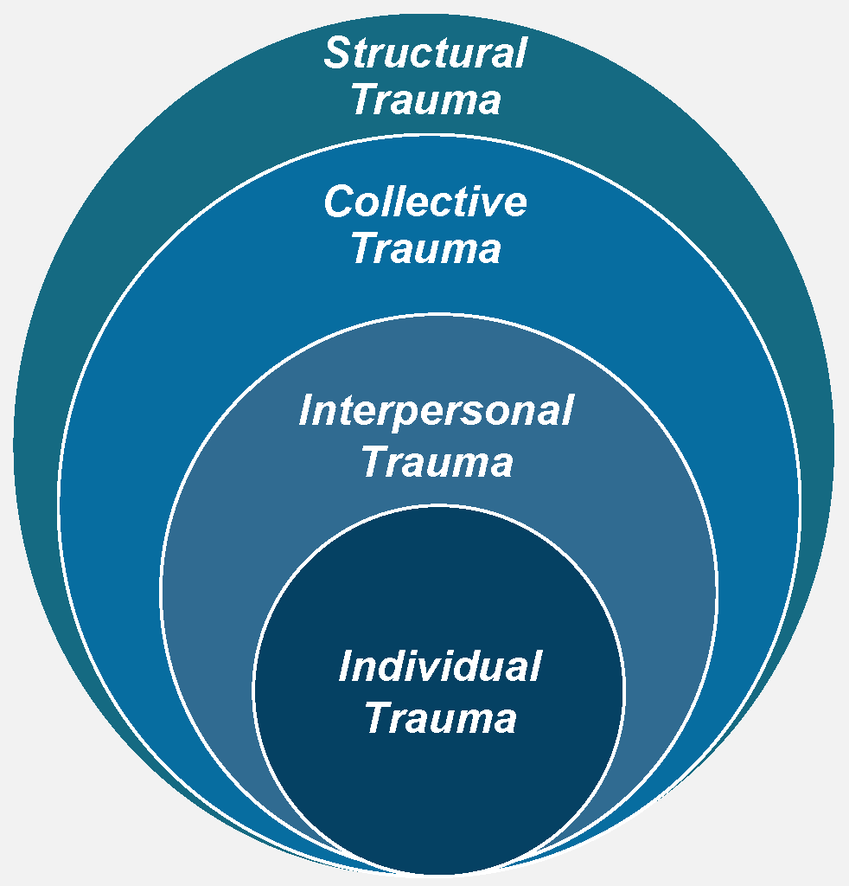

What Is Trauma?
Adapted with permission © Lewis-O’Connor, A. 2015 © Rittenberg, E 2015 © Grossman, S. 2015 UPDATED, April 2020; UPDATED, February 2022.
Notes:
Facilitator Notes:
Please set up your own QR code and link as those listed here are meant as an example only; by setting up your own you’ll ensure the data on the word cloud is specific to your training session and participant responses. There are numerous free platforms to choose from including Zoom, Mentimeter, and Microsoft Forms.
Chat box Link: https://forms.office.com/r/968XU9Ns4g
Facilitator Script:
Before we jump in further, let’s start with a quick exercise to help set some important context for our discussion about trauma. Using your phones (or the link in the chat box if training virtually), please answer the following question:
Prompt for Participants:
In your professional role, what types of traumas have your clients experienced? You are welcome to submit as many responses as you would like which will populate as a real-time word cloud for us to view together [Note, display the word cloud on the screen and review responses in real-time before moving on to the talking points below].
Our field of practice is tasked with engaging parents, children, and families who hold and carry within various forms of traumas. While you’ll notice a variety of different language used to describe the different types or levels of trauma, they all do so with the same purpose of amplifying the message that trauma comes in many forms and experiences that often do not occur in isolation of the others; meaning trauma is dynamic and highly interconnected.
In this model referenced here, individual trauma simply represents a single or series of traumatic events experienced by an individual that has lasting effects on their physical safety and emotional well-being. In other models, this might be labeled acute trauma, which also represents a single traumatic event.
Interpersonal trauma, as implied by its name, represents traumatic experiences that are relational in nature; things like DV, child abuse and neglect, and other adverse childhood experiences would fall within this category. In childhood trauma models, this level of trauma is often referred to as chronic due to repeated and prolonged exposure and overlaps with complex due to the invasive and interpersonal nature of the traumatic experiences.
And finally, structural trauma in this model refers to systems’ policies and practices that perpetuate harm; whereas collective trauma refers to the cumulative effects of shared adverse experiences including but not limited to historical, social, or political events. The term collective was chosen intentionally to redirect attention and efforts upstream; identifying the source and root causes, therein employing our collective responsibility to improve this public health matter on behalf of all parents, children, and family members we serve. More on this with our next activity…
Additional Resources:
N/A
Slide Citations:
Adapted with permission © Lewis-O’Connor, A. 2015 © Rittenberg, E 2015 © Grossman, S. 2015 UPDATED, April 2020; UPDATED, February 2022
Script Citations:
(Grossman et al., 2021)
Full Citations:
Grossman, S., Cooper, Z., Buxton, H., Hendrickson, S., Lewis-O'Connor, A., Stevens, J., Wong, L. Y., & Bonne, S. (2021). Trauma-informed care: Recognizing and resisting re-traumatization in health care. Trauma Surgery & Acute Care Open, 6(1), e000815. https://doi.org/10.1136/tsaco-2021-000815

Slide 37
Trauma-Informed Care
Elevator Speech
Activity Pair Share
Notes:
Facilitator Script:
As child welfare workers, we have a collective responsibility to understand trauma and transform the standard of care for our communities’ most vulnerable children and families—which in this context are those affected by co-occurring SUDs, mental health, domestic partner violence, and trauma. We know from statistics that 60-90% of parents with substance use disorders report experiencing at least one traumatic event in their lifetime. We also know that when these same families come to the attention of child welfare, our system and other public serving entities represent the source of some these deeply painful traumatic experiences. As a system charged with supporting the safety and well-being of children and families, we also have a responsibility to not add to or compound trauma—which speaks to the importance of trauma-informed care. Before we dig in more, let’s hear from each other on what exactly we mean by ‘trauma-informed’ child welfare services.
Facilitator Notes:
Activity: Pair Share—ask participants to turn to a neighbor and share what ‘trauma-informed care’ in child welfare services would be like. Ask pairs to work together to craft an elevator speech describing trauma-informed care to someone not in our field of practice. Ask for volunteers to share their crafted elevator speeches to the larger group.
Use the example from NCTSN to help generate discussion (if needed):
“Trauma-informed [care] infuses and sustains trauma awareness, knowledge, and skills into organizational practices and policies to maximize physical and psychological safety, facilitate the recovery of the child and family, and support their ability to thrive.”
Materials Needed:
- Large Easel Paper
- Markers
______________________________________________________________
*Alternative Instructions for Virtual Training
Use breakout rooms feature on your respective virtual platform to allow for activity. Recommend switching this from a pair share activity to a small group activity (max 4-5 learners per group) and proceed with the same instructions as noted above.
Additional Resources:
N/A
Slide Citations:
N/A
Script Citations:
(The National Child Traumatic Stress Network, n.d.-b)
Full Citations:
The National Child Traumatic Stress Network. (n.d.-b). NCTSN Trauma-informed organizational assessment. https://www.nctsn.org/trauma-informed-care/nctsn-trauma-informed-organizational-assessment

Slide 38

Consequences of
Systems Not Delivering Trauma-Informed Care
Inadequate or Inappropriate Services
Re-Traumatization
Engagement & Retention
Return to Use
Notes:
Facilitator Script:
So, why is this all important? The consequences of child welfare and other systems not delivering trauma-informed care are well documented.
First, when systems are not designed to screen families for trauma, there’s an even greater likelihood of families being referred to any combination of inadequate or inappropriate services.
In the absence of trauma responsive services, systems’ policies and practices can either intentionally or unintentionally trigger or re-traumatize both parents and children.
We also know that trauma fundamentally disrupts trust, and it can take just one negative experience to alter a family’s willingness to engage or remain in services.
Which consequently may increase their risk for a return to use and/or further destabilization. Ultimately, leading to poor treatment outcomes.
Additional Resources:
Substance Abuse and Mental Health Services Administration: SAMHSA’s Concept of Trauma and Guidance for a Trauma-Informed Approach (2014)
Slide Citations:
(Menschner & Maul, 2016)
Script Citations:
(Menschner & Maul, 2016)
Full Citations:
Menschner, C. & Maul, A. (2016). Key ingredients for successful trauma-informed care implementation. Center for Health Care Strategies, Robert Wood Johnson Foundation. https://www.samhsa.gov/sites/default/files/programs_campaigns/childrens_mental_health/atc-whitepaper-040616.pdf

Slide 39

Components of a Trauma-Informed
Child Welfare System
Screening and
Assessment
Prioritizing
Secondary Trauma
Referral to
Evidence-Based Treatment
Measurement-Driven
Case Planning
Workforce
Development
Cross-System Collaboration
Notes:
Facilitator Script:
So, what is trauma-informed care actually like in our everyday child welfare practice?
First, it starts with ensuring that all families are screened and assessed for trauma at time of initial service engagement. This practice will allow for upfront identification and appropriate service planning based on the individual child and family’s needs. An example of a child-specific trauma screening is the Child Trauma Screen, formerly called the Connecticut Trauma Screen—a brief tool developed by Connecticut’s Department of Children and Families, or DCF, in partnership with the Child Health and Development Institute, or CHDI, and Yale University. This free, 10-item tool is designed and tested for use on children ages 6-17, with a version for children 3-6 under development, and is used by DCF multidisciplinary teams, including child welfare workers, juvenile probation officers, pediatricians, and school personnel.
As we briefly touched on earlier in this module, child welfare agencies are now shifting their resources toward funding of evidence-based interventions under the Family First Prevention Services Act. The Prevention Services Clearinghouse is a resource to child welfare agencies seeking to expand or improve upon their service delivery options for families affected by co-occurring substance use, mental disorders, and trauma.
The transition to becoming a trauma-informed system will also require attention and resources directed at ongoing workforce development and organizational needs. This should include a re-examination of all foundational and ongoing workforce training to ensure that all staff are adequately trained to understand trauma and its effects on children and families, including practice strategies to ensure their psychological safety and emotional well-being. Training alone will not suffice though, trauma-informed care requires a system’s transformation from all aspects of the child welfare agency—from the front-end to the back-end of the continuum of services, as well as all administrative and policy-level functions. It requires a paradigm shift that will transcend the perspective and goals of child welfare service provision with greater emphasis on interagency collaboration, early intervention, and family-centered treatment.
Trauma-informed child welfare systems are also designed to recognize and prioritize the health and well-being of its workforce. The effects of secondary trauma are well documented—lower productivity, increased leave of absences, and high staff turnover. Trauma-informed strategies to offset the impact of secondary trauma include things like secondary trauma groups, agency-sponsored wellness activities, and dedicated restorative space for decompression throughout the workday.
Measurement-driven case planning relies on agencies use of data to inform continuous quality improvement—a trauma-informed strategy that helps identify current strengths, needs, or gaps in child welfare service delivery (including the direct practice, system and cross-system levels).
Being trauma-informed will also require cross-system collaboration among the many service providers for child welfare-involved families. Strategies that promote collaboration and systems-level change should include consideration to cross-system training, system mapping, multidisciplinary staffings, and ways to maximize funding streams to better serve children and families affected by trauma.
Additional Resources:
Promising Futures Website (2024)
Casey Family Programs: Supportive Communities-Issue Brief: Why Should Child Protection Agencies Become Trauma-Informed? (2018)
Title IV-E Prevention Services Clearinghouse Website (2023)
Slide Citations:
N/A
Script Citations:
(Child Health and Development Institute, 2023; Child Welfare Information Gateway, 2020)
Full Citations:
Child Health and Development Institute. (2023). Child trauma screen (CTS). https://www.chdi.org/our-work/trauma-informed-initiatives/ct-trauma-screen-cts/
Child Welfare Information Gateway. (2020). The importance of a trauma-informed child welfare system. U.S. Department of Health and Human Services, Administration for Children and Families, Children’s Bureau. https://www.childwelfare.gov/pubs/issue-briefs/trauma-informed/

Slide 40

Recovery Is Possible!
Notes:
Facilitator Script:
Recovery from co-occurring disorders is not easy, but it is possible! As child welfare workers we play an important role in ensuring parents and families are first screened and assessed while also facilitating access to an integrated treatment plan that is meeting both their substance use and mental health needs; and when done within a trauma-informed approach this then becomes the foundation for hope and a pathway toward self-directed change and long-term recovery.
Additional Resources:
National Center on Substance Abuse and Child Welfare: Building Hope for Families Affected by Substance Use and Mental Health Disorders—A Blueprint for an Effective System of Care to Promote Lasting Recovery and Family Well-Being (2023)
National Center on Substance Abuse and Child Welfare: Building Hope for Family Healing and Recovery Webinar (2023)
Slide Citations:
N/A
Script Citations:
N/A
Full Citations:
N/A

Slide 41
Doorway Recovery Videos
Permission to Use & Video Credit provided by
New Hampshire Department of Health and Human Services
DJ’s Story: You Can Change and Live the Life You Want
Notes:
Facilitator Script:
Let’s now pause and take a few minutes to watch a real-life recovery video made possible by Doorway Recovery and the New Hampshire Department of Health and Human Services.
Prompts for Participants to Close Out Today’s Training Discussion:
What part of DJ’s story resonated with you the most?
DJ spoke openly about his substance use, but what else may have been contributing to his de-stabilization from a co-occurring standpoint?
Yes, it is clear that DJ and his family suffered a significant trauma through the loss of his brother. Without knowing the exact details of this loss, we can infer from parts of his story that there may have been unprocessed grief, survivor’s guilt, and unhealthy coping patterns that may have contributed to his substance use such as self-medicating through alcohol and drugs to ease the pain brought on by difficult and challenging emotions following the loss of his brother. Treatment of co-occurring disorders will take time to get at what may have come first (substance use or mental disorder) which is why it is so important that parent and families have access to quality integrated care and services. Remember, recovery is possible and let’s be sure we are doing our part to set parents and families up for success.
Video Source:
Doorway Recovery Videos and New Hampshire Department of Health and Human Services

Slide 42

Contact the NCSACW TTA Program
Connect with programs that are developing tools and implementing practices and protocols to support their collaborative
Training and technical assistance to support collaboration and systems change
https://ncsacw.acf.hhs.gov/
ncsacw@cffutures.org
Toll-Free @ 1-866-493-2758
Notes:
Facilitator Script:​​
​​
Alright, this wraps up the instructional content for module three. If you have any follow up questions from today’s training, feel free to reach out to the National Center on Substance Abuse and Child Welfare at ncsacw@cffutures.org or toll free at 1-866-493-2758. Thank you all for our rich discussion today and for your continued work on behalf of children, parents, and families affected by parental substance use and co-occurring disorders. ​Have a nice day, everyone!​

Slide 43
References

Slide 44
References, 1 of 4
Bell, A. (2021). Mental health for all: Working across the spectrum. Centre for Mental Health. https://www.centreformentalhealth.org.uk/mental-health-all-working-across-spectrum/
Blumenfeld, S. & Baca, J. (2021). Family-centered toolkit for domestic violence programs. National Center on Domestic Violence, Trauma, and Mental Health. https://ncdvtmh.org/wp-content/uploads/2022/10/NCDVTMH-Family-Centered-Toolkit.pdf
Blumenfeld, S. (2015). Guide for engaging & supporting parents affected by domestic violence. National Center on Domestic Violence, Trauma & Mental Health. https://ncdvtmh.org/wp-content/uploads/2022/10/NCDVTMH_GuideEngagingSupportingParents.pdf
Casey Family Programs. (2024). How can child welfare partner with other systems to support families experiencing domestic violence? https://www.casey.org/child-welfare-domestic-violence-collaboration/
Center for Court Innovation. (2022). Guiding principles for engagement and intervention with people who cause harm through intimate partner violence [Fact sheet]. Futures Without Violence, Office on Violence Against Women, U.S. Department of Justice. https://www.innovatingjustice.org/sites/default/files/media/document/2022/CCI_Factsheet_DV_Guiding_Principles_IPV_04132022.pdf
Center for Justice Innovation. (2022). Coordinated community response definition [Fact sheet]. National Crime Victim Law Institute. https://www.innovatingjustice.org/sites/default/files/media/document/2024/Coordinated%20Community%20Response%20Definition%20Fact%20Sheet.pdf
Child Health and Development Institute. (2023). Child trauma screen (CTS). https://www.chdi.org/our-work/trauma-informed-initiatives/ct-trauma-screen-cts/
Child Welfare Information Gateway. (2020). The importance of a trauma-informed child welfare system. U.S. Department of Health and Human Services, Administration for Children and Families, Children’s Bureau. https://www.childwelfare.gov/pubs/issue-briefs/trauma-informed/

Slide 45
References, 2 of 4
Criminal Justice Investment Initiative. (2021). Creating a trauma-informed abusive partner intervention program. https://www.innovatingjustice.org/sites/default/files/media/document/2022/Creating%20a%20Trauma-Informed%20Abusive%20Partner%20Intervention%20Program.pdf
Cunningham, A., & Baker, L. (2007). Little eyes, little ears: How violence against a mother shapes children as they grow. National Clearinghouse on Family Violence, Family Violence Prevention Unit, Public Health Agency of Canada. https://www.socialworkerstoolbox.com/little-eyes-little-ears-how-violence-against-mother-shapes-children-as-they-grow-booklet
de Boinville, M. (2013). Screening for domestic violence in health care settings [Policy brief]. Office of the Assistant Secretary for Planning and Evaluation (ASPE), Office of Human Services Policy, U.S. Department of Health and Human Services. https://aspe.hhs.gov/reports/screening-domestic-violence-health-care-settings-0
Domestic Abuse Intervention Programs. (2017). Understanding the power and control wheel. The Duluth Model. https://www.theduluthmodel.org/wheels/
Grossman, S., Cooper, Z., Buxton, H., Hendrickson, S., Lewis-O'Connor, A., Stevens, J., Wong, L. Y., & Bonne, S. (2021). Trauma-informed care: Recognizing and resisting re-traumatization in health care. Trauma Surgery & Acute Care Open, 6(1), e000815. https://doi.org/10.1136/tsaco-2021-000815
HeadStart ECLKC. (2024). Domestic violence and child abuse reporting. https://eclkc.ohs.acf.hhs.gov/publication/domestic-violence-child-abuse-reporting
Hidalgo, R. (2023). DVAM 2023: Ending domestic violence requires us all to work together. U.S. Department of Justice, Office on Violence Against Women. https://www.justice.gov/archives/ovw/blog/dvam-2023-ending-domestic-violence-requires-us-all-work-together#:~:text=Data%20from%20the%20last%20National,intimate%20partner%20violence%2Drelated%20impact

Slide 46
References, 3 of 4
Mandated Reporter Training. (2022). Which states have mandatory domestic violence reporting? https://mandatedreportertraining.com/resources/blog/which-states-have-mandatory-domestic-violence-reporting/
Menschner, C. & Maul, A. (2016). Key ingredients for successful trauma-informed care implementation. Center for Health Care Strategies, Robert Wood Johnson Foundation. https://www.samhsa.gov/sites/default/files/programs_campaigns/childrens_mental_health/atc-whitepaper-040616.pdf
Minnesota Department of Human Services. (2021). Minnesota’s best practice guide for the co-occurrence of child maltreatment and domestic violence. https://edocs.dhs.state.mn.us/lfserver/Public/DHS-3490-ENG
National Center on Substance Abuse and Child Welfare. (2022). Disrupting stigma: How understanding, empathy, and connection can improve outcomes for families affected by substance use and mental disorders. Administration for Children and Families, Substance Abuse and Mental Health Services Administration. https://ncsacw.acf.hhs.gov/files/disrupting-stigma-brief.pdf
The National Child Traumatic Stress Network. (n.d.-a). Interventions. https://www.nctsn.org/what-is-child-trauma/trauma-types/intimate-partner-violence/interventions
The National Child Traumatic Stress Network. (n.d.-b). NCTSN Trauma-informed organizational assessment. https://www.nctsn.org/trauma-informed-care/nctsn-trauma-informed-organizational-assessment
Quality Improvement Center on Domestic Violence in Child Welfare. (2019). Protective factors for survivors of domestic violence [Issue brief]. Futures Without Violence. https://promising.futureswithoutviolence.org/wp-content/uploads/2022/07/FWV-QIC-Protective-Factors-Brief-Final-09-1.pdf
Substance Abuse and Mental Health Services Administration. (2009). Integrated treatment for co-occurring disorders: Building your program. DHHS Publication No. SMA-08-4366. U.S. Department of Health and Human Services. https://store.samhsa.gov/sites/default/files/d7/priv/ebp-kit-building-your-program-10112019.pdf

Slide 47
References, 4 of 4
Substance Abuse and Mental Health Services Administration. (2022). Co-occurring disorders: Diagnoses and integrated treatments. U.S. Department of Health and Human Services. https://www.samhsa.gov/co-occurring-disorders
Substance Abuse and Mental Health Services Administration. (2023a). Co-occurring disorders and other health conditions. U.S. Department of Health and Human Services. https://www.samhsa.gov/medications-substance-use-disorders/medications-counseling-related-conditions/co-occurring-disorders
Substance Abuse and Mental Health Services Administration. (2023b). Key substance use and mental health indicators in the United States: Results from the 2022 national survey on drug use and health (NSDUH). HHS Publication No. PEP23-07-01-006, NSDUH Series H-58. U.S. Department of Health and Human Services. https://www.samhsa.gov/data/report/2022-nsduh-annual-national-report
UCLA Pritzker Center. (2021). Child welfare and domestic violence: The report on intersection and action. https://pritzkercenter.ucla.edu/wp-content/uploads/2021/05/Pritzker-Domestic-Violence-Report-Endnotes_final.pdf
U.S. Preventive Services Task Force. (n.d.). USPSTF recommendations app for web and mobile devices. Prevention TaskForce. https://www.uspreventiveservicestaskforce.org/apps/
Warrier, S., & Lizdas, K. (2022). Reimagining coordinated community response (CCR): A focus on survivor-centered design. Battered Women's Justice Project. https://bwjp.org/wp-content/uploads/2022/08/CCR_Report.pdf
Warshaw, C., & Zapata-Alma, G. (2025). In honor of domestic violence awareness month: Responding to substance use coercion in treatment and recovery services. National Center on Domestic Violence, Trauma, and Mental Health, Addiction Technology Transfer Center Network. https://attcnetwork.org/in-honor-of-domestic-violence-awareness-month-responding-to-substance-use-coercion-in-treatment-and-recovery-services/

Slide 48
Resources

Slide 49
Resources, 1 of 3
Battered Women's Justice Project: Reimagining Coordinated Community Response (CCR): A Focus on Survivor-Centered Design (2022)
Casey Family Programs: How Can Child Welfare Partner with Other Systems to Support Families Experiencing Domestic Violence? (2024)
Casey Family Programs: Supportive Communities: How are child protection agencies implementing trauma-informed, healing-centered policies and practices? (2023)
Center for Justice Innovation: Coordinated Community Response Definition Fact Sheet (2022)
Child Welfare Information Gateway: State Statutes Search (n.d.)
Criminal Justice Investment Initiative: Creating a Trauma-Informed Abusive Partner Intervention Program (2021)
Domestic Abuse Intervention Programs: The Duluth Model Wheel Library (2017)
Minnesota Department of Human Services: Minnesota’s Best Practice Guide for the Co-Occurrence of Child Maltreatment and Domestic Violence (2021)
National Center on Domestic Violence, Trauma, and Mental Health: Family-Centered Toolkit for Domestic Violence Programs (2021)
National Center on Domestic Violence, Trauma & Mental Health: Guide for Engaging & Supporting Parents Affected by Domestic Violence (2015)
National Center on Domestic Violence, Trauma & Mental Health Website (2023)

Slide 50
Resources, 2 of 3
National Center on Substance Abuse and Child Welfare: Building Hope for Families Affected by Substance Use and Mental Health Disorders—A Blueprint for an Effective System of Care to Promote Lasting Recovery and Family Well-Being (2023)
National Center on Substance Abuse and Child Welfare: Building Hope for Family Healing and Recovery Webinar (2023)
National Center on Substance Abuse and Child Welfare: Collaborative Teams Toolkit for Trauma-Informed Care—Part 1: Trauma-Informed Care Tip Sheet for Collaborative Teams Serving Children, Parents, and Family Members Affected by Substance Use and Co-occurring Mental Health Challenges (2024)
National Center on Substance Abuse and Child Welfare: Strengthening Systems Collaboration for Families: The Intersection of Domestic Violence and Co-Occurring Substance Use and Mental Health Disorders (2025)
National Domestic Violence Hotline (n.d.)
National Resource Center on Domestic Violence Website (2021)
Promising Futures Website (2024)
Quality Improvement Center on Domestic Violence in Child Welfare: Adult & Child Survivor-Centered Approach for Addressing Domestic Violence (2019)
Quality Improvement Center on Domestic Violence in Child Welfare: Protective Factors for Survivors of Domestic Violence (2019)
Starr, R. W., Summers, A., Malhotra, K., Gonzalez, C., Branch, E. J., & Sicafuse, L.: Moving Toward Evidence-Based Practices: A Guide for Domestic Violence Organizations (2016)

Slide 51
Resources, 3 of 3
Strong Hearts Native Helpline (2024)
Substance Abuse and Mental Health Services Administration: SAMHSA’s Concept of Trauma and Guidance for a Trauma-Informed Approach (2014)
Substance Abuse and Mental Health Services Administration: Treatment Improvement Protocol (TIP) 42: Substance Use Treatment for Persons With Co-Occurring Disorders (2020)
Title IV-E Prevention Services Clearinghouse Website (2023)
UCLA Pritzker Center: Child Welfare and Domestic Violence: The Report on Intersection and Action, (2021)
Ward, A., Barry, K., Laliberte, T., & Meyer-Kalos, P.: Supporting Recovery in Parents with Co-Occurring Disorders in Child Welfare. No. 26 (2016)

