Slide 1
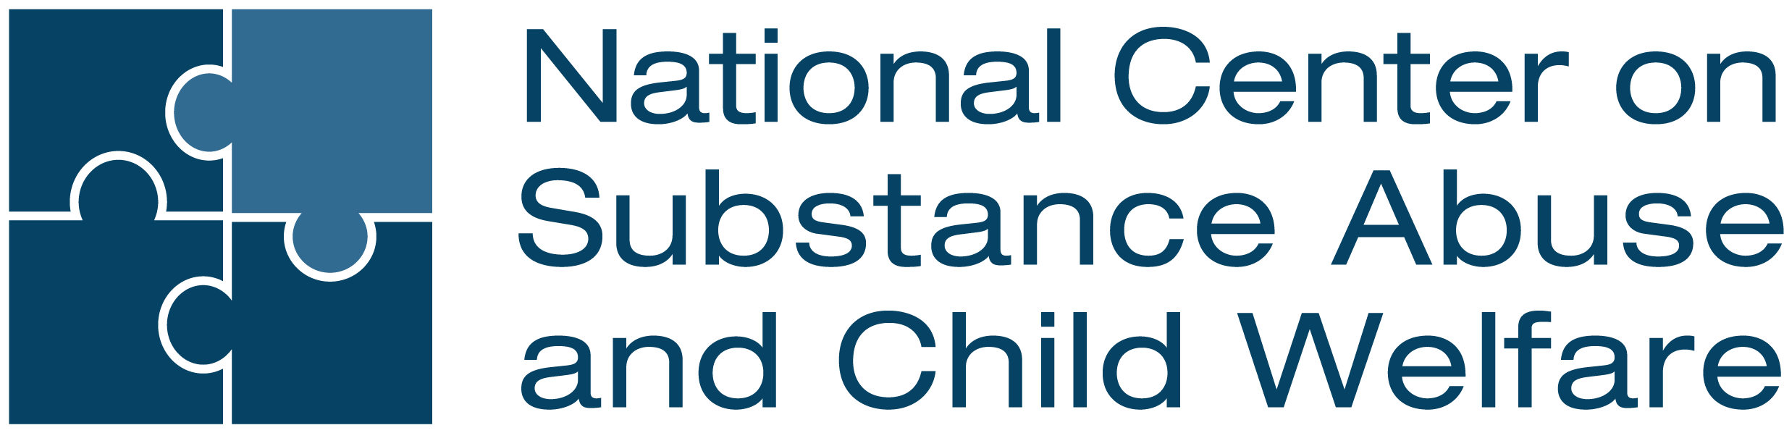
Module 1:
Understanding the Multiple Needs of Families Involved with the Child Welfare System
Child Welfare Training Toolkit
Notes:
Facilitator Script:
Hello and welcome! Thank you for creating time in your schedule for today’s training discussion. The next three hours were carefully designed to be a robust learning experience. We encourage your active participation in the various adult learning exercises leading to a more in-depth understanding about the multiple needs of families involved with the child welfare system.

Slide 2




Acknowledgement
This content is supported by contract number 75S20422C00001 from the Children’s Bureau (CB), Administration for Children and Families (ACF), co-funded by the Substance Abuse and Mental Health Services Administration (SAMHSA). The views, opinions, and content of this presentation are those of the presenters and do not necessarily reflect the views, opinions, or policies of ACF, SAMHSA or the U.S. Department of Health and Human Services (HHS).
https://ncsacw.acf.hhs.gov | ncsacw@cffutures.org
Notes:
Facilitator Script:
Before we begin, we have an acknowledgement slide to go over. The contents of this training toolkit, including today’s module, was developed by the National Center on Substance Abuse and Child Welfare—an initiative of the U.S. Department of Health and Human Services that is co-funded by the Children’s Bureau, Administration for Children and Families, and the Substance Abuse and Mental Health Services Administration.

Slide 3
Learning Objectives
After completing this training,
child welfare workers will:
Identify the prevalence of trauma, substance use and mental disorders in the child welfare population
Recognize the effects of substance use and
co-occurring disorders on children and families
Describe the negative effects of stigma on treatment and recovery outcomes
Understand the importance of a family-centered approach when working with families affected by
co-occurring disorders
Identify the benefits of collaborating with other systems and service providers to better serve children and families
Notes:
Facilitator Script:
The goal of Module 1 is to provide learners with foundational knowledge on a range of co-occurring needs that children and families involved in the child welfare system may experience. This module serves as a primer to the remaining modules and includes a broad-level overview of relevant data; important child welfare laws and considerations; introductory information on substance use and co-occurring disorders, including topic-based discussions on the cumulative effects of trauma and stigma. The module closes with an introduction to a family-centered approach and highlights the benefits and importance of cross-system collaboration for identifying and responding to the needs of children, parents, and families.

Slide 4

What the Data Tells Us About
Parental Substance Use
Notes:
Facilitator Script:
Let’s begin today’s training session by reviewing more closely what the data tells us about parental substance use. An analysis pooling data from the National Survey on Drug Use and Health from 2015-2019 estimated that more than 21 million children lived with a parent who misused substances in the past year, representing 16% of all children in the United States. Now understandably not all 21 million children will come to the attention of child welfare services but for the subset that do, let’s take a closer examination at what those numbers entail…
Additional Resources:
N/A
Slide Citations:
N/A
Script Citations:
(Ghertner, 2023)
Full Citations:
Ghertner, R. (2023). U.S. national and state estimates of children living with parents using substances, 2015-2019. Assistant Secretary for Planning and Evaluation, Office of Human Services Policy. https://aspe.hhs.gov/sites/default/files/documents/faa1b19e66053008e89782914f0aa693/children-at-risk-of-sud.pdf ​

Slide 5
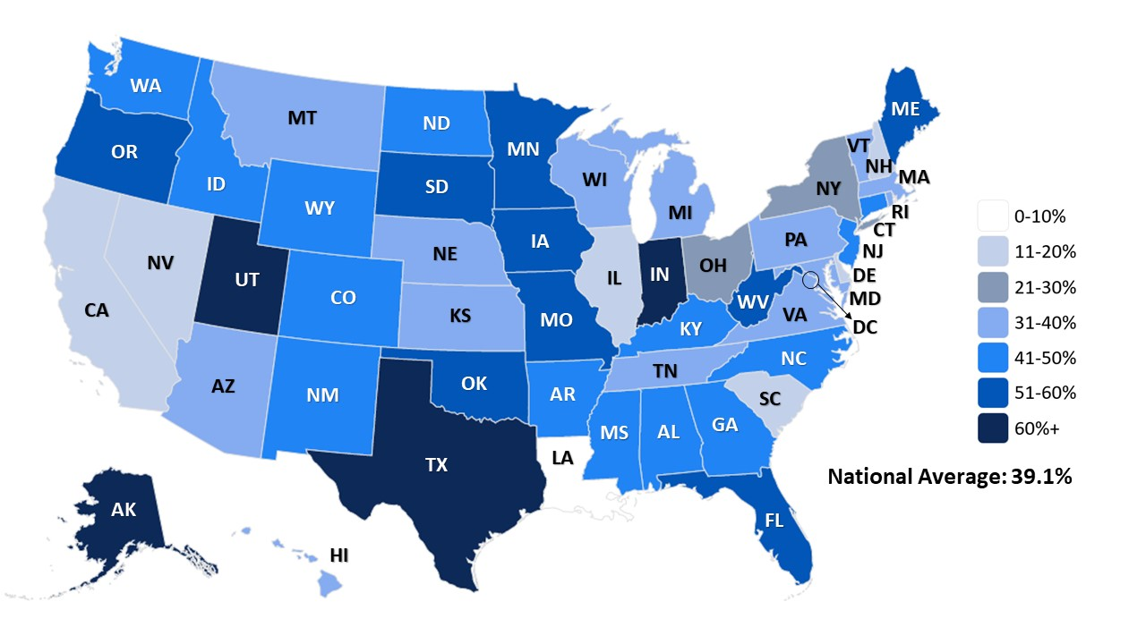
Parental Alcohol or Drug Abuse as a Condition
Associated with Removal by State, 2021
N = 606,187
Note: Estimates based on all children in out-of-home care at some point during the Fiscal Year
Source: AFCARS Data 2021, as of 10/01/24
Notes:
Facilitator Script:
According to the Adoption and Foster Care Analysis and Reporting System (also known and commonly referred to as AFCARS), there were a total of 603,823 children in out-of-home care at some point during the 2021 fiscal year (an adjusted figure from the total numerator shown on the heat map due to 2,364 children who had alcohol or other drug (AOD) information missing from their dataset). Of the adjusted 603,823 children, 236,143 had parental substance use listed as a condition associated with their removal (either alone or in combination with another reason)—totaling a national average of 39%.
Prompts for Participants:
Any initial reactions to this data?
Do the state percentages align with what you are experiencing in your frontline practice?
If not, what could be contributing to these discrepancies?
Additional Notes:
States typically don’t agree with what this slide says in terms of their prevalence —it’s part of the You Can’t Fix What You Don’t Count messaging. This issue is related to:
Lack of protocols re. identification (screening and assessment) and data entry
Variation in data systems
How AOD is captured in data systems (e.g.: neglect; is there a AOD box?)
Point in time in which the AOD is identified; and then entered in the data system
Often, at the local level, multiple child abuse/neglect (CA/N) reasons are reported and sometimes only the primary reason is reported to the Fed system(s)
Good ending points/reason to share these slides;
Opens the conversation on data collection and what that means for resources, sustainability, etc.
Additional Resources:
N/A
Slide Citations:
Source: AFCARS Data 2021, as of 10/01/24
Script Citations:
Source: AFCARS Data 2021, as of 10/01/24
Full Citations:
Center for Children and Family Futures. (2024). Analyses of the 2021 Adoption and Foster Care Analysis and Reporting System from the National Data Archive on Child Abuse and Neglect (file number 274) [Data set]. NDACAN. https://www.ndacan.acf.hhs.gov/

Slide 6
Year 2021 Data Listed by State
(A-K)
State | Percentage | Number
AK | 67.2% | 2768
AL | 46.8% | 4250
AR | 50.3% | 3610
AZ | 34.3% | 7640
CA | 11.7% | 8379
CO | 49.9% | 4063
CT | 43.4% | 2189
DC | 15.7% | 127
DE | 19.6% | 142
FL | 51.8% | 18745
GA | 44.7% | 7161
HI | 35.4% | 855
IA | 60.0% | 4448
ID | 41.9% | 1130
IL | 11.1% | 3033
IN | 61.7% | 13504
KS | 35.5% | 3654
KY | 41.6% | 5678
Source: AFCARS Data 2021, as of 10/01/24
Notes:
Facilitator Notes:​
​
This slide details state-specific data organized alphabetically for the year 2021. Based on where you are training, this presents an opportunity to take a closer review of the data to help provide additional context and increased awareness of state and/or regional data trends. ​
Additional Resources:
N/A
Slide Citations:
Source: AFCARS Data 2021, as of 10/01/24
Script Citations:
N/A
Full Citations:
Center for Children and Family Futures. (2024). Analyses of the 2021 Adoption and Foster Care Analysis and Reporting System from the National Data Archive on Child Abuse and Neglect (file number 274) [Data set]. NDACAN. https://www.ndacan.acf.hhs.gov/

Slide 7
Year 2021 Data Listed by State
(L-N)
State | Percentage | Number
LA | 1.9% | 109
MA | 34.5% | 4685
MD | 31.2% | 1715
ME | 51.5% | 1638
MI | 39.3% | 5693
MN | 51.2% | 6187
MO | 51.3% | 9924
MS | 48.0% | 2668
MT | 39.4% | 1984
NC | 44.0% | 6745
ND | 42.6% | 1053
NE | 36.4% | 2003
NH | 15.4% | 260
NJ | 43.6% | 2303
NM | 43.6% | 1319
NV | 15.9% | 1133
NY | 30.9% | 6181
Source: AFCARS Data 2021, as of 10/01/24
Notes:
Facilitator Notes:​
​
This slide details state-specific data organized alphabetically for the year 2021. Based on where you are training, this presents an opportunity to take a closer review of the data to help provide additional context and increased awareness of state and/or regional data trends. ​
Additional Resources:
N/A
Slide Citations:
Source: AFCARS Data 2021, as of 10/01/24
Script Citations:
N/A
Full Citations:
Center for Children and Family Futures. (2024). Analyses of the 2021 Adoption and Foster Care Analysis and Reporting System from the National Data Archive on Child Abuse and Neglect (file number 274) [Data set]. NDACAN. https://www.ndacan.acf.hhs.gov/

Slide 8
Year 2021 Data Listed by State
(O-W, Puerto Rico)
State | Percentage | Number
OH | 30.9% | 7974
OK | 52.9% | 6088
OR | 57.3% | 4747
PA | 36.8% | 7896
RI | 38.6% | 1113
SC | 17.3% | 1162
SD | 57.9% | 1522
TN | 40.1% | 5843
TX | 65.7% | 29523
UT | 61.3% | 2374
VA | 33.8% | 2562
VT | 31.6% | 512
WA | 44.5% | 5944
WI | 38.2% | 4049
WV | 55.2% | 6574
WY | 50.8% | 813
Puerto Rico | 17.5% | 471
Total US | 39.1% | 236143
Source: AFCARS Data 2021, as of 10/01/24
Notes:
Facilitator Notes:​
​
This slide details state-specific data organized alphabetically for the year 2021. Based on where you are training, this presents an opportunity to take a closer review of the data to help provide additional context and increased awareness of state and/or regional data trends. ​
Additional Resources:
N/A
Slide Citations:
Source: AFCARS Data 2021, as of 10/01/24
Script Citations:
N/A
Full Citations:
Center for Children and Family Futures. (2024). Analyses of the 2021 Adoption and Foster Care Analysis and Reporting System from the National Data Archive on Child Abuse and Neglect (file number 274) [Data set]. NDACAN. https://www.ndacan.acf.hhs.gov/

Slide 9
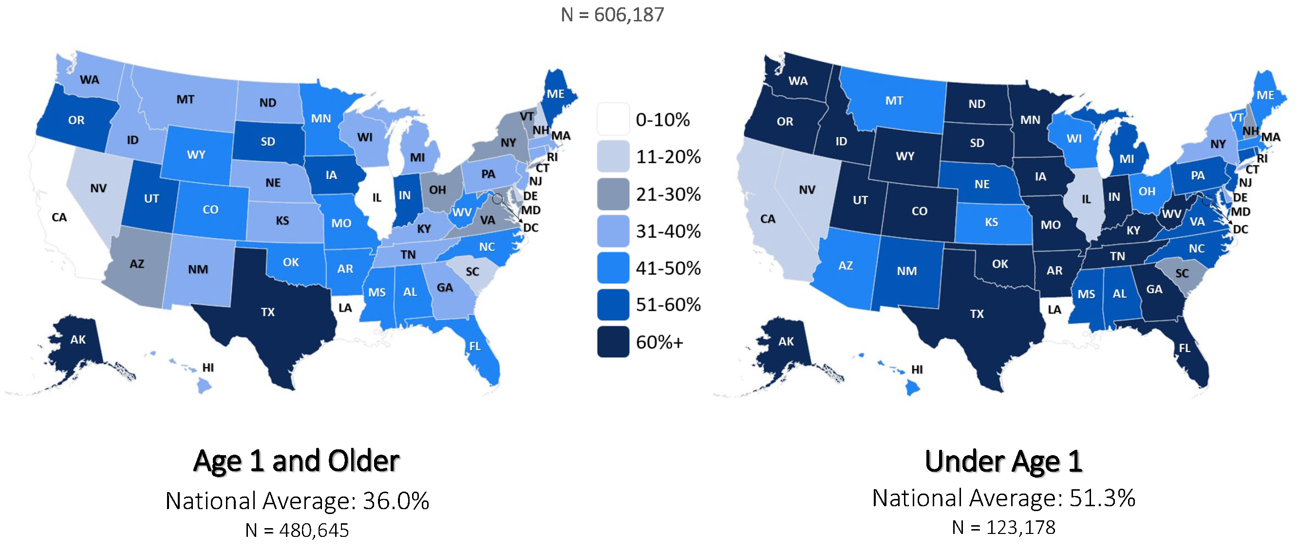
Parental Alcohol or Drug Abuse as a Condition
Associated with Removal for Children by Age, 2021
Note: Estimates based on all children in out-of-home care at some point during Fiscal Year
Source: AFCARS Data 2021, as of 10/01/24
Notes:
Facilitator Script:
​Let’s now take a closer review at this same dataset just now broken out by age categories. On the left-side heat map we have national and state-specific percentages for children ages 1 and older compared to the percentages on the right-side heat map for children under age 1. As a reminder the number of children who entered out-of-home care in fiscal year 2021 totaled 606,187; however, the numerators listed on the slide account for the 2,364 children who had missing AOD information. So, of the 480,645 children aged 1 and older, there were 173,013 with parental AOD listed as an identified condition associated with their removal—totaling a national average of 36%. Whereas of the 123,178 children under age 1, there were 63,130 with parental AOD listed—totaling a national average of 51%
Prompts for Participants:​
Any initial reactions to these comparison figures?​
What thoughts do you have regarding your specific state or region?​
Do these figures align with the age breakdown on your caseloads?
Additional Resources:
N/A
Slide Citations:
Source: AFCARS Data 2021, as of 10/01/24
Script Citations:
Source: AFCARS Data 2021, as of 10/01/24
Full Citations:
Center for Children and Family Futures. (2024). Analyses of the 2021 Adoption and Foster Care Analysis and Reporting System from the National Data Archive on Child Abuse and Neglect (file number 274) [Data set]. NDACAN. https://www.ndacan.acf.hhs.gov/

Slide 10
Year 2021 Data Listed by State, by Age (A-K)
State | Under | Age 1 | Age 1 | and Older
AK | 75.00% | 565 | 65.40% | 2203
AL | 60.80% | 1108 | 43.30% | 3142
AR | 64.90% | 855 | 47.10% | 2755
AZ | 47.80% | 2166 | 30.90% | 5474
CA | 16.70% | 2612 | 10.30% | 5767
CO | 76.30% | 1247 | 43.20% | 2816
CT | 54.00% | 655 | 40.10% | 1534
DC | 27.00% | 38 | 13.30% | 89
DE | 37.20% | 55 | 15.10% | 87
FL | 66.00% | 5152 | 47.90% | 13593
GA | 61.10% | 1969 | 40.50% | 5192
HI | 48.30% | 232 | 32.20% | 623
IA | 70.80% | 908 | 57.70% | 3540
ID | 63.10% | 320 | 37.00% | 810
IL | 14.00% | 907 | 10.20% | 2126
IN | 72.50% | 3180 | 59.00% | 10324
KS | 48.60% | 731 | 33.30% | 2923
KY | 61.60% | 1416 | 37.60% | 4262
Source: AFCARS Data 2021, as of 10/01/24
Notes:
Facilitator Notes:​
​
This slide details state-specific data organized alphabetically for the year 2021—broken out by age category. Based on where you are training, this presents an opportunity to take a closer review of the data to help provide additional context and increased awareness of state and/or regional data trends. ​
Additional Resources:
N/A
Slide Citations:
Source: AFCARS Data 2021, as of 10/01/24
Script Citations:
N/A
Full Citations:
Center for Children and Family Futures. (2024). Analyses of the 2021 Adoption and Foster Care Analysis and Reporting System from the National Data Archive on Child Abuse and Neglect (file number 274) [Data set]. NDACAN. https://www.ndacan.acf.hhs.gov/

Slide 11
Year 2021 Data Listed by State, by Age (L-N)
State | Under | Age 1 | Age 1 | and Older
LA | 2.00% | 28 | 1.80% | 81
MA | 48.50% | 1243 | 31.20% | 3442
MD | 51.90% | 558 | 26.20% | 1157
ME | 50.70% | 368 | 51.70% | 1270
MI | 53.10% | 1657 | 35.50% | 4036
MN | 65.10% | 1372 | 48.30% | 4815
MO | 70.50% | 2654 | 46.70% | 7270
MS | 58.40% | 687 | 45.20% | 1981
MT | 48.60% | 476 | 37.20% | 1508
NC | 55.70% | 1597 | 41.30% | 5148
ND | 67.10% | 312 | 37.00% | 741
NE | 52.10% | 440 | 33.50% | 1563
NH | 26.90% | 72 | 13.20% | 188
NJ | 56.10% | 840 | 38.60% | 1463
NM | 56.50% | 316 | 40.60% | 1003
NV | 20.10% | 332 | 14.60% | 801
NY | 39.20% | 1844 | 28.30% | 4337
Source: AFCARS Data 2021, as of 10/01/24
Notes:
Facilitator Notes:​
​
This slide details state-specific data organized alphabetically for the year 2021—broken out by age category. Based on where you are training, this presents an opportunity to take a closer review of the data to help provide additional context and increased awareness of state and/or regional data trends. ​
Additional Resources:
N/A
Slide Citations:
Source: AFCARS Data 2021, as of 10/01/24
Script Citations:
N/A
Full Citations:
Center for Children and Family Futures. (2024). Analyses of the 2021 Adoption and Foster Care Analysis and Reporting System from the National Data Archive on Child Abuse and Neglect (file number 274) [Data set]. NDACAN. https://www.ndacan.acf.hhs.gov/

Slide 12
Year 2021 Data Listed by State, by Age
(O-W, Puerto Rico)
State | Under | Age 1 | Age 1 | and Older
OH | 47.20% | 2256 | 27.20% | 5718
OK | 65.30% | 2015 | 48.40% | 4073
OR | 67.70% | 1118 | 54.70% | 3629
PA | 53.40% | 2284 | 32.70% | 5612
RI | 51.60% | 320 | 35.10% | 793
SC | 30.20% | 300 | 15.10% | 862
SD | 71.80% | 328 | 55.00% | 1194
TN | 70.00% | 1521 | 34.90% | 4322
TX | 76.70% | 7564 | 62.60% | 21959
UT | 79.40% | 540 | 57.50% | 1834
VA | 55.30% | 591 | 30.30% | 1971
VT | 46.90% | 123 | 28.60% | 389
WA | 66.20% | 2324 | 36.80% | 3620
WI | 49.10% | 1066 | 35.40% | 2983
WV | 75.90% | 1611 | 50.70% | 4963
WY | 70.50% | 146 | 47.80% | 667
Puerto Rico | 31.10% | 111 | 15.50% | 360
Total US | 51.30% | 63130 | 36.00% | 173013
Source: AFCARS Data 2021, as of 10/01/24
Notes:
Facilitator Notes:​
​
This slide details state-specific data organized alphabetically for the year 2021—broken out by age category. Based on where you are training, this presents an opportunity to take a closer review of the data to help provide additional context and increased awareness of state and/or regional data trends. ​
Additional Resources:
N/A
Slide Citations:
Source: AFCARS Data 2021, as of 10/01/24
Script Citations:
N/A
Full Citations:
Center for Children and Family Futures. (2024). Analyses of the 2021 Adoption and Foster Care Analysis and Reporting System from the National Data Archive on Child Abuse and Neglect (file number 274) [Data set]. NDACAN. https://www.ndacan.acf.hhs.gov/

Slide 13
Incidence of Parental Alcohol or Drug Abuse as a Condition Associated with Removal in the United States, 2000 to 2021
Note: Estimates based on children who entered out-of-home care during Fiscal Year
Source: AFCARS Data 2021, as of 10/01/24
Notes:
Facilitator Script:
On this slide, it is important to note that the graph provides data related to incidence of parental alcohol or other drug (AOD) abuse as an identified condition associated with removal within a given amount of time (which is different than the previous data slide on prevalence); incidence data is more helpful in understanding changes in events occurring over time as incidence data only includes new cases and doesn’t factor in length of out-of-home stays for children. With that important piece of clarification, we note here that there has been a steady increase of children entering out-of-home care due to conditions associated with parental AOD (with only slight decreases in 2008, 2011, and 2019).
Prompts for Participants:
Any initial reactions to the upward trend in OOH data associated with parental AOD?
In your opinion, what has contributed to the increase in removals over time?
How does this data align with the advancements in the field of substance use disorder treatment and recovery?
Additional Resources:
N/A
Slide Citations:
Source: AFCARS Data 2021, as of 10/01/24
Script Citations:
Source: AFCARS Data 2021, as of 10/01/24
Full Citations:
Center for Children and Family Futures. (2024). Analyses of the 2021 Adoption and Foster Care Analysis and Reporting System from the National Data Archive on Child Abuse and Neglect (file number 274) [Data set]. NDACAN. https://www.ndacan.acf.hhs.gov/

Slide 14
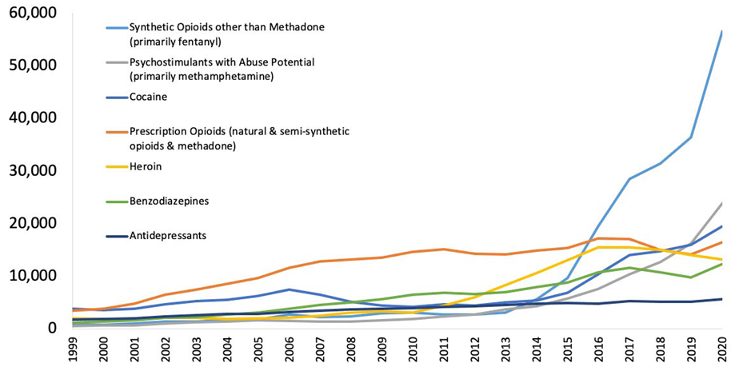
Understanding the Cumulative Effects of Overdose Rates on Parental Capacity & Family Well-Being
Wave 1, 1999:
Rise in Prescription Opioid Deaths
Wave 2, 2010:
Rise in Heroin Deaths
Wave 3, 2013: Rise in
Fentanyl Deaths
Wave 4, 2015: Rise in
Fentanyl & Stimulant Deaths
Notes:
Facilitator Script:
[As we touched on with the previous slide’s discussion], one of the most significant contributing factors to the upward trend in OOH data associated with parental AOD involves the cumulative effects of substance use including parental overdose death rates. This slide captures a data overlay highlighting the waves of opioid-related deaths spanning two decades. In a separate study, parental AOD was found to have increased child removals by 147% when examining data from 2000-2017 alone. The Office of the Assistant Secretary for Planning and Evaluation (ASPE) conducted a mixed-methods study to investigate this trend further. The study (released in early 2018) included rates of drug overdose deaths, rates of hospital stays, and emergency department visits related to substances to measure substance use prevalence. The study found a statistical relationship between the rates of drug overdose deaths and drug-related hospitalization to an increase in child welfare caseloads nationally—including a direct correlation to caseloads of families with more severe and complex needs.
Prompt for Participants:
Does the data presented (both on the slide and the supporting references) resonate with what you have been experiencing in your direct work with families affected by parental substance use?
Additional Resources:
N/A
Slide Citations:
(National Institute on Drug Abuse, 2023)
Script Citations:
(National Institute on Drug Abuse, 2023; Radel et al., 2018; Meinhofer & Angleró-Díaz, 2019)
Full Citations:
National Institute on Drug Abuse. (2023). Drug overdose death rates. National Institutes of Health. https://nida.nih.gov/research-topics/trends-statistics/overdose-death-rates
Radel, L., Baldwin, M., Crouse, G., Ghertner, R. & Waters, A. (2018). ASPE research brief: Substance use, the opioid epidemic, and the child welfare system: Key findings from a mixed methods study. Office of the Assistant Secretary for Planning and Evaluation, U.S. Department of Health and Human Services. https://aspe.hhs.gov/system/files/pdf/258836/SubstanceUseChildWelfareOverview.pdf
Meinhofer, A., & Angleró-Díaz, Y. (2019). Trends in foster care entry among children removed from their homes because of parental drug use, 2000 to 2017. JAMA Pediatrics, 173(9), 881–883. https://doi.org/10.1001/jamapediatrics.2019.1738

Slide 15
Child Welfare Laws
& Considerations for Families Affected by Parental Substance Use
Notes:
Facilitator Script:
Now that we have familiarized ourselves with the data, let’s also spend some time reviewing key child welfare laws and considerations for families affected by parental substance use…

Slide 16
Key Federal Legislation
Related to Infants with
Prenatal Substance
Exposure in the U.S.
1974
Child Abuse Prevention Treatment Act (CAPTA)
2003
The Keeping Children & Families Safe Act
2010
The CAPTA Reauthorization Act
Comprehensive Addiction & Recovery Act (CARA)
2016
Notes:
Facilitator Script:
Let’s start by reviewing a summary of key federal legislation related to infants with prenatal substance exposure in the United States.
First, we have the Child Abuse Prevention and Treatment Act (or CAPTA) dating back to 1974 which provides federal funding and guidance to states in support of prevention,
assessment, investigation, prosecution, and treatment activities related to child abuse and neglect. CAPTA also established a federal definition of child abuse and neglect.
The Keeping Children and Families Safe Act of 2003 amended and reauthorized CAPTA. The amendments included the provision of a healthcare notification regarding prenatally exposed infants to child welfare along with an identified plan of safe care outlining service engagement and care coordination.
CAPTA was again amended and reauthorized by the CAPTA Reauthorization Act of 2010, which included amending the criteria to include infants with fetal alcohol spectrum disorders (or FASDs) to notification and plan of safe care requirements.
And more recently, additional amendments were made by the Comprehensive Addiction and Recovery Act (or CARA) of 2016. The CARA act modified the CAPTA state plan requirement for infants born and identified as being affected by substance use or withdrawal symptoms or fetal alcohol spectrum disorders by adding criteria to state plans to ensure the safety and well-being of infants following their release from the care of healthcare providers, to address the health and substance use disorder treatment needs of the infant and affected family or caregiver, and to develop the plans of safe care for infants affected by all substance use (not just the use of illegal substances, as was the requirement prior to this change).
Additional Resources:
Child Welfare Information Gateway: About CAPTA: A Legislative History (2019)
National Center on Substance Abuse and Child Welfare: How States Serve Infants and Their Families Affected by Prenatal Substance Exposure (2021)
Slide Citations:
(Child Welfare Information Gateway, 2019a)
Script Citations:
(Child Welfare Information Gateway, 2019a)
Full Citations:
Child Welfare Information Gateway. (2019a). About CAPTA: A legislative history. U.S. Department of Health and Human Services, Children's Bureau. https://www.childwelfare.gov/resources/about-capta-legislative-history/

Slide 17

Adoption and Safe Families Act (ASFA)
Primary goals for child welfare intervention:
  Safety
  Permanency
  Well-being
Notes:
Facilitator Script:
The Adoption and Safe Families Act (commonly referred to as ASFA) was enacted into federal law in 1997; the goal of this law was to improve the lives of children in foster care by establishing three primary goals for child welfare intervention, these include:
Children are safely maintained in their homes whenever possible and appropriate—Safety.
Children have permanency and stability in their living situations and continuity of family relationships and natural supports is preserved for children—Permanency.
Families develop enhanced capacities to safely provide for their children’s needs (physical, mental, emotional, and educational)—Well-being.
Let’s now review the key provisions of ASFA…
Additional Resources:
N/A
Slide Citations:
N/A
Script Citations:
N/A
Full Citations:
N/A

Slide 18
Key ASFA
Provisions
Permanency Hearings
Permanency Timeline
Reunification Guidelines
Safety Checks
Accountability
Notes:
Facilitator Script:
The passage of ASFA also established new guidelines for child welfare agencies and the courts to improve permanency outcomes for children and youth in foster care (an attempt to prevent long-term foster care where children remain in care without any form of legal permanency). These key provisions included…
Permanency hearings—requires that each child must receive a permanency hearing within 12 months of entry into care with an identified permanency goal (returned home, placed for adoption, referred for legal guardianship, or an alternate permanent living arrangement).
Permanency timeline—requires child welfare agencies to file a petition for termination of parental rights for all children who have been in foster care for 15 out of the most recent 22 months. This provision also requires child welfare agencies to make concerted efforts to find an adoptive family for the child or youth regardless of age. The only exceptions being:
If the child or youth is being cared for by a relative
Demonstrates a compelling reason why filing for termination is not in the best interest of the child
The child welfare agency has not provided the family the needed services within the required deadlines
Reunification guidelines—identifies specific circumstances in which the child welfare agency is not required to make attempts to reunify children with their parent(s) due to high-risk safety concerns placing the priority on the safety of the child over family reunification. Examples of these circumstances include the parent inflicting significant harm or bodily injury on the child, parent has a conviction related to the death of the child’s sibling or half-sibling or felony assault resulting in serious bodily injury to the child or sibling (again including half-siblings), or parental rights to the child’s sibling have been involuntarily terminated.
Safety checks—requires criminal background checks be completed on all prospective foster or adoptive parents before placement of a child in the home.
Accountability—established specific guidelines and measures related to the goals of safety, permanency, and well-being. Child welfare agencies are required to undergo service reviews every three years to monitor progress and improve service delivery on behalf of children and families.
Prompts for Participants:
How do ASFA provisions affect children and families in the child welfare system?
And how might this be different for children and families affected by parental substance use?
Additional Resources:
N/A
Slide Citations:
(Child Welfare Information Gateway, 2019b)
Script Citations:
(Child Welfare Information Gateway, 2019b)
Full Citations:
Child Welfare Information Gateway. (2019b). Major federal legislation concerned with child protection, child welfare, and adoption. U.S. Department of Health and Human Services, Children's Bureau. https://www.childwelfare.gov/resources/major-federal-legislation-concerned-child-protection-child-welfare-and-adoption/

Slide 19



Conflicting Timelines: Time to Treatment Matters!
Child Welfare
Child Development
Treatment & Recovery
Notes:
Facilitator Script:
As you just identified, child welfare cases move quickly. The ASFA timeline for permanency poses challenges for children and families affected by parental substance use because it may not provide parents with enough time to complete treatment or to demonstrate sufficient stability to care for their children. Another timeline for consideration is the child’s development and the nature of the parent-child relationship. For our youngest children, we know this is a critical period of development due to the significance of their formative years, specifically related to bonding and attachment. Balancing all these needs can be challenging and speaks to importance of early identification through screening and referral for substance use disorder treatment.
Additional Resources:
National Center on Substance Abuse and Child Welfare: Child Welfare Timeline for Substance Use Disorder Treatment and Other Partners (2023)
Slide Citations:
N/A
Script Citations:
N/A
Full Citations:
N/A

Slide 20




Indian Child Welfare Act
Notes:
Facilitator Script:
Now that we’ve covered the basics of ASFA, let’s now shift our attention to another key federal law governing our practice—the Indian Child Welfare Act (or commonly known and referred to as ICWA).

Slide 21

Historical Events Leading to the Passage of ICWA
Indian Removal Act of 1830
Boarding School Experience
Urban Relocation Program
Indian Adoption Project
Notes:
Facilitator Script:
Before we get into the Indian Child Welfare Act, it is important that we first take the time to recognize and understand the historical events leading to its passage in 1978.
Dating back to 1830, congress passed the Indian Removal Act allowing for the forcible removal of Native persons from their ancestral lands and relocating them to what was referred to as “Indian Territory” the area now known as Oklahoma. The act became known as the “Trail of Tears” due to more than 4,000 Native American’s dying.
In 1891 a federal law was passed that made boarding school attendance mandatory for all Native children and allowed for withholding of key provisions such as food for any tribal communities who refused to comply with this mandate. By the 19th and 20th centuries the US and Canada were both using federal funds to operate boarding schools specifically designed for Native children's forced assimilation into white society. Children were forcibly removed from their families and were not permitted to keep their given birth name, speak in their native language, or engage in native cultural practices. Many children endured abuse, neglect, and death while under the care of these federally funded boarding schools.
In 1953 congress established a policy that ended the protected status of Indian-owned lands and support by the government. The Bureau of Indian Affairs created the urban relocation program. The program was voluntary and was designed to ease the transition. Native children and families could move from tribal lands to metropolitan areas like Chicago, Denver, Los Angeles, Cleveland, and Seattle. Understandably, acclimating to urban life was not easy; many struggled finding adequate housing and employment, and experienced many other adverse experiences.
The Indian Adoption Project was established contractually between the Child Welfare League of America (CWLA) and the Bureau of Indian Affairs (BIA) from 1958-1967. The project aimed to promote the adoption of Native children by predominantly Caucasian and religious-based families. The federally recognized project allowed child welfare agencies to forcibly remove Native children from their homes often with no formal paperwork or acknowledgement of parental rights–purposefully severing all ties to their parents, families, and culture.
According to the Association of American Indian Affairs, 85% of Native children were forcibly removed and placed into non-Native homes or institutions between the years 1941-1967 alone. As we piece together these historical events, we only begin to understand the deeply rooted historical trauma caused by our federal policies and the subsequent efforts to amend and repair these wrongdoings—to allow for individual, familial, and cultural healing. Let’s now take a closer review of the passage of ICWA.
Additional Resources:
Tribal Information Exchange Website (n.d.)
Slide Citations:
(Bureau of Indian Affairs, 2016; Tribal Information Exchange, n.d.; National Geographic Society, 2022)
Script Citations:
(Bureau of Indian Affairs, 2016; Tribal Information Exchange, n.d.; National Geographic Society, 2022)
Full Citations:
Bureau of Indian Affairs. (2016). Final rule: Indian Child Welfare Act (ICWA) proceedings. U.S. Department of the Interior. https://www.bia.gov/sites/default/files/dup/assets/bia/ois/raca/pdf/idc1-034295.pdf
Tribal Information Exchange. (n.d.). Indian Child Welfare Act. Capacity Building Center for Tribes, Administration for Children and Families, Children's Bureau. https://tribalinformationexchange.org/index.php/icwa/
National Geographic Society. (2022). Indian Removal Act. Indian Removal Act. https://education.nationalgeographic.org/resource/indian-removal-act/

Slide 22
The Passage of
ICWA in 1978
Governs state child-custody proceedings by
Recognizing Tribal jurisdiction over decisions for Indian children
Establishing minimum federal standards for the removal of Indian children from their families
Establishing preferences for placement of Indian children with extended family or other Tribal community members
Instituting protections to ensure that birth parents’ voluntary relinquishment of their children is truly voluntary
(Bureau of Indian Affairs, 2016; National Indian Law Library, 2011)​
Notes:
Facilitator Script:
The passage of ICWA in 1978 signified formal acknowledgement and the beginning of restorative justice (also commonly referred to as a remedial act) for tribal communities nationwide. Its purpose and intent was to restore and maintain connections between Indian children, their families, as well as their culture. Children and youth ages 0-18 who are a member of a federally recognized tribe, or the biological child of a member (thereby eligible for tribal membership) are protected under ICWA.
In addition, the passage of ICWA protected tribes by granting them jurisdiction over their enrolled tribal members in place of federal, state, or contracted government agencies; this included federal assistance to tribal communities for oversight of their own child and family agencies and courts with full discretion on how they choose to exercise their tribal sovereignty.
ICWA also established minimum federal standards for the removal of Indian children from their families, requiring placement into foster or adoptive homes that reflect and preserve the values of Indian culture—establishing preferences for placement with extended family or other tribal community members.
As we know, American Indian and Alaska Native children have and continue to be removed from their homes and families at a higher rate compared to other non-Native children. We just reviewed the historical events predating ICWA’s passage that highlighted the forcible and involuntary removal of children which speaks to the need to ensure that birth parents’ voluntary relinquishment of their children is truly voluntary and in no way reflective of past coercive practices. To ensure a birth parent’s voluntary consent to a foster placement, it must be executed in writing and recorded before a judge, after the parent has a full understanding of the consequences of the consent.
Let’s now watch a powerful digital story capturing the heart of ICWA…
Additional Resources:
Tribal Information Exchange Website (n.d)
National Indian Child Welfare Association Website (2024)
National Center on Substance Abuse and Child Welfare: Module 1: An Introduction to the Indian Child Welfare Act and Active Efforts (2024)
National Center on Substance Abuse and Child Welfare: ICWA Active Efforts Guidance Document (2024)
National Center on Substance Abuse and Child Welfare: ICWA Active Efforts Support Tool (2024)
Slide Citations:
(Bureau of Indian Affairs, 2016; National Indian Law Library, 2011)​
Script Citations:
(Bureau of Indian Affairs, 2016; National Indian Law Library, 2011)​
Full Citations:
Bureau of Indian Affairs. (2016). Final rule: Indian Child Welfare Act (ICWA) proceedings. U.S. Department of the Interior. https://www.bia.gov/sites/default/files/dup/assets/bia/ois/raca/pdf/idc1-034295.pdf
National Indian Law Library. (2011). A practical guide to the Indian Child Welfare Act. Native American Rights Fund. https://narf.org/nill/documents/icwa/faq/voluntary.html

Slide 23
The Heart of ICWA:
Lukas’ Digital Story
Video Credit & Permission to Use by National Indian Child Welfare Association
WWW.NICWA.ORG
Notes:
Facilitator Notes: Internet or Wi-Fi permitting, open the hyperlink for a 5-minute digital story about a family’s ICWA adoption protections. Proceed with facilitating a large group discussion using the following prompts:
Prompts for Participants:
Any initial reactions to the digital story?
Which parts of Lukas’ story resonated with you the most?
Lukas' mother's birthing experience was a painful reminder of coercive practices despite the passage of ICWA—what other challenges are Native families enduring present day?
Any key takeaways about the importance and value of preserving Native culture as perceived through Lukas’ experience?
Video Source:
National Indian Child Welfare Association

Slide 24
Understanding Substance Use &
Co-Occurring Disorders
Notes:
Facilitator Script:
Let’s now shift our attention to the topic of co-occurring substance use and mental disorders...

Slide 25
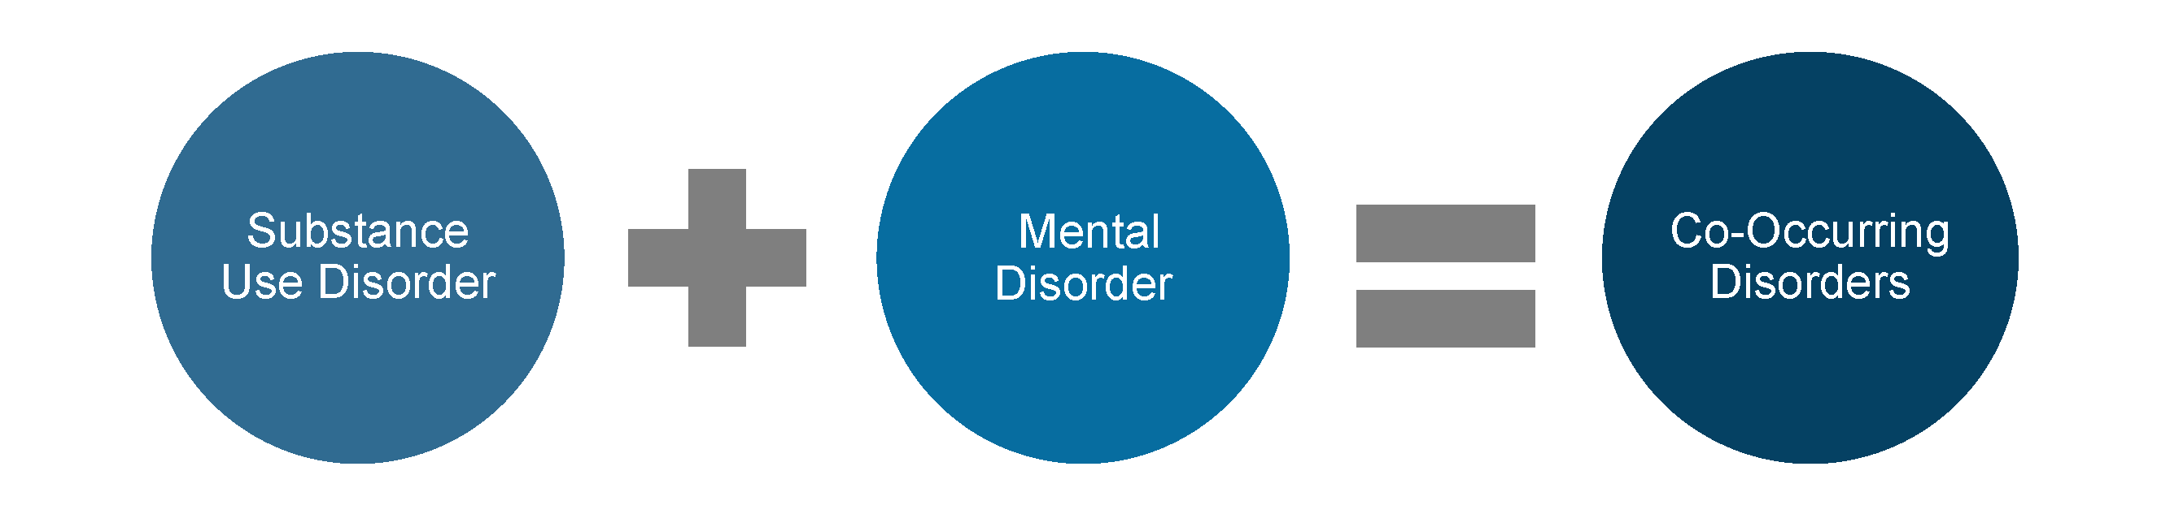
What is a Co-Occurring Disorder?
Notes:
Facilitator Script:
In this context, a co-occurring disorder is a diagnostic term used to describe when a person meets criterion for a concurrent substance use and mental disorder (of any type or severity). In other contexts, a co-occurring disorder may also represent meeting criterion for two substance use disorders or two mental disorders, respectively.
Additional Resources:
N/A
Slide Citations:
N/A
Script Citations:
N/A
Full Citations:
N/A

Slide 26

More on Substance Use & Co-Occurring Disorders
Notes:
Facilitator Script:
Co-occurring disorders present in many ways. This can include a substance use disorder in combination with a mood disorder such as depression or bipolar disorder; or an anxiety disorder such as post-traumatic stress disorder (PTSD); or for some individuals a psychotic disorder like schizophrenia (among many other different types). Regardless of the specific type, it’s important to remember that the severity of the co-occurring disorder can vary from mild, moderate, or severe. And in some instances, one disorder can mask or complicate the symptoms of the other, making it difficult to differentiate for diagnostic and treatment planning purposes.
Additional Resources:
National Center on Substance Abuse and Child Welfare: Understanding Substance Use Disorders: What Child Welfare Staff Need to Know (updated 2022)
Slide Citations:
N/A
Script Citations:
N/A
Full Citations:
N/A

Slide 27
Prevalence of Substance Use & Co-Occurring Disorders
25 million
Substance
Use Disorder
37.7 million
Mental
Disorder
21.5 million
Co-Occurring Disorders
(Substance Abuse and Mental Health Services Administration, 2023)​
Notes:
Facilitator Script:
So, just how common are co-occurring disorders? According to the 2022 National Survey on Drug Use and Health, 9.7% of adults aged 18 or older (or 25 million people) met criteria for a substance use disorder (not in combination with a mental disorder) while 14.7% (or 37.7 million people) met criteria for a mental disorder (not in combination with a substance use disorder), with another 8.4% (or 21.5 million people) meeting criterion for co-occurring disorders (or as we’ve learned, a substance use disorder in combination with a mental disorder of any type or severity).
Additional Resources:
N/A
Slide Citations:
(Substance Abuse and Mental Health Services Administration, 2023)
Script Citations:
(Substance Abuse and Mental Health Services Administration, 2023)
Full Citations:
Substance Abuse and Mental Health Services Administration. (2023). Key substance use and mental health indicators in the United States: Results from the 2022 national survey on drug use and health (NSDUH). HHS Publication No. PEP23-07-01-006, NSDUH Series H-58. U.S. Department of Health and Human Services. https://library.samhsa.gov/product/results-2022-national-survey-drug-use-and-health-nsduh-key-substance-use-and-mental-health

Slide 28

Understanding the Cumulative Effects of Trauma
Physical
Emotional/Behavioral
Cognitive
Interpersonal
Notes:
Facilitator Script:
Let’s now spend some more time on the concept of trauma. Trauma can affect all aspects of a person—from their own behavior and responses to the relationships they have with others. This is especially important for parents affected by substance use disorders as they often have a history of co-occurring trauma.
SAMHSA’s concept of trauma: “Individual trauma results from an event, series of events, or set of circumstances that is experienced by an individual as physically or emotionally harmful or life threatening and that has lasting adverse effects on the individual’s functioning and mental, physical, social, emotional, or spiritual well-being.”
Examples of adverse effects include an individual’s inability to cope with the normal stresses and strains of daily living; to trust and benefit from relationships; to manage cognitive processes, such as memory, attention, and thinking; regulating behavior; or controlling the expression of their emotions. These are just a few examples of how trauma symptoms manifest but let’s now shift to an activity to gain a more in-depth understanding of the cumulative effects of trauma.
Additional Resources:
National Center on Substance Abuse and Child Welfare: Collaborative Teams Toolkit for Trauma-Informed Care—Part 1: Trauma-Informed Care Tip Sheet for Collaborative Teams Serving Children, Parents, and Family Members Affected by Substance Use and Co-occurring Mental Health Challenges (2024)
National Center on Substance Abuse and Child Welfare: Collaborative Teams Toolkit for Trauma-Informed Care—Part 2: Trauma-Informed Care Tutorial Video (2024)
National Center on Substance Abuse and Child Welfare: Collaborative Teams Toolkit for Trauma-Informed Care—Part 3: Collaborative Trauma-Informed Care (C-TIC) Tool
Slide Citations:
N/A
Script Citations:
(Substance Abuse and Mental Health Services Administration, 2014)
Full Citations:
Substance Abuse and Mental Health Services Administration. (2014). SAMHSA’s concept of trauma and guidance for a trauma-informed approach. HHS Publication No. (SMA) 14-4884. U.S. Department of Health and Human Services. https://library.samhsa.gov/sites/default/files/sma14-4884.pdf

Slide 29
Trauma Symptomology
Small Group Activity
Notes:
Facilitator Notes: Assign participants to small groups and assign one category to each group (depending on size of training you may have groups overlap on categories which is fine). Task the groups with generating a list of signs and symptoms (e.g., fatigue, anxiety, or nightmares). Each group will then add their list to one large post-it note in the front of the training room creating a visual representation of the cumulative effects of trauma.
Small Group Assignments:
Physical Signs and Symptoms of Trauma
Emotional/Behavioral Signs and Symptoms of Trauma
Cognitive Signs and Symptoms of Trauma
Interpersonal/Relational Signs and Symptoms of Trauma
Materials Needed:
- One large easel paper in the front of the training room
- Markers for each small group
--------------------------------------------------------------------------------------------------
*Alternative Instructions for Virtual Training
Prepare a link for a word cloud generator through www.mentimeter.com. Ask participants to identify physical, emotional, cognitive, or interpersonal/relational signs or symptoms of trauma. Then display the completed word cloud for the learners in real-time to create the same effect as the in-person exercise.

Slide 30




Substance Use Disorders & Domestic Violence
Women engaged in substance use disorder treatment report high rates of DV
47-90%
lifetime prevalence
40-60%
of domestic violence (DV) incidents involve substance use
31-67%
within past year
Notes:
Facilitator Script:
When substance use and domestic violence co-occur, substance use may play a facilitative role in domestic violence by precipitating or exacerbating the violent encounter. Here we have some key data points to highlight…
Substance use is involved in 40-60% of domestic violence incidents
Women engaged in substance use disorder treatment report high rates of DV
31-67% within past year
47-90% lifetime prevalence
We’ll delve deeper into the interconnections of substance use disorders and domestic violence in module 4 of this toolkit.
Additional Resources:
N/A
Slide Citations:
(Koennicke, 2021; Warshaw & Zapata-Alma, 2025)
Script Citations:
(Koennicke, 2021; Warshaw & Zapata-Alma, 2025)
Full Citations:
Koennicke, A. (2021). Relationship between substance abuse and domestic violence. Addiction Resource. https://www.addictionresource.net/substance-abuse-and-domestic-violence/
Warshaw, C., & Zapata-Alma, G. (2025). In honor of domestic violence awareness month: Responding to substance use coercion in treatment and recovery services. National Center on Domestic Violence, Trauma, and Mental Health, Addiction Technology Transfer Center Network. https://attcnetwork.org/in-honor-of-domestic-violence-awareness-month-responding-to-substance-use-coercion-in-treatment-and-recovery-services/

Slide 31
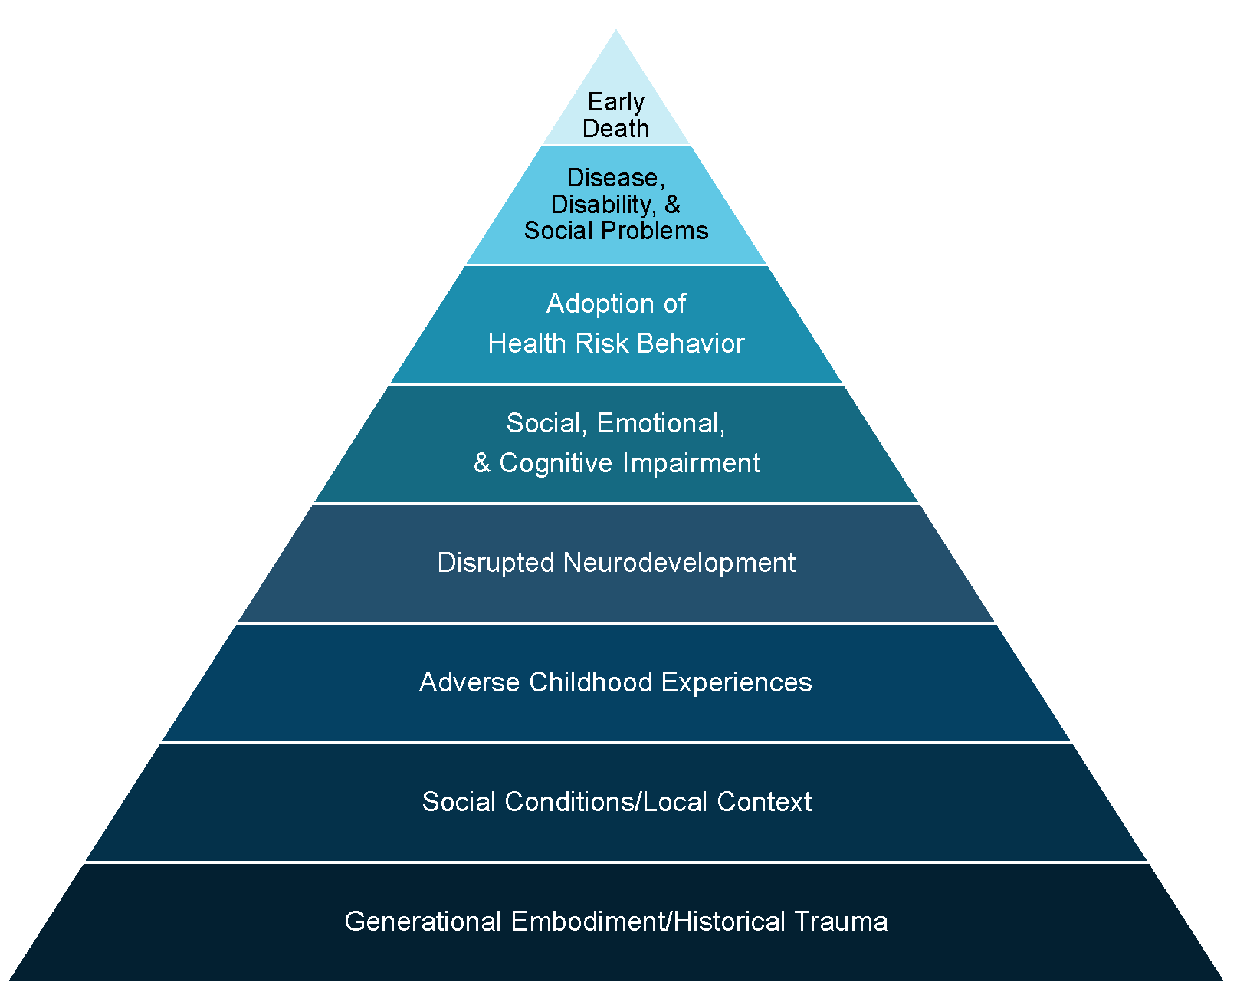
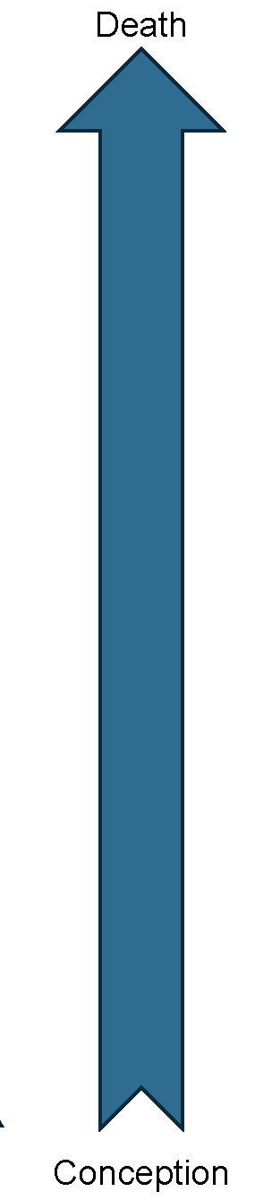
Long-Term Effects of Trauma
Mechanism by Which Adverse Childhood Experiences Influence Health and Well-Being Throughout the Lifespan
(Centers for Disease Control and Prevention, 2021; Felitti et al., 1998)
Notes:
Facilitator Script:
Parents affected by substance use and co-occurring disorders need a system of care that recognizes the cumulative effects of trauma and understands how this may impact their daily functioning and sustained recovery. Who here is familiar with the Adverse Childhood Experiences (or ACEs) Study? Would anyone like to summarize for your peers what this study found in relation to ACEs and long-term health and well-being?
Facilitator Note: [Pause to allow time for a volunteer; if no volunteers, skip the first line of praise and continue with the remaining talking points]
That was great, thank you for jumping in and sharing your knowledge with your peers.
We now have a better understanding of the cumulative effects of trauma. ACEs may include childhood exposure to various forms of abuse: emotional, psychological, physical, or sexual; household dysfunction including exposure to substance abuse, mental illness, familial violence, and/or criminal behavior. We also know that ACEs are linked to chronic health problems such as heart disease, diabetes, obesity, among many others that may result in early death. In addition, ACEs are known to increase the propensity for substance use and mental disorders in adolescence and adulthood; and can negatively impact social and well-being conditions such as educational and employment opportunities, as well as earning potential. As ACEs add up, so does the risk for these long-term health and well-being outcomes. We also now have a better understanding about the prevalence of ACEs—according to the CDC 61% of individuals surveyed across 25 states reported experiencing at least one type of ACE before age 18 with nearly 1 in 6 reporting 4 or more ACEs. Additional evidence points to greater risk for women and children from underserved communities with reports of 4 or more ACEs. We'll have a much deeper discussion about ACEs and trauma in upcoming modules, but let's now transition to watching a video describing the long-term effects of trauma.
Facilitator Note: The CDC’s webpage has detailed information on the ACE study, including free access to ACE questionnaires.
Additional Resources:
About the CDC-Kaiser ACE Study
Slide Citations:
(Centers for Disease Control and Prevention, 2021; Felitti et al., 1998)
Script Citations:
(Centers for Disease Control and Prevention, 2021; Felitti et al., 1998)
Full Citations:
Centers for Disease Control and Prevention. (2021). We can prevent childhood adversity. U.S. Department of Health & Human Services. https://vetoviolence.cdc.gov/apps/aces-infographic/
Felitti, V.J., Anda, R.F., Nordenberg, D., Edwards, V., Koss, M.P., Marks, J.S. (1998). Relationship of childhood abuse and household dysfunction to many of the leading causes of death in adults the adverse childhood experiences (ACE) study. American Journal of Preventive Medicine, 14(4), 245-258. https://doi.org/10.1016/S0749-3797(98)00017-8

Slide 32
ACEs Primer on the
Long-Term Effects of Trauma
Video Credit & Permission to Use by KPJR Films
Notes:
Facilitator Notes: Show the 5-minute video summarizing the relationship between adverse childhood experiences and long-term effects of trauma. Proceed with facilitating a large group discussion using the following prompts:
Prompts for Participants:
Any initial reactions to the video?
What specifically stood out to you from the video’s content?
Was anybody surprised to hear the statistics on substance use—5 ACEs increases the risk for an alcohol use disorder by 8x’s? What about the statistic about 6 or more ACEs leading to 20 years less in life expectancy?
How can this information about ACEs and long-term health and well-being outcomes help improve how we go about serving children and families affected by substance use and co-occurring disorders?
Video Source:
KPJR Films

Slide 33
Understanding the Effects of Substance Use &
Co-Occurring Disorders on Children & Families
Notes:
Facilitator Script:
Let’s now take what we’ve just learned and begin applying it to how it might affect child and family well-being…

Slide 34
Effects of Substance Use Disorders on Family Functioning
Child Development
Housing/Living Conditions
Level of Parenting and Supervision
Psychosocial Stressors
Support Network
Notes:
Facilitator Script:
The life of a person with a substance use disorder is often out of balance, and the negative effects of misuse or abuse can have a significant impact on those around them. Let’s review how substance use disorders can negatively affect a family’s functioning across various life domains.
Child Development
Children may present with fetal alcohol syndrome or have a history of neonatal abstinence syndrome. Infants exposed to substances may experience a range of social, emotional, and behavioral effects as a result of exposure. In the absence of universal screening practices, many children’s prenatal exposure goes undetected until later stages of development when other needs present which greatly limits the opportunity for early screening and intervention known to be associated with more optimal outcomes.
Housing and Living Conditions
It is not uncommon for families affected by substance use disorders to experience homelessness, housing insecurity and/or unsafe living conditions. We’ll learn more in the next module about the science of addiction and how misuse or abuse of substances alters our brain chemistry where the need for the substance can supersede all other basic needs. This could look like parents mismanaging their finances to support their use or not being able to plan and manage their finances (e.g., timely payment of rent or utilities), resulting in possible eviction. Alternatively, this could also look like unkept housing conditions, or exposure to safety hazards due to open use of substances, in-home manufacturing and/or selling of illicit substances.
Level of Parenting and Supervision
Substance use disorders may also interfere with consistent levels of parenting and supervision. This may look like inconsistencies in meeting a child’s physical and emotional needs; an absence of daily structure and family routines; inappropriate or inadequate levels of supervision during or immediately after active substance use; and exposure to high levels of toxic stress secondary to the parent’s own adverse childhood experiences and long-term health and well-being outcomes.
Psychosocial Stressors
Parental substance use can also be associated with a host of psychosocial stressors—we’ve already touched on some, but others include financial instability, food insecurity, limited educational and employment opportunities, exposure to violence both at the domestic and community levels, and incarceration. All contribute significantly to the level of undue toxic stress for children and families with direct impact on their stability and well-being.
Support Network
Substance use disorders affect all levels of family functioning and relationships which can greatly alter a parent’s access to a healthy support network. Remember, the brain is rewired to prioritize the drug over all other basic needs—relationships with family members and friends are not immune to this change. Parents in active use may begin surrounding themselves with other individuals who use substances and similarly, friends and family members may begin to distance themselves to exercise healthy boundaries. Parental substance use is often associated with increased social isolation and this in part is directly linked to the level of public and personal stigma—we’ll touch more on this in just a few minutes as well as cover different components throughout the remaining modules of this toolkit.
Additional Resources:
National Center on Substance Abuse and Child Welfare: Comprehensive Framework to Improve Outcomes for Families Affected by Substance Use Disorders and Child Welfare Involvement (2021)
Slide Citations:
(Smith & Wilson, 2016)
Script Citations:
(Smith & Wilson, 2016)
Full Citations:
Smith, V. C., & Wilson, C. R., AAP Committee on Substance Use and Prevention. (2016). Families affected by parental substance use. Pediatrics, 138(2), e20161575. https://doi.org/10.1542/peds.2016-1575

Slide 35

Understanding Coping Strategies of Parents with Substance Use
& Co-Occurring Disorders
Notes:
Facilitator Script:
Part of understanding the effects of substance use disorders on children and families is also understanding the various levels of coping strategies that may be at play at the point of child welfare intervention. Many persons including parents may have gone all their life without a formal diagnosis or treatment for any combination of trauma, substance use or mental disorders. It is also not uncommon for these same parents to be engaging in self-medicating behaviors with alcohol and other drugs to manage symptoms from undiagnosed or untreated trauma or mental disorders. This speaks volumes for the need for screening and assessment at point of child welfare intervention for early identification and referral to treatment as indicated. Some parents may indeed meet diagnostic criterion for a co-occurring substance use and mental disorder—but this doesn’t mean they will be ready for behavioral change which might come off as denial or minimization of use. We’ll spend much more time digging into readiness for change and stages of change theory in module 4 of this toolkit including the use of solution-focused and motivational interviewing techniques to use in your casework practice.
Additional Resources:
N/A
Slide Citations:
N/A
Script Citations:
(Child Welfare Information Gateway, 2022)
Full Citations:
Child Welfare Information Gateway. (2022). The use of safety and risk assessments in child protection cases. U.S. Department of Health and Human Services, Administration for Children and Families, Children’s Bureau. https://www.childwelfare.gov/topics/systemwide/laws-policies/statutes/safety-risk

Slide 36
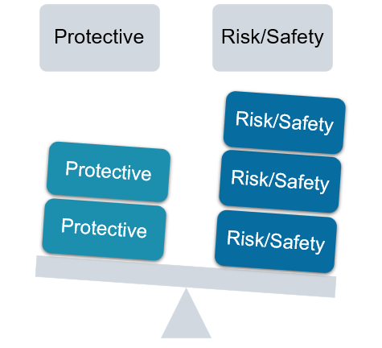
Assessment of Child Safety & Family Well-Being
Notes:
Facilitator Script:
As we know, substance use, mental disorders, and/or trauma do not in and of itself make a child unsafe or warrant child welfare intervention. As child welfare workers we must assess the situation that brought the family to the attention of the department as well as the family’s circumstances to determine if the child is in immediate or impending danger and if the child’s safety and well-being is or likely to be threatened. We do this by using standardized assessment tools for the identification of safety, risk, strengths (also commonly referred to as protective capacities and protective factors) and needs. While no standardized assessment tool can provide comprehensive insight into each family's individual dynamics and circumstances, it can inform and generate discussions with the child and family team and support collaborative case planning and decision-making. Assessment of child safety and well-being are not one-time events—rather, ongoing practice throughout the life of a family’s child welfare involvement.
We will go into greater detail on assessment and safety planning for families affected by substance use disorders in module 6 of this toolkit. But for now, let’s hear from you:
Prompt for Participants:
What standardized assessment tools are currently being used in your agency practice?
Additional Resources:
National Center on Substance Abuse and Child Welfare: Identifying Safety and Protective Capacities for Families with Parental Substance Use Disorders and Child Welfare Involvement (2023)
Slide Citations:
(Child Welfare Information Gateway, 2022)
Script Citations:
(Child Welfare Information Gateway, 2022)
Full Citations:
Child Welfare Information Gateway. (2022). The use of safety and risk assessments in child protection cases. U.S. Department of Health and Human Services, Administration for Children and Families, Children’s Bureau. https://www.childwelfare.gov/topics/systemwide/laws-policies/statutes/safety-risk

Slide 37
Engagement Strategies for Parents with
Substance Use & Co-Occurring Disorders
Lack of engagement
Outreach activities
Ambivalence
Warm
hand-offs
Lack of follow-through
Recovery support
Notes:
Facilitator Script:
The cumulative effects of substance use and co-occurring disorders may lead to myriad of actions, decisions, or behaviors that can make a parent appear uninterested, inconsistent, or evasive. Individuals who appear this way may not recognize a need for change or may feel ambivalent toward making any changes (e.g., doesn’t recognize the effects of substance use on themselves or their children/family), perhaps parents do not know how to go about taking steps toward their recovery (e.g., not sure how to access treatment or recovery supports), or may have negative experiences from past efforts at initiating change (e.g., stigma or bias; severe withdrawal symptoms or negative reactions to medications).
Our role as child welfare workers is to actively engage parents for screening, assessment, and treatment—this means going beyond just providing a referral. We do this by integrating engagement strategies to ensure access and utilization. For parents not willing to engage or who become unresponsive to your attempts to engage—don’t give up. Ambivalence is a normal part of the change process. Instead, use a strength-based approach and other engagement techniques to understand their reasons or concerns. Other strategies for engagement might be in the form of a warm hand-off with the parent and new provider or assisting parents with scheduling appointments, completing intake and enrollment paperwork, or problem-solving barriers such as lack of childcare or transportation. In addition, access to peer recovery supports (e.g., a person with lived experience and in recovery from a substance use or mental disorder) allows parents to receive help navigating the treatment system, reinforcing treatment plans and recovery behaviors, and serve as a source of hope and inspiration to the parent on their road to long-term recovery.
Additional Resources:
National Center on Substance Abuse and Child Welfare: Understanding Screening and Assessment Of Substance Use Disorders: Child Welfare Practice Tips (updated 2022)
National Center on Substance Abuse and Child Welfare: Building Collaborative Capacity Series—Module 6: Frontline Collaborative Efforts: Establishing Comprehensive Assessment Procedures and Promoting Family Engagement into Services (updated 2022)
National Center on Substance Abuse and Child Welfare: Understanding Engagement of Families Affected by Substance Use Disorders: Child Welfare Practice Tips (updated 2023)
Slide Citations:
(National Center on Substance Abuse and Child Welfare, 2022)
Script Citations:
(National Center on Substance Abuse and Child Welfare, 2022)
Full Citations:
National Center on Substance Abuse and Child Welfare. (2022). Understanding screening and assessment of substance use disorders: Child welfare practice tips. Administration for Children and Families, Substance Abuse and Mental Health Services Administration. https://ncsacw.acf.hhs.gov/files/tips-screening-assessment-508.pdf

Slide 38
5 Points of Intervention for Families Affected by SUDs
PRENATAL
BIRTH
NEONATAL, INFANCY, & POSTPARTUM
CHILDHOOD & ADOLESCENCE
PRE-PREGNANCY
Focus on preventing substance use disorders before a woman becomes pregnant through promoting public awareness of the effects of substance use (including alcohol and tobacco) during pregnancy and encouraging access to appropriate substance use disorder treatment
Focus on identifying substance use disorders among pregnant women through screening and assessment, engaging women into effective treatment services, and providing ongoing services to support recovery
Focus on identifying and addressing the needs of infants affected by prenatal substance exposure, withdrawal symptoms, and Fetal Alcohol Spectrum Disorder including the immediate need for bonding and attachment with a safe, stable, consistent caregiver
Focus on ensuring the infant’s safety and responding to the needs of the infant, mother, and family through a comprehensive approach that ensures consistent access to a safe, stable caregiver and a supportive early care environment
Focus on identifying and responding to the unique developmental and service needs of the toddler, preschooler, child, or adolescent who was exposed and/or affected by parental substance use through a comprehensive family-centered approach
Notes:
Facilitator Script:
Here we’ll wrap up this section with a visual reminder of the 5-points of intervention for families affected by substance use disorders…
Beginning with the pre-pregnancy stage—the focus is on prevention. Promoting awareness of the effects of substance use during pregnancy and encouraging access to appropriate substance use disorder treatment services.
With the prenatal stage—the focus is on early identification through screening, assessment, and referral for effective treatment services including recovery-oriented supports for pregnant women
During the birth stage—the focus is on screening and identification of prenatal substance exposure, access to non-pharmacological and pharmacological treatment to promote the health and well-being of both infant and mother.
With the neonatal, infancy, and postpartum stage—the focus should remain on meeting the comprehensive needs of the infant, mother, and family to ensure a stable and supportive early care environment.
And lastly, the childhood and adolescence stage—the focus is on early screening and identification of developmental needs and referral to indicated services and supports.
We’ll go into a much more in-depth level on these points on intervention throughout the remaining modules of this toolkit, but for now let’s segue into a discussion about stigma.
Facilitator Note: The Prenatal module has additional information on the prenatal stage and Plans of Safe Care.
Additional Resources:
National Center on Substance Abuse and Child Welfare: Infants with Prenatal Substance Exposure and their Families: Five Points of Family Intervention (2020)
National Center on Substance Abuse and Child Welfare: ICWA Active Efforts—Module 2: An Introduction to the Five Points of Family Intervention (2024)
Slide Citations:
N/A
Script Citations:
N/A
Full Citations:
N/A

Slide 39
Understanding How Stigma Affects the Families We Serve
Notes:
Facilitator Script:
Understanding how stigma affects the families we serve is critical to their well-being and recovery outcomes. Let’s start off this discussion with a little exercise…

Slide 40
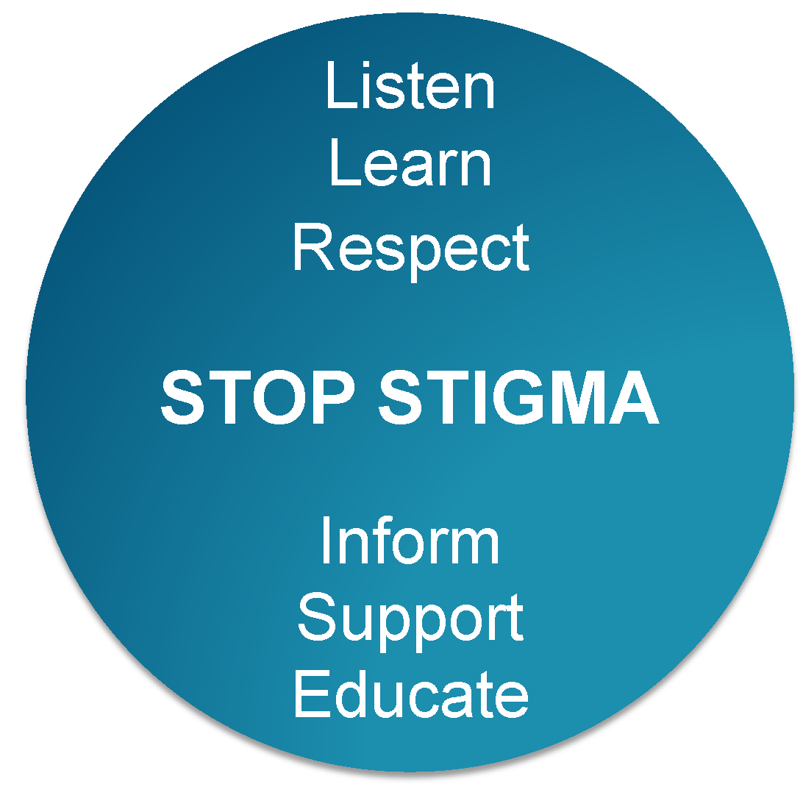
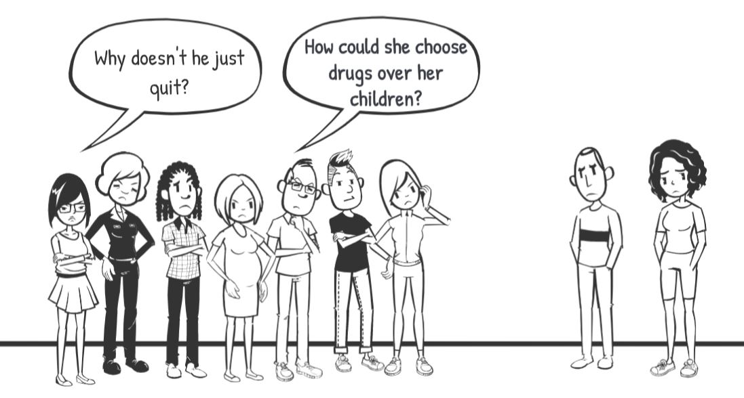
What is Stigma?
Notes:
Facilitator Script:
With a show of hands, who here has heard any one of these two comments made in relation to your work with children and families affected by substance use disorders? “Why doesn’t he just quit?” and “How could she choose drugs over her children?” Now these are just two examples, but what others come to mind?
Facilitator Note: [allow time for responses before proceeding ahead]
Other examples include:
- Once an addict, always an addict.
- They really must not love their children or else they would just stop using drugs.
- Children should be removed from parents who abuse alcohol or drugs.
Thank you for your additions. Now let’s turn our attention to how common statements like these shape and perpetuate substance use disorder stigma.
Additional Resources:
National Center on Substance Abuse and Child Welfare: Disrupting Stigma: A Virtual Conversation (2022)
Slide Citations:
N/A
Script Citations:
N/A
Full Citations:
N/A

Slide 41
Disrupting Stigma to
Support Meaningful Change
Animated Video by Children and Family Futures
Notes:
Facilitator Notes: Internet or Wi-Fi permitting, open the hyperlink for a 5-minute animated video about disrupting stigma to support meaningful change. Proceed with facilitating a large group discussion using the following prompts:
Prompts for Participants:
Any initial reactions to the animated video?
We heard some examples of institutional stigma specific to Family Treatment Court (or FTC) program requirements—what are some other examples of how institutional stigma affects child welfare outcomes?
What about the relationship between the media and public stigma—in what ways has the media perpetuated negative stereotypes (or attitudes, beliefs, values) about individuals affected by substance use disorders, and specifically in relation to parenting?
From your experience, how has self-stigma (or what we commonly refer to as shame) affected parent’s engagement and retention in child welfare and substance use disorder treatment services?
Video Source:
Children and Family Futures

Slide 42


Burden of Stigma
Stigmatized Conditions
High perceived fault
High perceived control
Low perceived fault
Low perceived control
Non-Stigmatized Conditions
Notes:
Facilitator Script:
As we now know, stigma can significantly influence health and well-being outcomes. For parents affected by substance use disorders this can be especially true, as fear of being judged or penalized for their condition often prevents them from seeking out and/or agreeing to the help that they need.
The burden of stigma (as represented on the slide) demonstrates how when individuals perceive a low level of fault and a low level of control over their substance use disorder, the level of perceived stigma decreases; whereas if an individual feels that others blame them for their substance use—that their condition is a choice (and a bad one at that) and that they can change if they really want to—the level of perceived stigma increases.
Another form of stigma that we can work to prevent is attribution error. Let’s put this into perspective for a moment. If a parent is late dropping off their children to school or making it to a pediatrician's appointment it is easy to attribute fault to things like the morning commute and subsequent traffic, or the reality of having kids—misplaced shoes or backpacks, last minute diaper change, etc. Now let’s use the scenario of a parent who may arrive late or miss their treatment session or child and family team meeting—in this scenario, how quick are we to attribute fault to things like parental lack of engagement or accountability?
This concept of perceived fault and control is so critical to our work with parents, children, and families. So, let’s continue this discussion as it relates to the language we use in our collaborative treatment and case planning.
Additional Resources:
National Center on Substance Abuse and Child Welfare: Disrupting Stigma: How Understanding, Empathy, and Connection Can Improve Outcomes for Families Affected by Substance Use Disorders (2022)
Slide Citations:
(Education Development Center, 2017)
Script Citations:
(Education Development Center, 2017)
Full Citations:
Education Development Center. (2017). Words matter: How language choice can reduce stigma. EDC Solutions. https://preventionsolutions.edc.org/sites/default/files/attachments/Words-Matter-How-Language-Choice-Can-Reduce-Stigma.pdf

Slide 43






Your Choice of Language Reflects Your Understanding of Substance Use Disorders as a Disease
Instead of… | Try…
Addict/Drug Abuser | Person/Parent with a substance use disorder
Clean/Dirty Drug Screen | Screen tested negative or positive for substances
Former Addict | Person in recovery
Drug Addicted Baby | Infant with prenatal substance exposure
Hard-to-Place Kids | Children affected by trauma
Foster Child | Child in-care or out-of-home placement
Notes:
Facilitator Script:
Reframing our use of language is one of many first steps to help reduce stigma and raise awareness about substance use disorders as a chronic disease, not a personal failing.
With a show of hands who still hears the terms in the first column being used in our field present day? [allow time for a response]
Let’s examine a few of these more closely…
Clean/Dirty Drug Test—What does that say about the person who tested positive for a substance? That they are dirty? Does that language increase or decrease stigma?
Drug Addicted Baby—Are babies really addicted? No. Addiction is characterized by tolerance and cravings. Babies don’t have cravings. They may be exposed prenatally and may have a physical dependency—but they are not addicted.
Drug Abuse—What does this really mean? Think back to the idea of perceived fault and perceived control. The word “abuse” implies the person is at fault and has control over their behavior.
The language we use matters! When we engage with or on behalf of parents, children, and families affected by substance use disorders we want to be using person-first language, which is a strength-based approach that places emphasis on the person before their condition versus using the condition to define the person—a powerful shift as depicted by the examples highlighted on the slide. We’ll continue to delve into the topic of stigma and person-first language in other modules throughout the toolkit, but for now, let’s transition to a small group exercise.
Additional Resources:
N/A
Slide Citations:
N/A
Script Citations:
N/A
Full Citations:
N/A

Slide 44
Strategies for Combating Stigma
Small Group Discussion
Notes:
Facilitator Script:
Let’s convene in our small groups for the next [x] minutes to discuss strategies for combating stigma. Use the following list of questions to help facilitate your small group discussions…
Prompts for Participants:
Is the language we use to engage parents, children, and families strength-based and person-first?
Are there other terms or labels that perpetuate stigma for families affected by substance use disorders?
What about current child welfare policies and practices—do these help to reduce or perpetuate stigma for families affected by substance use disorders?
Facilitator Note: Reconvene learners for a large group debrief highlighting key takeaways or lessons from the small group discussions.
_______________________________________________________________
*Alternative Option for Virtual Instruction
Engage learners for the list of facilitative prompts in a large group virtual format.

Slide 45
Strategies for Combating Stigma
Small Group Discussion Questions
Is the language we use to engage parents, children, and families strength-based and person-first?
Are there other terms or labels that perpetuate stigma for families affected by substance use disorders?
What about current child welfare policies and practices—do these help to reduce or perpetuate stigma for families affected by substance use disorders?
Notes:
Facilitator Notes:
In-person training: ask learners to identify a scriber for their small group discussion to support readiness for large group debrief. After [x] minutes, bring the learners back for a large group debrief asking for volunteers to share highlights or key takeaways from their table discussions.
Virtual training: proceed with facilitating a large group discussion.

Slide 46
Treatment of Substance Use & Co-Occurring Disorders
Notes:
Facilitator Script:
Let’s now segue into a broad-level overview regarding treatment of substance use and co-occurring disorders…

Slide 47

“Groundbreaking discoveries about the brain have revolutionized our understanding of addiction, enabling us to respond effectively to the problem.”
—Dr. Nora Volkow,
National Institute on Drug Abuse
A Treatable Disease
Notes:
Facilitator Script:
Substance use disorders are a treatable disease! Through scientific advances, we now have a better understanding about the short- and long-term effects of substance use, namely the powerful influence on brain circuitry and subsequent physical and psychological effects. These groundbreaking discoveries have led to improvements in how we approach substance use disorder treatment for sustained long-term recovery—often a combination of medication, behavioral interventions, and peer recovery support.
Additional Resources:
N/A
Slide Citations:
(Volkow et al., 2016)
Script Citations:
(Volkow et al., 2016)
Full Citations:
Volkow, N. D., Koob, G. F., & Mclellan, T. A. (2016). Neurobiologic advances from the brain disease model of addiction. New England Journal Of Medicine, 374(4), 363-371. https://doi.org/10.1056/NEJMra1511480

Slide 48
Overview of the Treatment Process
Early Identification, Screening, and Brief Intervention
Done at earliest point possible
Comprehensive Assessment
Determine extent and severity of disease
Stabilization
Via medically supervised withdrawal when necessary
Timely and Appropriate Substance Use Disorder Treatment
Timely and Appropriate Substance Use Disorder Treatment
Address substance use disorder and co-occurring issues
Continuing Care and Recovery Support
Help parents sustain recovery, maintain family safety and stability
Notes:
Facilitator Script:
As child welfare workers, when we have concerns that a parent may have a substance use disorder, we should ensure timely screening and refer the parent for a substance use disorder assessment when indicated. This slide provides a general overview of the treatment process from assessment through ongoing support or aftercare. We’ll have a more in-depth discussion of the assessment and treatment process in Module 2 of this toolkit, but for now let’s spend more time reviewing treatment services and approaches.
Additional Resources:
National Center on Substance Abuse and Child Welfare: Understanding Screening and Assessment of Substance Use Disorders: Child Welfare Practice Tips (updated 2022)
National Center on Substance Abuse and Child Welfare: Understanding Substance Use Disorder Treatment: A Resource Guide for Professionals Referring to Treatment (updated 2022)
Slide Citations:
(American Society of Addiction Medicine, 2014)
Script Citations:
(American Society of Addiction Medicine, 2014)
Full Citations:
American Society of Addiction Medicine. (2014). The ASAM performance measures for the addiction specialist physician, 13. https://www.asam.org/docs/default-source/advocacy/performance-measures-for-the-addiction-specialist-physician.pdf?sfvrsn=5f986dc2_0

Slide 49
Specialized Treatment Services
What is specialized treatment services?
What are the benefits of this treatment option?
  Considerations for males
  Considerations for females
Notes:
Facilitator Script:
Specialized treatment services are designed to meet the unique needs of men and women, respectively. While both men and women are affected by substance use disorders, how they are each affected may be different. Specialized treatment allows practitioners to tailor programming to these very specific differences which often include information on preferred substances, rates of dependence, neurobiological responses, and careful attention to psychosocial stressors that may increase risk of return to use.
In addition to addressing these inherent biopsychosocial differences, specialized treatment programming also allows for an environment that is tailored to the emotional and interpersonal needs of men and women alike. For men, this may mean a greater emphasis on their physiological needs as a strategy to build trust and a willingness to speak openly about their emotional and psychological needs. Whereas women who are more generally open and willing to speak freely may need the safety of a women’s treatment group especially when addressing areas of domestic violence and trauma. Lastly, specialized treatment programming allows men and women to prioritize their health and well-being away from the opposite sex thereby reducing the risk of co-dependent relationships during treatment.
Additional Resources:
N/A
Slide Citations:
N/A
Script Citations:
(Substance Abuse and Mental Heath Services Administration, 2021a; Substance Abuse and Mental Health Services Administration, 2013)
Full Citations:
Substance Abuse and Mental Health Services Administration. (2021a). Addressing the specific needs of women for treatment of substance use disorders. Advisory. Publication No. PEP20-06-04-002. U.S. Department of Health and Human Services. https://store.samhsa.gov/sites/default/files/pep20-06-04-002.pdf
Substance Abuse and Mental Health Services Administration. (2013). Addressing the specific behavioral health needs of men. Treatment improvement protocol (TIP) series 56. HHS Publication No. (SMA) 13-4736. U.S. Department of Health and Human Services. https://store.samhsa.gov/product/tip-56-addressing-specific-behavioral-health-needs-men/sma14-4736

Slide 50
Family-Focused Intervention
Parent Recovery
Parenting skills
& competencies
Family connections
& resources
Parental mental health
Medication management
Parental substance use
Domestic violence
Child Well-Being
Physical health & well-being
Social/Emotional development
School readiness
Trauma
Mental health
Adolescent
substance abuse
At-risk youth prevention
Family Recovery
and Well-Being
Food
Housing
Employment
Childcare
Transportation
Family counseling
Specialized parenting
Notes:
Facilitator Script:
When serving a family holistically intervention efforts are designed to meet the needs of every member of the family. This includes identifying the family’s strengths and using these as a catalyst for achieving increased safety and stability.
Services to support the parent’s recovery should include:
Parenting skills and competencies
Family connections and resources
Parental mental health
Medication management
Parental substance use
Domestic violence
Providing services that support child’s well-being must include:
Physical health and well-being
Social/emotional development
School readiness
Trauma
Mental health
Adolescent substance use
At-risk youth prevention
Supporting the entire family's recovery and well-being means providing:
Food
Housing
Employment
Childcare
Transportation
Family counseling
Specialized parenting
Additional Resources:
National Center on Substance Abuse and Child Welfare: Overview of a Family-Centered Approach and Its Effectiveness (2021)
Slide Citations:
N/A
Script Citations:
N/A
Full Citations:
N/A

Slide 51



Family-Centered Approach
Recognizes that addiction is a brain disease that affects the entire family, and that recovery and well-being occurs in the context of the family
Provides a comprehensive array of clinical treatment and related support services that meet the needs of each member in the family, not only the individual requesting care
Extends well beyond the substance use disorder (SUD) treatment system, the child welfare system, the courts, and mental health services, and includes all other agencies and individuals that interact with and serve families
(Adams, 2016; Bruns et al., 2012; National Center on Substance Abuse and Child Welfare, 2021)
Notes:
Facilitator Script:
A family centered approach recognizes and accepts the individual person’s definition of family and recognizes that every person defines “family” differently.
​A family-centered approach extends well beyond the substance use disorder treatment system, the child welfare system, the courts, and mental health services. It includes all other agencies and individuals that interact with and serve families. It was important to us to be very intentional about our language. We used the phrase “family-centered treatment” when we were talking about treatment specifically but whenever possible we used “family-centered approach” to be more encompassing of all systems.
Not all this work is clinical.
A family-centered approach is important with schools, doctors, early education providers, anyone that is providing services to people.
A family-centered approach recognizes that parents and children live within the context of a larger family system and that families exist within the context of their identified communities—all of which must be prioritized when implementing a family-centered approach. This often requires a paradigm shift from business as usual, as identifying the family as a system requires a shift in thinking for service providers who have traditionally focused on their identified client. However, we know that child safety and parental recovery are critically linked to one another and must be addressed holistically to ensure the best outcomes for the entire family.
Additional Resources:
National Center on Substance Abuse and Child Welfare: Implementing a Family-Centered Approach Modules (2021)
Slide Citations:
(Adams, 2016; Bruns et al., 2012; National Center on Substance Abuse and Child Welfare, 2021)
Script Citations:
N/A
Full Citations:
Adams, P. J. (2016). Switching to a social approach to addiction: Implications for theory and practice. International Journal of Mental Health and Addiction, 14(1), 86–94. http://dx.doi.org/10.1007/s11469-015-9588-4
Bruns, E. J., Pullmann, M. D., Weathers, E. S., Wirschem, M. L., & Murphy, J. K. (2012). Effects of a multidisciplinary family treatment drug court on child and family outcomes: Results of a quasi-experimental study. Child Maltreatment, 17(3), 218–230. https://doi.org/10.1177/1077559512454216
National Center on Substance Abuse and Child Welfare. (2021). Overview of a family-centered approach and its effectiveness. Administration for Children and Families, Substance Abuse and Mental Health Services Administration. https://ncsacw.acf.hhs.gov/files/fca-practice-module-1.pdf

Slide 52

Benefits of Family-Centered
Substance Use Disorder Treatment
Mothers who participated in the Celebrating Families! Program and received integrated case management showed significant improvements in recovery, including reduced mental health symptoms, reduction in risky behaviors, and longer program retention
(Zweben et al., 2015)
Women who participated in programs that included a “high” level of family and children’s services were twice as likely to reunify with their children as those who participated in programs with a “low” level of these services
(Grella et al., 2006)
Retention and completion of comprehensive substance use treatment have been found to be the strongest predictors of reunification with children for parents with substance use disorders
(Green et al., 2007; Marsh et al., 2011)
Notes:
Facilitator Script:
Here we have a summary of proven outcomes from family-centered substance use disorder treatment…
Mothers who participated in the Celebrating Families! Program and received integrated case management showed significant improvements in recovery, including reduced mental health symptoms, reduction in risky behaviors, and longer program retention
Women who participated in programs that included a “high” level of family and children’s services were twice as likely to reunify with their children as those who participated in programs with a “low” level of these services
Retention and completion of comprehensive substance use treatment have been found to be the strongest predictors of reunification with children for parents with substance use disorders
Additional Resources:
N/A
Slide Citations:
(Zweben et al., 2015; Grella et al., 2006; Green et al., 2007; Marsh et al., 2011)
Script Citations:
(Zweben et al., 2015; Grella et al., 2006; Green et al., 2007; Marsh et al., 2011)
Full Citations:
Zweben, J. E., Moses, Y., Cohen, J. B., Price, G., Chapman, W., & Lamb, J. (2015). Enhancing family protective factors in residential treatment for substance use disorders. Child Welfare, 94(5), 145–166.
Grella, C. E., Hser, Y., & Huang, Y. (2006). Mothers in substance abuse treatment: Differences in characteristics based on involvement with child welfare services. Child Abuse & Neglect, 30(1), 55–73. https://doi.org/10.1016/j.chiabu.2005.07.005
Green, B. L., Rockhill, A., & Furrer, C. (2007). Does substance abuse treatment make a difference for child welfare case outcomes? A statewide longitudinal analysis. Children and Youth Services Review, 29(4), 460–473. https://doi.org/10.1016/j.childyouth.2006.08.006
Marsh, J. C., Smith, B. D., & Bruni, M. (2011). Integrated substance abuse and child welfare services for women: A progress review. Children and Youth Services Review, 33(3), 466–472. https://doi.org/10.1016/j.childyouth.2010.06.017

Slide 53
The Role of Collaborative Partnerships in Helping Families Navigate Parental Substance Use & Child Safety
Notes:
Facilitator Script:
Let’s now close out today’s training discussion with acknowledging the important role collaborative partnerships play in helping families navigate parental substance use and child safety…

Slide 54



The Need to Do Better for Families
Lower likelihood of successful reunification
Children tend to remain in out-of-home care longer
Notes:
Facilitator Script:
The process of engaging and retaining parents with substance use disorders for screening, assessment, treatment, and in moving from treatment to lifelong recovery is multifaceted and complex.
We know families affected by substance use disorders and involved with child welfare often face a host of challenges and barriers to family well-being. While recovery is possible, substance use disorders can negatively affect a parent’s ability to safely parent their children in the absence of services and supports to promote recovery and family stability. At the point of removal, we also know these same families have a lower likelihood of successful reunification and children tend to stay in out-of-home care longer.
Additional Resources:
N/A
Slide Citations:
(Brook et al., 2010; Radel et al., 2018; Wulczyn et al., 2011)​
Script Citations:
(Brook et al., 2010; Radel et al., 2018; Wulczyn et al., 2011)​
Full Citations:​
​
Brook, J., McDonald, T., Gregoire, T., Press, A. & Hindan, B. (2010). Parental substance abuse and family reunification. Journal of Social Work Practice in the Addictions, 10(4), 393-412. https://doi.org/10.1080/1533256X.2010.521078 ​
​
Radel, L., Baldwin, M., Crouse, G., Ghertner, R. & Waters, A. (2018). ASPE research brief: Substance use, the opioid epidemic, and the child welfare system: Key findings from a mixed methods study. Office of the Assistant Secretary for Planning and Evaluation, U.S. Department of Health and Human Services. https://aspe.hhs.gov/system/files/pdf/258836/SubstanceUseChildWelfareOverview.pdf ​
​
Wulczyn, F., Ernst, M., & Fisher, P. (2011). Who are the infants in out-of-home care? An epidemiological and developmental snapshot. Chapin Hall at the University of Chicago, The Center for State Child Welfare Data. https://fcda.chapinhall.org/wp-content/uploads/2012/10/2011_infants_issue-brief.pdf

Slide 55

Improving Partnerships:
No Single Agency Can Do This Alone
Better Together
Improving outcomes for children and families affected by parental substance use requires a coordinated response that draws from the talents and resources of at least the following systems:
Child Welfare
Treatment Providers
Courts
Notes:
Facilitator Script:
We also know that no single agency can tackle this issue on its own—it requires a coordinated multi-system approach that draws on the talents and resources of many agencies and providers to promote the safety, permanency, well-being, and recovery outcomes of parents, children, and families. This new way of doing business will rely heavily on relationships across systems and within our communities that extends far beyond that of child welfare, substance use disorder treatment providers, and the courts—reaching agencies and providers in healthcare, early childhood, education, and family support—to just name a few.
Additional Resources:
National Center on Substance Abuse and Child Welfare: Building Collaborative Capacity Series (updated 2022)
Slide Citations:
N/A
Script Citations:
N/A
Full Citations:
N/A

Slide 56

An Important Reminder About the 'Why'
Behind Our Collaborative Partnerships
Meaningful collaboration across systems that includes agreement on common values, enhanced communication and information sharing, blended funding and data collection for shared outcomes…
…results in improved outcomes for families including increased engagement and retention of parents in substance use disorder treatment, fewer children removed from parental custody, increased family reunification post-removal and fewer children re-entering the child welfare system and out-of-home care.
Notes:
Facilitator Script:
And finally, we also know that cultivating collaborative partnerships takes time and an ongoing commitment from all involved—we’ll have a more in-depth discussion on this topic in module 7 but wanted to close out today’s training with an important reminder about the ‘why’ behind our work…
Optimal family outcomes rely on a coordinated and collaborative approach across systems. When partner agencies share common values, understand each other’s roles and responsibilities, and streamline procedures and protocols this leads to improved efficiencies in case planning and more effective monitoring of progress toward identified goals and objectives; these cross-system improvements in turn, result in an improved experiences for parents, children, and families—translating to better treatment engagement and retention, fewer child removals, improved reunification rates including lowered rates of re-entry.
Additional Resources:
N/A
Slide Citations:
(Boles et al., 2012; Dennis et al., 2015; Drabble, 2010; Substance Abuse and Mental Health Services Administration, 2020)
Script Citations:
N/A
Full Citations:
Boles, S., Young, N.K., Dennis, K. & DeCerchio, K. (2012). The regional partnership grant (RPG) program: Enhancing collaboration, promising results. Journal of Public Child Welfare, 6(4), 482-496. https://doi.org/10.1080/15548732.2012.705239
Dennis, K., Rodi, M. S., Robinson, G., DeCerchio, K., Young, N. K., Gardner, S. L., Stedt, E., & Corona, M. (2015). Promising results for cross-systems collaborative efforts to meet the needs of families impacted by substance use. Child Welfare, 94(5e), 21. https://www.ncbi.nlm.nih.gov/pubmed/26827463
Drabble, L. (2010). Advancing collaborative practice between substance abuse treatment and child welfare fields: what helps and hinders the process? Administration in Social Work, 35(1), 88-106. http://dx.doi.org/10.1080/03643107.2011.533625
Substance Abuse and Mental Health Services Administration. (2020). Substance use disorder treatment and family therapy. Treatment improvement protocol (TIP) series, No. 39. HHS Publication No. PEP20-02-02-012. U.S. Department of Health and Human Services. https://store.samhsa.gov/sites/default/files/tip-39-substance-abuse-treatment-family-therapy-pep20-02-02-012.pdf

Slide 57
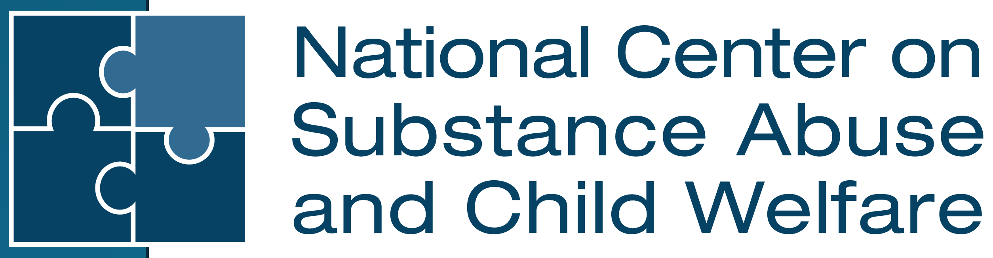
Contact the NCSACW Training and Technical Assistance (TTA) Program
Connect with programs that are developing tools and implementing practices and protocols to support their collaborative
Training and technical assistance to support collaboration and systems change
https://ncsacw.acf.hhs.gov/
ncsacw@cffutures.org
Toll-Free @ 1-866-493-2758
Notes:
Facilitator Script:
Alright everyone, this concludes the instructional content for module one. If you have any follow up questions from today’s training, feel free to reach out to the National Center on Substance Abuse and Child Welfare at ncsacw@cffutures.org or toll free at 1-866-493-2758. Thank you all for our rich training discussion today and for your continued work on behalf of children, parents, and families affected by substance use and co-occurring disorders.

Slide 58
References

Slide 59
References, 1 of 5
Adams, P. J. (2016). Switching to a social approach to addiction: Implications for theory and practice. International Journal of Mental Health and Addiction, 14(1), 86–94. http://dx.doi.org/10.1007/s11469-015-9588-4
American Society of Addiction Medicine. (2014). The ASAM performance measures for the addiction specialist physician. https://www.asam.org/docs/default-source/advocacy/performance-measures-for-the-addiction-specialist-physician.pdf?sfvrsn=5f986dc2_0
Boles, S., Young, N.K., Dennis, K. & DeCerchio, K. (2012). The regional partnership grant (RPG) program: Enhancing collaboration, promising results. Journal of Public Child Welfare, 6(4), 482-496. https://doi.org/10.1080/15548732.2012.705239
Brook, J., McDonald, T., Gregoire, T., Press, A. & Hindan, B. (2010). Parental substance abuse and family reunification. Journal of Social Work Practice in the Addictions, 10(4), 393-412. https://doi.org/10.1080/1533256X.2010.521078
Bruns, E. J., Pullmann, M. D., Weathers, E. S., Wirschem, M. L., & Murphy, J. K. (2012). Effects of a multidisciplinary family treatment drug court on child and family outcomes: Results of a quasi-experimental study. Child Maltreatment, 17(3), 218–230. https://doi.org/10.1177/1077559512454216
Bureau of Indian Affairs. (2016). Final rule: Indian Child Welfare Act (ICWA) proceedings. U.S. Department of the Interior. https://www.bia.gov/sites/default/files/dup/assets/bia/ois/raca/pdf/idc1-034295.pdf
Center for Children and Family Futures. (2024). Analyses of the 2021 Adoption and Foster Care Analysis and Reporting System from the National Data Archive on Child Abuse and Neglect (file number 274) [Data set]. NDACAN. https://www.ndacan.acf.hhs.gov/
Centers for Disease Control and Prevention. (2021). We can prevent childhood adversity. National Center for Injury Prevention and Control, Division of Violence Prevention. https://vetoviolence.cdc.gov/apps/aces-infographic/
Child Welfare Information Gateway. (2019a). About CAPTA: A legislative history. U.S. Department of Health and Human Services, Children's Bureau. https://www.childwelfare.gov/resources/about-capta-legislative-history/

Slide 60
References, 2 of 5
Child Welfare Information Gateway. (2019b). Major federal legislation concerned with child protection, child welfare, and adoption. U.S. Department of Health and Human Services, Children's Bureau. https://www.childwelfare.gov/resources/major-federal-legislation-concerned-child-protection-child-welfare-and-adoption/
Child Welfare Information Gateway. (2022). The use of safety and risk assessments in child protection cases. U.S. Department of Health and Human Services, Administration for Children and Families, Children’s Bureau. https://www.childwelfare.gov/topics/systemwide/laws-policies/statutes/safety-risk
Dennis, K., Rodi, M. S., Robinson, G., DeCerchio, K., Young, N. K., Gardner, S. L., Stedt, E., & Corona, M. (2015). Promising results for cross-systems collaborative efforts to meet the needs of families impacted by substance use. Child Welfare, 94(5e), 21. https://www.ncbi.nlm.nih.gov/pubmed/26827463
Drabble, L. (2010). Advancing collaborative practice between substance abuse treatment and child welfare fields: What helps and hinders the process? Administration in Social Work, 35(1), 88-106. http://dx.doi.org/10.1080/03643107.2011.533625
Education Development Center. (2017). Words matter: How language choice can reduce stigma. EDC Solutions. https://preventionsolutions.edc.org/sites/default/files/attachments/Words-Matter-How-Language-Choice-Can-Reduce-Stigma.pdf
Felitti, V.J., Anda, R.F., Nordenberg, D., Edwards, V., Koss, M.P., Marks, J.S. (1998). Relationship of childhood abuse and household dysfunction to many of the leading causes of death in adults the adverse childhood experiences (ACE) study. American Journal of Preventive Medicine, 14(4), 245-258. https://doi.org/10.1016/S0749-3797(98)00017-8
Ghertner, R. (2023). U.S. national and state estimates of children living with parents using substances, 2015-2019. Assistant Secretary for Planning and Evaluation, Office of Human Services Policy. https://aspe.hhs.gov/sites/default/files/documents/faa1b19e66053008e89782914f0aa693/children-at-risk-of-sud.pdf ​
Green, B. L., Rockhill, A., & Furrer, C. (2007). Does substance abuse treatment make a difference for child welfare case outcomes? A statewide longitudinal analysis. Children and Youth Services Review, 29(4), 460–473. https://doi.org/10.1016/j.childyouth.2006.08.006

Slide 61
References, 3 of 5
Grella, C. E., Hser, Y., & Huang, Y. (2006). Mothers in substance abuse treatment: Differences in characteristics based on involvement with child welfare services. Child Abuse & Neglect, 30(1), 55–73. https://doi.org/10.1016/j.chiabu.2005.07.005
Kennedy, S. C., Miller, C., & Wilke, D. (2020). Development and validation of the child welfare provider stigma inventory. Journal of Social Work, 20(6), 703–729. https://doi.org/10.1177/1468017319837518
Koennicke, A. (2021). Relationship between substance abuse and domestic violence. Addiction Resource. https://www.addictionresource.net/substance-abuse-and-domestic-violence/
Marsh, J. C., Smith, B. D., & Bruni, M. (2011). Integrated substance abuse and child welfare services for women: A progress review. Children and Youth Services Review, 33(3), 466–472. https://doi.org/10.1016/j.childyouth.2010.06.017
Meinhofer, A., & Angleró-Díaz, Y. (2019). Trends in foster care entry among children removed from their homes because of parental drug use, 2000 to 2017. JAMA Pediatrics, 173(9), 881–883. https://doi.org/10.1001/jamapediatrics.2019.1738
National Center on Substance Abuse and Child Welfare. (2021). Overview of a family-centered approach and its effectiveness. Administration for Children and Families, Substance Abuse and Mental Health Services Administration. https://ncsacw.acf.hhs.gov/files/fca-practice-module-1.pdf
National Center on Substance Abuse and Child Welfare. (2022). Understanding screening and assessment of substance use disorders: Child welfare practice tips. Administration for Children and Families, Substance Abuse and Mental Health Services Administration. https://ncsacw.acf.hhs.gov/files/tips-screening-assessment-508.pdf
National Geographic Society. (2022). Indian Removal Act. Indian Removal Act. https://education.nationalgeographic.org/resource/indian-removal-act/
National Indian Law Library. (2011). A practical guide to the Indian Child Welfare Act. Native American Rights Fund. https://narf.org/nill/documents/icwa/faq/voluntary.html

Slide 62
References, 4 of 5
National Institute on Drug Abuse. (2018). Principles of drug addiction treatment: A research-based guide (3rd ed.). U.S. Department of Health and Human Services, National Institutes of Health. https://www.drugabuse.gov/publications/principles-drug-addiction-treatment-research-based-guide-third-edition
National Institute on Drug Abuse. (2023). Drug overdose death rates. U.S. Department of Health and Human Services, National Institutes of Health. https://nida.nih.gov/research-topics/trends-statistics/overdose-death-rates
Radel, L., Baldwin, M., Crouse, G., Ghertner, R. & Waters, A. (2018). ASPE research brief: Substance use, the opioid epidemic, and the child welfare system: Key findings from a mixed methods study. Office of the Assistant Secretary for Planning and Evaluation, U.S. Department of Health and Human Services. https://aspe.hhs.gov/system/files/pdf/258836/SubstanceUseChildWelfareOverview.pdf
Smith, V. C., & Wilson, C. R., AAP Committee on Substance Use and Prevention. (2016). Families affected by parental substance use. Pediatrics, 138(2), e20161575. https://doi.org/10.1542/peds.2016-1575
Substance Abuse and Mental Health Services Administration. (2013). Addressing the specific behavioral health needs of men. Treatment improvement protocol (TIP) series 56. HHS Publication No. (SMA) 13-4736. U.S. Department of Health and Human Services. https://store.samhsa.gov/product/tip-56-addressing-specific-behavioral-health-needs-men/sma14-4736
Substance Abuse and Mental Health Services Administration. (2014). SAMHSA’s concept of trauma and guidance for a trauma-informed approach. HHS Publication No. (SMA) 14-4884. U.S. Department of Health and Human Services. https://library.samhsa.gov/sites/default/files/sma14-4884.pdf
Substance Abuse and Mental Health Services Administration. (2020). Substance use disorder treatment and family therapy. Treatment improvement protocol (TIP) series, No. 39. HHS Publication No. PEP20-02-02-012. U.S. Department of Health and Human Services. https://store.samhsa.gov/sites/default/files/tip-39-substance-abuse-treatment-family-therapy-pep20-02-02-012.pdf
Substance Abuse and Mental Health Services Administration. (2021a). Addressing the specific needs of women for treatment of substance use disorders. Advisory. Publication No. PEP20-06-04-002. U.S. Department of Health and Human Services. https://store.samhsa.gov/sites/default/files/pep20-06-04-002.pdf

Slide 63
References, 5 of 5
Substance Abuse and Mental Health Services Administration. (2021b). Medications for opioid use disorder. Treatment improvement protocol (TIP) series 63. Publication No. PEP21-02-01-002. https://store.samhsa.gov/product/TIP-63-Medications-for-Opioid-Use-Disorder-Full-Document/PEP21-02-01-002
Substance Abuse and Mental Health Services Administration. (2023). Key substance use and mental health indicators in the United States: Results from the 2022 National Survey on Drug Use and Health (NSDUH). HHS Publication No. PEP23-07-01-006, NSDUH Series H-58. U.S. Department of Health and Human Services. https://library.samhsa.gov/product/results-2022-national-survey-drug-use-and-health-nsduh-key-substance-use-and-mental-health
Tribal Information Exchange. (n.d.). Indian Child Welfare Act. Capacity Building Center for Tribes, Administration for Children and Families, Children's Bureau. https://tribalinformationexchange.org/index.php/icwa/
Volkow, N. D., Koob, G. F., & Mclellan, T. A. (2016). Neurobiologic advances from the brain disease model of addiction. New England Journal of Medicine, 374(4), 363-371. https://doi.org/10.1056/NEJMra1511480
Warshaw, C., & Zapata-Alma, G. (2025). In honor of domestic violence awareness month: Responding to substance use coercion in treatment and recovery services. National Center on Domestic Violence, Trauma, and Mental Health, Addiction Technology Transfer Center Network. https://attcnetwork.org/in-honor-of-domestic-violence-awareness-month-responding-to-substance-use-coercion-in-treatment-and-recovery-services/
Wogen, J., & Restrepo, M. T. (2020). Human rights, stigma, and substance use. Health and Human Rights. https://www.ncbi.nlm.nih.gov/pmc/articles/PMC7348456/
Wulczyn, F., Ernst, M., & Fisher, P. (2011). Who are the infants in out-of-home care? An epidemiological and developmental snapshot. Chapin Hall at the University of Chicago, The Center for State Child Welfare Data. https://fcda.chapinhall.org/wp-content/uploads/2012/10/2011_infants_issue-brief.pdf
Zweben, J. E., Moses, Y., Cohen, J. B., Price, G., Chapman, W., & Lamb, J. (2015). Enhancing family protective factors in residential treatment for substance use disorders. Child Welfare, 94(5), 145–166.

Slide 64
Resources

Slide 65
Resources, 1 of 4
Casey Family Programs: Resource List: Strong Families: What is the Impact of Substance Abuse on Child Welfare? (2018)
Centers for Disease Control and Prevention: About the CDC-Kaiser ACE Study (2021)
Child Welfare Information Gateway: About CAPTA: A Legislative History (2019)
Children and Family Futures: Comprehensive Framework to Improve Outcomes for Families Affected by Substance Use Disorders and Child Welfare Involvement (2021)
Children and Family Futures: Putting The Pieces Together. Disrupting Stigma to Support Meaningful Change for Families in Family Treatment Court (2022)
Children and Family Futures: The Collaborative Practice Model for Family Recovery, Safety and Stability (2011)
National Association for Children of Addiction: Celebrating Families!™ (n.d.)
National Center on Substance Abuse and Child Welfare: Building Collaborative Capacity Series (updated 2022)
National Center on Substance Abuse and Child Welfare: Building Collaborative Capacity Series—Module 6: Frontline Collaborative Efforts: Establishing Comprehensive Assessment Procedures and Promoting Family Engagement into Services (updated 2022)
National Center on Substance Abuse and Child Welfare: Child Welfare Timeline for Substance Use Disorder Treatment and Other Partners (2023)
National Center on Substance Abuse and Child Welfare: Collaborative Teams Toolkit for Trauma-Informed Care—Part 1: Trauma-Informed Care Tip Sheet for Collaborative Teams Serving Children, Parents, and Family Members Affected by Substance Use and Co-occurring Mental Health Challenges (2024)

Slide 66
Resources, 2 of 4
National Center on Substance Abuse and Child Welfare: Collaborative Teams Toolkit for Trauma-Informed Care—Part 2: Trauma-Informed Care Tutorial Video (2024)
National Center on Substance Abuse and Child Welfare: Collaborative Teams Toolkit for Trauma-Informed Care—Part 3: Collaborative Trauma-Informed Care (C-TIC) Tool (2024)
National Center on Substance Abuse and Child Welfare: Comprehensive Framework to Improve Outcomes for Families Affected by Substance Use Disorders and Child Welfare Involvement (2021)
National Center on Substance Abuse and Child Welfare: Disrupting Stigma: A Virtual Conversation (2022)
National Center on Substance Abuse and Child Welfare: Disrupting Stigma: How Understanding, Empathy, and Connection Can Improve Outcomes for Families Affected by Substance Use Disorders (2022)
National Center on Substance Abuse and Child Welfare: How States Serve Infants and Their Families Affected by Prenatal Substance Exposure (2021)
National Center on Substance Abuse and Child Welfare: ICWA Active Efforts Guidance Document (2024)
National Center on Substance Abuse and Child Welfare: ICWA Active Efforts Support Tool (2024)
National Center on Substance Abuse and Child Welfare: ICWA Active Efforts—Module 1: An Introduction to the Indian Child Welfare Act and Active Efforts (2024)
National Center on Substance Abuse and Child Welfare: ICWA Active Efforts—Module 2: An Introduction to the Five Points of Family Intervention (2024)

Slide 67
Resources, 3 of 4
National Center on Substance Abuse and Child Welfare: Identifying Safety and Protective Capacities for Families with Parental Substance Use Disorders and Child Welfare (2023)
National Center on Substance Abuse and Child Welfare: Implementing a Family-Centered Approach Modules (2021)
National Center on Substance Abuse and Child Welfare: Infants with Prenatal Substance Exposure and their Families: Five Points of Family Intervention (2020)
National Center on Substance Abuse and Child Welfare: Overview of a Family-Centered Approach and Its Effectiveness (2021)
National Center on Substance Abuse and Child Welfare: Understanding Substance Use Disorder Treatment: A Resource Guide for Professionals Referring to Treatment (updated 2022)
National Center on Substance Abuse and Child Welfare: Understanding Engagement of Families Affected by Substance Use Disorders: Child Welfare Practice Tips (updated 2023)
National Center on Substance Abuse and Child Welfare: Understanding Screening and Assessment of Substance Use Disorders: Child Welfare Practice Tips (updated 2022)
National Center on Substance Abuse and Child Welfare: Understanding Substance Use Disorders: What Child Welfare Staff Need to Know (updated 2022)
National Indian Child Welfare Association: Setting the Record Straight: The Indian Child Welfare Act Fact Sheet (2015)
National Indian Child Welfare Association Website (2024)

Slide 68
Resources, 4 of 4
ShatterProof: Addiction Language Guide (2023)
Substance Abuse and Mental Health Services Administration: 2022 National Survey of Drug Use and Health (NSDUH) (2023)
Substance Abuse and Mental Health Services Administration: Concept of Trauma and Guidance for a Trauma-Informed Approach (2014)
Substance Abuse and Mental Health Services Administration and the Office of the National Coordinator for Health Information Technology: Disclosure of Substance Use Disorder Patient Records: Does Part 2 Apply to Me? (n.d.)
Substance Abuse and Mental Health Services Administration and the Office of the National Coordinator for Health Information Technology: Disclosure of Substance Use Disorder Patient Records: How Do I Exchange Part 2 Data? (n.d.)
Tribal Information Exchange: About the Center for Tribes (n.d.)
U.S. Department of the Interior Indian Affairs: Indian Child Welfare Act Summary (n.d.)

